Slide 1


Expanded uses – it’s not just for college anymore 529 plans: beyond the basics
Month XX, 2025
Name
Use Soft Returns (shift + enter) To Accommodate Up to 3 Lines of Title Email/Phone number
Notes:
Main Point: Greeting and opening remarks.
Personal greeting.
[Interactive]
You’re here because you know the importance of a college degree. Today, a college education has become a necessity rather than a luxury. We’re going to explore savings strategies and show you how investing for a college education is an expense you can afford. You might still be thinking, “How am I going to pay for a college education and afford everything else I need?” I can relate to that sentiment. [Provide a personal experience. For example: I’m trying to save for my own retirement while trying to finance a new home and save for my children’s education.]
Fortunately, there’s a highly flexible investment plan designed to help families, like yours and mine, to help you save for college.
By the end of this seminar, you’ll be one step closer to saving for the education you’ve always dreamed of for the children in your life.

Slide 2
Agenda
Current Education Landscape
A Little Bit of History
Saving for Education
Tax Treatment of 529s
529 Myths and Facts
Notes:
Main Point: Here’s what we’ll discuss today.
Let’s begin.
First, we’ll talk about the Current Education Landscape.
Second, I’ll share some history of how 529 plans began.
Third, I’ll review different ways of saving for education.
Fourth, I’ll talk about the tax treatment of 529 plans.
Fifth, I’ll review the myths and facts about 529 plans.
Also, I’ll talk about the Franklin Templeton 529 Plan, along with sharing the special benefits for New Jersey residents.
Please feel free to ask questions at any point. I want our time together to be as helpful to you as possible.

Slide 3
Current Education Landscape

Slide 4
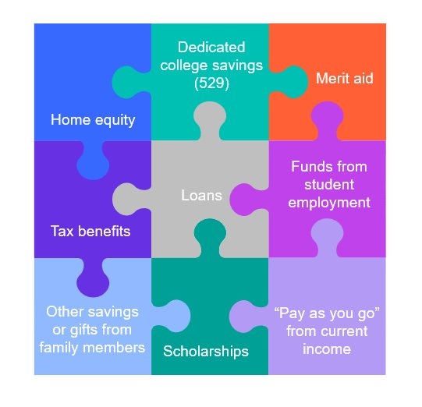
How the typical family pays for college
​Families reported spending an average of $28,409 in Academic Year 2023-24, in line with $28,026 in 2022-23 — and covered nearly half (48%) of expenses with family income and savings.​
81% of families say they eliminated a school from consideration based on cost.​
Nearly 6 in 10 families (59%) said they created a plan to pay for all years of college before the student enrolled​.
% of families using 529​
Ways to pay for college
For informational purposes only. Source: How America Saves for College, 2023.

Slide 5

Understanding the cost of college
Four years of tuition and fees (including room and board and necessary supplies)
$126,796
TODAY
$223,078
$215,862
18 YEARS
$379,776
Student borrowers pay an average of $1,898 in interest each year, and the average student borrower spends 20 years paying off their loans.
Public college (in-state)
Private college
This chart is for illustrative purposes only and does not reflect the performance of any Franklin Templeton fund.
Sources: educationdata.org, Franklin Templeton College Planning calculator.
Notes:
Here’s a look current costs (averages) for both public and private institutions as well as projected costs 18 years from now.

Slide 6

Current college planning trends
Student debt has exploded
Federal financial aid has decreased and is predominantly loans
$1.7T
Growth in student debt over last decade
Of total federal financial aid, loans comprise 69%
$833B
Federal financial aid (total) has decreased by 25% over last 10 years
Cost of college can exceed $60k annually
College education pays off for most
$60,420
Average private 4-year college = $60,420, public in state = $28,840
College grads earn more — on average $29k more per year than high school graduates
$28,840
Sources: finaid.org; College board, Trends in student aid, November 2023; College Board, Trends in College Pricing, November 2023, includes tuition, room & board, and fees; (College Board, Education Pays, February 2023).
Notes:
Before we get started, let’s look at the major trends within the higher education world. While the challenges are clear, college costs rising faster than overall inflation, student loan debt reaching critical levels, the reality is that college education still provides real, long-term value.

Slide 7
Average earnings in 2023 Based on level of education¹
2
1. Source: U.S. Census Bureau, Current Population Survey, 2023 Annual Social and Economic Supplement. 2. Bureau of Labor Statistics, May 2021 National Occupational Employment and Wage Estimates United States; Average of selected trade and vocational occupations (Plumbers, Roofers, Solar Installers, Electricians, Masons, Construction Equipment Operators, Painters, Iron Workers, Construction and Building Inspectors, Telecom Equipment Installers, Automotive Technicians, Power-Line Installers, Machinists, Flight Attendants, Truck Drivers, Locomotive Engineers and Operators, Computer Support Specialists, Database and Network Administrators, Software Developers, Art and Design Workers, Firefighters, Correctional Officers, Police Officers, Dental Hygienists, Dental Assistants.)
Notes:
Main Idea: A college degree can have a significant financial impact.
1. Source: U.S. Census Bureau, Current Population Survey, 2022 Annual Social and Economic Supplement.
2. Bureau of Labor Statistics, May 2021 National Occupational Employment and Wage Estimates United States; Average of selected trade and vocational occupations (Plumbers, Roofers, Solar Installers, Electricians, Masons, Construction Equipment Operators, Painters, Iron Workers, Construction and Building Inspectors, Telecom Equipment Installers, Automotive Technicians, Power-Line Installers, Machinists, Flight Attendants, Truck Drivers, Locomotive Engineers and Operators, Computer Support Specialists, Database and Network Administrators, Software Developers, Art and Design Workers, Firefighters, Correctional Officers, Police Officers, Dental Hygienists, Dental Assistants.)
529 FAID 07/18

Slide 8
Unemployment rates by education
5.6 No High School
4.3 High School
3.5 Some College
3.4 National Average
2.4 College Graduate
Unemployment figures are seasonally-adjusted and include individuals age 25 years and over, for the period 01/31/05–03/31/25.
Source: U.S. Department of Labor, Bureau of Labor Statistics, Current Population Survey. https://www.bls.gov/charts/employment-situation/unemployment-rates-for-persons-25-years-and-older-by-educational-attainment.htm
Notes:
Main Idea: A college degree can have a significant employment impact.
Unemployment rates are consistently higher than the National average for those without a college degree.¹
As of January 2024, the statistics show that:
Without a high school diploma, the unemployment rate is 6.0%
With a high school diploma, 4.3%
Some college education, 3.3%
National average 3.2%
However, college graduates see an unemployment rate of 2.1%, significantly lower than those without a degree.
Transition: Next, let’s look at how much college will cost.
Unemployment figures are seasonally-adjusted and include individuals age 25 years and over, for the period 09/30/2000 – 01/31/2024.
Source: U.S. Department of Labor, Bureau of Labor Statistics, Current Population Survey.
529 FAID 07/18

Slide 9
A Little Bit of History
Notes:
529 FAID 07/18

Slide 10
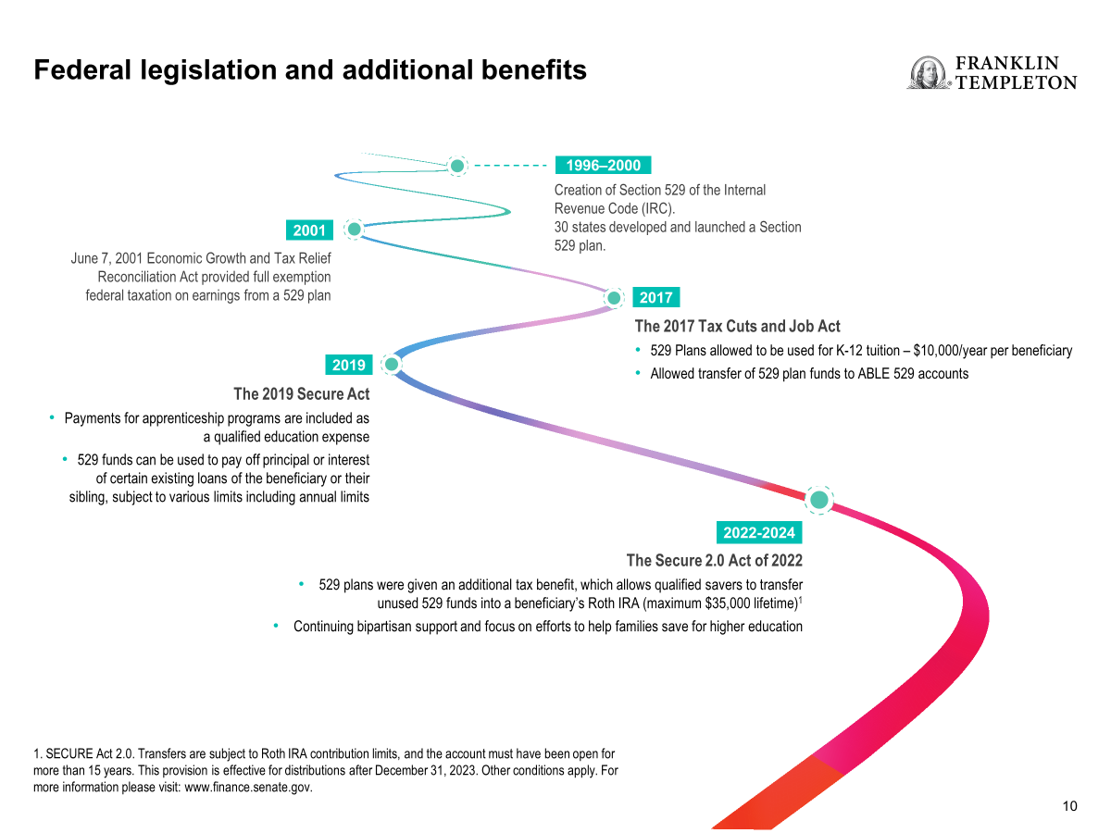
Notes:
Here’s a bit of history on 529 plans.
In 1997, Congress passed legislation that created qualified state tuition programs under Section 529 of the Internal Revenue Code. The intention was to provide tax incentives to families trying to meet the high cost of a college education.
In January 2018, two changes were put in place:
1) 529 savings plans may now be used for up to $10,000 per year for K-12 tuition expenses. This provides families with additional opportunities to save federal income tax-free for tuition expenses at private, public and religious K-12 schools, as well as for costs characterized as tuition that may be incurred in connection with attendance at a public K-12 school (it is not clear what public K-12 school costs, if any, will be regarded as tuition for this purpose.)
2) The federal tax law allows rollovers from a 529 savings plan account to an account in a 529A “ABLE” savings plan for the same beneficiary or a “member of the family” of the same beneficiary. The amount that may be rolled over cannot exceed, together with contributions from other sources to the applicable beneficiary's plan account, the annual limit on contributions to an ABLE account ($15,000 in 2018) without regard to the increased limit permitted for contributions by certain working beneficiaries.
In December 2019, the SECURE Act allowed for expanded uses of 529 plan account withdrawals.
1) 529 savings can now be used for certified apprenticeships.
2) In addition, up to $10,000 may be paid toward principal or interest of a student loan for the beneficiary or sibling. Please note that amounts paid as principal or interest on certain existing loans of the Beneficiary or sibling, subject to various limits including annual limits, can constitute qualified distributions. State tax benefits and treatment of loans may vary by state, may not have been updated for changes in federal tax law and may be uncertain; consult a tax professional concerning your state.
The Secure 2.0 Act of 2022
SECURE 2.0 introduces another option for families: beneficiaries of 529 plans that have been in place for 15 years or more may be able to move assets into a Roth IRA, giving the beneficiary an early start on saving for retirement. Eligibility rules apply to these Roth IRA rollovers:
• The 529 account must have been in existence for 15 or more years.
• The funds to be rolled over must have been in the 529 account for at least five years.
• The 529 plan beneficiary must have earned income (similar to the Roth IRA eligibility requirements) in the rollover year.
• The rollover amount in any given year can’t exceed the beneficiary’s IRA contribution limit, reduced by any IRA contributions previously made for the year.
• The total (lifetime) rollover amount is limited to $35,000.

Slide 11
Saving for Education

Slide 12

A Vehicle to Help You Save
529 College
Savings Plans

Slide 13

What is a 529 savings plan?
A state-sponsored tuition program designed to provide tax incentives to encourage families to save for the high cost of education – especially college.
“
Our daughter is only in preschool now but with the rising cost of a college education, it’s important for our family to invest in her future now.”
Notes:
Main Point: Define 529 plans for the audience.
529 FAID 07/18

Slide 14
Why use 529 College Savings programs?
529 savings plans are tax-advantaged accounts specifically designed to encourage saving for education expenses, while offering high contribution limits, flexibility and account owner control.
Tax advantages
Flexibility
Options
Withdrawals are federally and state tax free, when used for qualified
expenses¹
Gift and estate tax opportunities²
No income limits
No age or time restrictions
Ownership/beneficiary changes
Anyone can contribute
Covers a wide range of college expenses
K-12
Apprenticeship programs
Student loan payments
Transfer to Roth IRA
1. Tax benefits are conditioned on meeting certain requirements. State laws vary. Federal income tax, a 10% federal tax penalty, and state income tax and penalties may apply to nonqualified withdrawals of earnings. Consult a financial or tax professional before investing. Please refer to irs.gov for more complete information.
2. Consider consulting a tax professional to fully understand any potential tax consequences before taking action.
Notes:
Main Point: Why use a 529?
Qualified Withdrawals
Not subject to federal or state tax, provided school accepts U.S. Federal Student Aid.
Tax Treatment of Non-Qualified Withdrawals
Only the earnings portion of the withdrawal would be taxed
Ordinary income tax rate of the distributee
Plus a 10% federal penalty on the earnings
Reduce Exposure to Estate Tax
Contributions are considered Completed Gifts – not subject to estate tax or probate
Forward Gifting
Contribute 5x Annual Gift Tax Exclusion under special provision in Section 529
No Generation Skipping Tax (GST)
Contributions to grandchildren/great-grandchildren NOT subject to Generation Skipping Tax
Tax-Free Wealth Transfer
Transferring Ownership of a 529 Plan account is NOT a taxable event

Slide 15
Don’t Delay the Inevitable
Mary | $612/month for 8 years
Michael | $1,954/month for 3 years
John | $250/month for 15 years
What do you think Mary and Michael will have to contribute on a monthly basis to accumulate the same amount as John?
This is a hypothetical illustration to represent the effects of compounding assets monthly assuming an annual rate of return of 7%. It does not reflect an actual investment or any taxes payable upon withdrawal. A periodic investment does not assure a profit or protect against a loss in declining markets. Returns are not guaranteed and may be less than or greater than the amounts illustrated.
Notes:
Main Point: Can you afford not to invest now? Investing a smaller amount of money over a longer period of time may help you avoid needing to accumulate larger amounts over a condensed period of time.
[Story for Hypo]
In our hypothetical situation, John starts a education savings program with the expectation that he will need to begin withdrawing from the account in 15 years. His plan is to contribute $250/month.
Mary doesn’t think she can afford to start saving now. She decides to wait a few years and invest a greater amount on a regular basis to make up for lost time. Based on this strategy, Mary will have eight years before she begins withdrawing from the account.
Michael is in a similar situation. However, he decides to delay investing until his son is in high school, which means he’ll only have three years to invest.
In these examples, we’ve assumed a hypothetical growth rate of 7% for all accounts.
What do you think Mary and Michael will have to contribute on a monthly basis to accumulate the same amount as John, who started saving early?
This is a hypothetical illustration to represent the effects of compounding assets monthly assuming an annual rate of return of 7%. It does not reflect an actual investment or any taxes payable upon withdrawal. A periodic investment does not assure a profit or protect against a loss in declining markets. Returns are not guaranteed and may be less than or greater than the amounts illustrated.

Slide 16
The Cost of Procrastination
Would You Rather Invest $45,000 or $70,000?
Assumes an Annual Rate of Return of 7%
This is a hypothetical illustration to represent the effects of compounding assets monthly assuming an annual rate of return of 7%. It does not reflect an actual investment or investment expenses or any taxes payable upon withdrawal. A periodic investment does not assure a profit or protect against a loss in declining markets. Returns are not guaranteed and may be less than or greater than the amounts illustrated.
Notes:
Main Point: Can you afford NOT to invest now? Investing a smaller amount of money over a longer period of time can help you avoid needing to accumulate larger amounts over a condensed period of time. Start small if you have to, but start now.
If you don’t think you can afford $250 a month now, how are you going to afford $612 or $1,954 a month in the future?
If you begin a regular investment program now and take advantage of compounded earnings, you may end up paying less in the long run.
This bar chart allows us to take a closer look at our hypothetical illustration. The blue portion shows the cumulative amount each—John, Mary and Michael—have contributed over time. The second portion in green shows the earnings they accumulated, assuming the 7% annual growth rate. The difference is significant. Due to the effects of compounding, John almost doubles what he invests out of pocket, while Mary and Michael do not gain nearly the same compounding benefits. They all end up with almost $80,000.
Put time to good use and leverage the power of compounding by starting to save today. It can be to your advantage—invest now to avoid the possibility of paying much more later.
Transition: Here’s another way to look at why starting early is key to your success.
This is a hypothetical illustration to represent the effects of compounding assets monthly assuming an annual rate of return of 7%. It does not reflect an actual investment or investment expenses or any taxes payable upon withdrawal. A periodic investment does not assure a profit or protect against a loss in declining markets. Returns are not guaranteed and may be less than or greater than the amounts illustrated.

Slide 17
Two ways to pay for college Investing today vs. paying tomorrow
The Projected Cost of a Newborn’s Public College Education = $166,589¹ (beginning school year 2042-2043)
Total Payments
Investing Today
Invest $394 monthly for 18 years which grows to $166,589 at 7%.
a $158,789 difference
Paying Tomorrow
Pay $1,355 monthly on a $166,589 loan for 15 years at 5.50%.²
1. Source: The College Board, Trends in College Pricing, 2023. Projected cost based upon child’s entrance to college for four years at a public college. Figure is based upon the 2.72% 10-year average annual increase in public college costs, as reported by The College Board for the 2023-24 school year. Cost includes tuition, fees and room and board.
2. The borrowing example assumes a fixed interest rate of 5.50% based on a subsidized Stafford loan issued between 7/1/2023-7/1/2024. Examples are for illustrative purposes only, are not representative of any particular investment, and do not take taxes into account. Investments do not guarantee any specific rate of return, and you may have a gain or a loss on the amounts invested. Periodic investing plans do not assure a profit and do not protect against loss in a declining market.
Notes:
Main Idea: Investing vs. borrowing.
In 18 years, it could cost approximately $166,589¹ to send a newborn to a public college for four years. The parents could wait until their child is 18 years old and borrow the money, paying interest on it for 15 years. That would ultimately cost them about $243,893, assuming a 5.50% interest rate on their loan.
Alternatively, when the child is born, the parents could begin investing $394 monthly in a tax-advantaged investment plan earning a hypothetical 7% (before taxes). Over the course of 18 years, their cumulative investment would grow to cover the amount needed. In this example, the parents save almost $160,000 by investing now, rather than borrowing later!
Transition: Now let’s compare education savings options.
1. Source: The College Board, Trends in College Pricing, 2023. Projected cost based upon child’s entrance to college for four years at a public college. Figure is based upon the 2.72% 10-year average annual increase in public college costs, as reported by The College Board for the 2023-24 school year. Cost includes tuition, fees and room and board.
2. The borrowing example assumes a fixed interest rate of 5.50% based on a subsidized Stafford loan issued between 7/1/2023-7/1/2024. Examples are for illustrative purposes only, are not representative of any particular investment, and do not take taxes into account. Investments do not guarantee any specific rate of return, and you may have a gain or a loss on the amounts invested. Periodic investing plans do not assure a profit and do not protect against loss in a declining market.
529 FAID 07/18

Slide 18
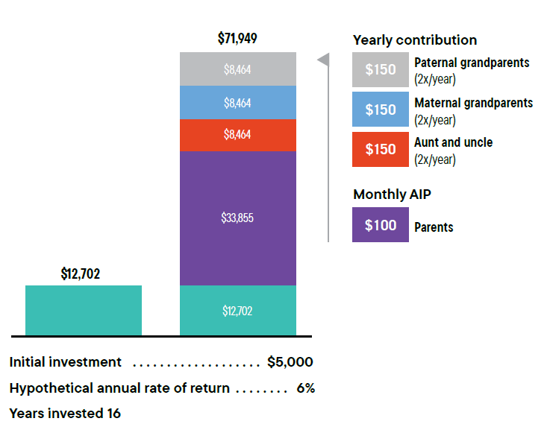
College savings–it takes a village
Example:
Parents set up a 529 plan for their three-year-old son with an initial contribution of $5,000. Assuming a 6% hypothetical annual rate of return, after 16 years they could expect to see the account grow to $12,702 before fees, expenses and taxes.
Now consider:
The same situation (including the assumed rate of return, before fees and expenses) but with the parents contributing $100 per month through an automatic contribution program.¹ The beneficiary’s two sets of grandparents and aunt and uncle contribute $150 each birthday and $150 each holiday season.
Saving for education may seem like an impossible task—
the good news is you don’t have to do it alone.
Examples are for illustrative purposes only and are not representative of any particular investment. 529 plan fees may vary. Expenses, sales loads, annual fees and deferred sales charges are not reflected in the illustration; if they were, results shown would be lower.
1. Periodic investment plans do not ensure a profit and do not protect against investment loss in declining markets. Since dollar-cost averaging involves continuous investment in securities regardless of
fluctuating price levels of such securities, an investor should consider his/her financial ability to continue purchasing through periods of low price levels.

Slide 19

Other Education Savings Vehicles
 | UGMA/UTMA
 | Roth IRA
Notes:
Main Point: Other types of savings vehicles for college include:
An Uniform Gift to Minors Act (UGMA) or Uniform Transfer to Minors Act (UTMA) and;
Coverdell Education Savings Account, which was formerly known as an Education IRA.
You may have already considered these options. While they offer some advantages similar to a 529 plan, none provides the same competitive combination of features offered by a 529 plan.
Let’s take a closer look and do a comparison.

Slide 20
Comparing different college saving options
 | 529 PLAN | CUSTODIAL ACCOUNT (UGMA/UTMA) | ROTH IRA
Control of assets | Owner of account, who may change beneficiary at any time | Beneficiary becomes owner at age of majority | Owner of account
Federal tax benefits | After-tax contributions grow and distribute tax free for qualified college expenses (or up to $10,000 per student, per year in K–12 tuition)¹ | After-tax contributions. First $1,350 in unearned income not taxed. The next $1,350 taxed at child’s tax bracket, and excess earnings are generally taxed at the parent’s marginal tax bracket | Contributions withdrawn without tax and penalty for any reason. Withdrawal of account earnings for higher education expenses not subject to an early withdrawal penalty⁴
Annual contributions | May front-load up to five years’ worth of gifts at one time ($95,000 for individuals/$190,000 for married couples) | $19,000 for individuals/ $38,000 for married couples | $7,000 ($8,000 for taxpayers age 50 and over). Must have taxable compensation, and the limit is phased out based on income
Federal financial aid treatment² | Parent asset (favorable) | Student asset (less favorable) | Not counted as asset
Allowed use of funds³ | Tuition, room and board, qualified apprenticeship programs, and other qualified expenses at any accredited college. Up to $10,000 annually per student for K–12 tuition | Funds must be used on behalf of the minor | Can be used for retirement, education, and up to $10,000 for first-time home purchase
1. Federal tax-free distributions (taken after December 31, 2017). Earnings may be subject to state income taxes in certain states.
2. Other types of financial aid calculations may differ from FAFSA.
3. Withdrawn earnings subject to federal tax and 10% penalty if not used for qualified expenses. A 529 plan can also be used to pay off student loans (up to $10,000 total).
4. Roth distributions are free from taxes and penalty if the account is held for 5 years and there has been a qualifying event such as the account owner turning age 59½.
Source: Internal Revenue service, 2025.
Notes:
Here’s a comparison of different ways to save for college education, 529 plans, custodial accounts, and Roth IRAs.

Slide 21
Tax treatment of 529 Plans
Notes:
Main Idea: Transition Slide.
Of course not all clients are dealing with short term issues. Those who have longer to plan for education will have different questions.
The long-term still shows necessity of saving for education
Education isn’t going away
Education costs aren’t going away

Slide 22
Tax Treatment of 529 Plans
Qualified Withdrawals
Not subject to federal or state tax, provided school accepts U.S. Federal Student Aid.
Tax Treatment of Non-Qualified Withdrawals
Only the earnings portion of the withdrawal would be taxed
Ordinary income tax rate of the distributee
Plus a 10% federal penalty on the earnings
Reduce Exposure to Estate Tax
Contributions are considered Completed Gifts – not subject to estate tax or probate
Forward Gifting
Contribute 5x Annual Gift Tax Exclusion under special provision in Section 529
No Generation Skipping Tax (GST)
Contributions to grandchildren/great-grandchildren NOT subject to Generation Skipping Tax
Tax-Free Wealth Transfer
Transferring Ownership of a 529 Plan account is NOT a taxable event¹
1. Consider consulting a tax professional to fully understand any potential tax consequences before considering such action.
Notes:
Note: Please remove the last bullet (Tax-Free Wealth Transfer) for Ameriprise.

Slide 23

Secure 2.0 creates new backdoor Roth opportunity¹
The Roth IRA must be established in the name of the 529 beneficiary
The 529 must be established for at least 15 years
Lifetime limit of $35,000 per beneficiary
Contributions made in the 529 plan during the last five years are not eligible to be transferred to a Roth IRA.
1. This provision is effective for distributions after December 31, 2023. Other conditions apply. For more information please visit: www.finance.senate.gov

Slide 24


Leverage these key estate planning benefits of 529s:
Reduce Taxable Estate
Once a Beneficiary is designated, and a contribution is made, the assets are removed from the client’s taxable estate, yet they don’t give up control
Gift Tax benefits
IRS provides Annual Gift Tax Exclusion
5-year “Accelerating Gifting”
Lifetime Gift & Estate Tax Exclusion
The lifetime exemption is an amount of property or cash that you can give over the course of your entire life without having to pay a gift tax.
The federal estate tax exclusion is an amount excluded from estate tax when a person dies.
Reduce Tax Liability of Trusts
Ability to help mitigate tax implications of a Trust, whose earnings typically are taxed at the highest bracket

Slide 25
Example 1:
Ultra High Net Worth (UHNW) Liquidity Event
Keep Unified Credit Intact
Peter and Melinda sold their business and were looking to remove assets from their estate.
Unified Credit, also known as the Lifetime Tax Exemption, is the gifted amount allowed in a taxpayer’s lifetime that will not be taxed. The 2025 lifetime estate tax exemption is $13.99 million (double for married couples).
Peter and Melinda are looking to keep their Unified Credit intact, and not dip into their lifetime exemption.
They open (20) 529 plan accounts for kids/spouses and grandchildren.
Fund each account with $190k, using the 5-year forward-gifting provision for a married couple.
Remove more than $3 million from their estate.
Through a special Section 529 provision, Owners may effectively use five years of their annual gift tax exclusion all at once: $95,000 for individual filers and $190,000 for joint filers.
In any year during which you 529 contributions for a particular beneficiary exceed the Annual Gift Tax Exclusion amount, you may make an election on Form 709 to spread the contributions ratably over five years (20% per year) for gift-tax purposes. This permits frontloading of up to $95,000 (in 2025) per beneficiary (or $190,000 for a married couple) into a 529 plan without generating a taxable gift, assuming no other gifts to that beneficiary are made during the five calendar-year period. If you make the five-year election and die before the fifth calendar year, the contributions allocated to the years after your death are included in your taxable estate.
Contributions in excess of the annual Gift Tax Exclusion ($19,000 for individuals; $38,000 for joint filers) – or the Section 529 5-year “Forward-Gifting” provision limits ($95,000 for individuals; $190,000 for joint filers) – would be deducted from the Giftor’s Lifetime Unified Credit.
Notes:
Through a special Section 529 provision, Owners may effectively use five years of their annual gift tax exclusion all at once:
$90,000 for individual filers
$180,000 for joint filers.*
*In any year during which you 529 contributions for a particular beneficiary exceed the Annual Gift Tax Exclusion amount, you may make an election on Form 709 to spread the contributions ratably over five years (20% per year) for gift-tax purposes. This permits frontloading of up to $90,000 (in 2024) per beneficiary (or $180,000 for a married couple) into a 529 plan without generating a taxable gift, assuming no other gifts to that beneficiary are made during the five calendar-year period. If you make the five-year election and die before the fifth calendar year, the contributions allocated to the years after your death are included in your taxable estate.
*Contributions in excess of the annual Gift Tax Exclusion ($18,000 for individuals; $36,000 for joint filers) – or the Section 529 5-year “Forward-Gifting” provision limits ($90,000 for individuals; $180,000 for joint filers) – would be deducted from the Giftor’s Lifetime Unified Credit.

Slide 26
Example 2:
High Net Worth (HNW) – Tap Into Unified Credit
Marge and Ed want to fully fund college for their ten teenage grandchildren.
Marge and Ed do want to make a larger contribution into their grandchildren's 529 accounts.
They contribute $300,000 each to 529 plan accounts for (10) grandchildren.
Their accountant makes a “Note to File” that their Unified Credit is to be reduced by $1.2 million for the portion of the contributions above the annual gift tax exclusion.
Marge and Ed – while they are still alive – get to see their grandchildren benefit from their gift.
Contributions in excess of the annual Gift Tax Exclusion ($19,000 for individuals; $38,000 for joint filers) – or the Section 529 5-year “Forward-Gifting” provision limits ($95,000 for individuals; $190,000 for joint filers) – would be deducted from the Giftor’s Lifetime Unified Credit.
Notes:
Through a special Section 529 provision, Owners may effectively use five years of their annual gift tax exclusion all at once:
$90,000 for individual filers
$180,000 for joint filers.*
*In any year during which you 529 contributions for a particular beneficiary exceed the Annual Gift Tax Exclusion amount, you may make an election on Form 709 to spread the contributions ratably over five years (20% per year) for gift-tax purposes. This permits frontloading of up to $90,000 (in 2024) per beneficiary (or $180,000 for a married couple) into a 529 plan without generating a taxable gift, assuming no other gifts to that beneficiary are made during the five calendar-year period. If you make the five-year election and die before the fifth calendar year, the contributions allocated to the years after your death are included in your taxable estate.
*Contributions in excess of the annual Gift Tax Exclusion ($18,000 for individuals; $36,000 for joint filers) – or the Section 529 5-year “Forward-Gifting” provision limits ($90,000 for individuals; $180,000 for joint filers) – would be deducted from the Giftor’s Lifetime Unified Credit.

Slide 27
Example 3:
Planning for Future Generations
Maria is looking for ways to remove assets from her estate and help her children’s children’s children attend college.
Maria’s financial professional explains the benefit of forward gifting to her 5 grandchildren, but is concerned because two of the five have already completed college, and her oldest granddaughter also recently graduated from law school.
She’s not sure how this will help them if they no longer have college costs to worry about.
Her financial professional explains that 529 plans are flexible:
Her granddaughter can let her gift grow allow her to help cover her own future children's college costs or transfer to a Roth IRA.
Her grandson has student loans remaining from college, so he can use $10,000 to pay back his loan without tax penalty and save the rest if he chooses to pursue a graduate degree or for his own children.
Notes:
Maria didn’t realize the flexibility that 529 plans offer. She agrees it’s a great way to remove some assets from her estate. In the end, she is able to gift $90,000 to each of her 5 grandchildren, thus removing $400,000 from her estate. And her legacy will live on for her future great-grandchildren, as she has helped relieve some of the burden of their college costs.

Slide 28
Benefits for grandparents
Substantial contributions can be made at any time
Reduce exposure to estate tax
Considered completed gifts – not subject to estate tax
No need to wait until the child is in college – or even born yet
Solution for Required Minimum Distributions
No expiration date
In some 529 Plans, there is no distribution requirement date, so accounts can grow tax-deferred for generations
Clients who don’t need their required minimum distributions may invest those assets in a 529 plan
Retain Control
Flexibility
Ensure assets are spent on education as distributions are controlled by the Account Owner, not the Beneficiary
Changes in beneficiaries and ownership can be made easily without tax consequence if child does not go to college or there are excess funds
Assign a Trust or child’s parent or custodian as the account “owner”
Can be used for various paths of education, and certain unused funds can be rolled over to Roth IRA and help kickstart grandchildren’s retirement
Federal Financial Aid
Objectives:
Grandparent owned 529s are not part of asset test or income test when determining federal financial aid eligibility
Optimize roll & carry | Utilize research best ideas | Downside protect

Slide 29
529 Education savings myths and facts

Slide 30


Common 529 education savings myths
MYTH
529s can only be used in the plan’s state.
FACT
You can use 529s for most higher education institutions in the United States, no matter where your 529 savings plan is based. You can even use it for international programs.

Slide 31

Common 529 education savings myths
MYTH
MYTH
Only parents can be an account owner and contribute to the 529 plans.
FACT
Parents, grandparents, aunts, uncles, friends…almost anyone can be an account owner with a valid U.S. Tax ID and a permanent address. You can even open a 529 plan for yourself. And anyone can contribute to a 529 plan!

Slide 32
Common 529 education savings myths
MYTH
Owning a 529 will impact the beneficiary’s access to financial aid.
FACT
The impact on financial aid is limited and will vary depending on who the Account Owner is.
Source How do 529 plans Affect Financial Aid? - Savingforcollege.com
Notes:
Do not share with Raymond James, Edward Jones, Ameriprise.
Assets in accounts owned by a parent are considered parental assets on the FAFSA, however a maximum of 5.64% of parental assets are counted in determining the Student Aid Index (SAI) compared to student assets, which are counted at 20%. ​
Qualified distributions from a student-owned or parent-owned 529 account to pay for this year’s college expenses are not included in the “base-year income” that would reduce college financial aid eligibility.​
Assets held in a 529 account owned by a grandparent, other relative or anyone else besides a dependent student or one of their parents will have no effect on the student’s FAFSA. ​
Qualified 529 plan distributions from accounts own by grandparents and anyone else are not reported as income on the FAFSA.​

Slide 33

Common 529 education savings myths
MYTH
I make too much money to contribute to a 529 plan.
FACT
It does not matter how much you earn. 529 plans have no income limits.

Slide 34

Common 529 education savings myths
MYTH
My child can take their money from their account when they turn 18.
FACT
You have control! The account owner controls the 529 plan’s assets and how they will be used. Unlike an UGMA/UTMA, the beneficiary has no legal rights to the plan’s assets, even when they turn 18.

Slide 35

Common 529 education savings myths
MYTH
529 plans can only be used for tuition
FACT
529 savings can be used for:
For accredited higher education schools (e.g. college or vocational schools), savings can also be used for mandatory fees, supplies, books, and room and board, if the beneficiary is enrolled at least half-time.
Tuition of $10,000 per year for K-12
Amounts paid as principal or interest on certain existing loans of the beneficiary or their sibling¹
Unused 529 funds can be transferred into a beneficiary's Roth IRA.²
1. Subject to various limits including annual limits, can constitute qualified distributions.
2. SECURE Act 2.0. Rollovers Transfers are subject to Roth IRA contribution limits, and the account must have been open for more than 15 years. This provision is effective for distributions after December
31, 2023. Other conditions apply. For more information please visit: www.finance.senate.gov.

Slide 36
Let’s Review
Higher Education Leads to Opportunities
Investing in an education is an expense that is worth it, given lifelong income advantages.
Put Time on Your Side
Start small if you have to, but start now.
529 Plans Provide a Wide Range of Benefits
The tax treatment, expanded flexibility and estate planning features of 529 plans provide many reasons to consider this method of saving for higher education.
Consider the Franklin Templeton 529 College Savings Plan
With tools and resources, along with special benefits for New Jersey residents, the Franklin Templeton plan offers options for each client’s unique goals.
Notes:
Main Point: Summarize seminar.
We’ve covered a lot of information today. I think it would be helpful to do a quick recap of the topics we’ve discussed.
You’re here today for information about how to finance an education. I hope what I’ve provided helps you believe that you can afford to finance a higher education that will empower a loved one.
Remember: Start small if you have to, but start now.
Although other investment vehicles are available, 529 plans may be the most advantageous way available today to pursue your education savings objectives.
Franklin Templeton 529 College Savings Plan provides the advantages of world-class investment management and proven financial services capabilities—all available to you in one plan.

Slide 37



Take Action Today
It’s as easy as 1, 2, 3
1. Educate yourself
2. Benefit from a financial professional
3. Start investing today in Franklin Templeton 529 College Savings Plan
Notes:
Main Point: Call to action.
Now it’s time to put what we’ve discussed into action.
By attending this seminar, you’ve already taken an important first step. You’ve learned about the importance of developing an education savings strategy early and how 529 plans can help you.
Next, leverage the benefit of a financial professional and identify an appropriate investment strategy for your personal situation.
Lastly, review the Franklin Templeton 529 College Savings Plan Investor Kit.
If you would like to discuss developing a 529 investment strategy, please speak to me after this presentation. We can set up a personal consultation and tailor a plan specifically for you.
Thank you for your time.
Any questions?

Slide 38

All investments involve risk including possible loss of principal. Diversification does not guarantee a profit or protect against a loss.
Investors should carefully consider the 529 plan’s investment goals, risks, charges and expenses before investing. To obtain the Program Description, which contains this and other information, talk to your financial professional or call Franklin Distributors, LLC, the manager and underwriter for the 529 plan at (800) DIAL BEN / 342-5236 or visit franklintempleton.com. You should read the Program Description carefully before investing and consider whether your, or the beneficiary’s, home state offers any state tax or other state benefits such as financial aid, scholarship funds, and protection from creditors that are only available for investments in its qualified tuition program. Franklin Templeton’s 529 College Savings Plan is offered and administered by the New Jersey Higher Education Student Assistance Authority (HESAA); managed and distributed by Franklin Distributors, LLC, an affiliate of Franklin Resources, Inc., which operates as Franklin Templeton. Investments in Franklin Templeton’s 529 College Savings Plan are not insured by the FDIC or any other government agency and are not deposits or other obligations of any depository institution. Investments are not guaranteed by the State of New Jersey, Franklin Templeton, or its affiliates and are subject to risks, including loss of principal amount invested. Investing in the plan does not guarantee admission to any particular primary, secondary school or college, or sufficient funds for primary, secondary school or college. Franklin Templeton, its affiliates, and its employees are not in the business of providing tax or legal advice to taxpayers. These materials and any tax-related statements are not intended or written to be used, and cannot be used or relied upon, by any such taxpayer for the purpose of avoiding tax penalties or complying with any applicable tax laws or regulations. Tax-related statements, if any, may have been written in connection with the “promotion or marketing” of the transaction(s) or matter(s) addressed by these materials, to the extent allowed by applicable law. Any such taxpayer should seek advice based on the taxpayer’s particular circumstances from an independent tax professional.
This material has been provided for informational purposes only and should not be construed as investment advice or a recommendation of any particular investment product, or strategy.
(800) 342-5236
franklintempleton.com
529-BEY-0325

