Slide 1
Direct indexing explained More control, potential tax savings and portfolios tailored to you
Notes:
Direct indexing is one of the fastest growing ways to invest today.
We’re going to show how it can help you simplify your portfolio, tailor your investments to what matters to you, and potentially reduce the taxes you owe over time.

Slide 2


What’s important to you this year?
Growing your investments
Reducing taxes
Managing risk through diversification
Customizing your portfolio to your values
Source: Cerulli Associates, 2025. Objectives sorted by the percentage of advisors with an affluent core market who are “very focused” on the objective.
Notes:
Before we get into direct indexing, let’s take a quick look at what investors like you say they’re focused on right now.
Think about what matters most to you over the next year: growing your investments, reducing taxes, managing risk, or aligning your portfolio with your values.

Slide 3
As your wealth grows, tax planning becomes important
Advisors’ Focus on Achieving Portfolio Objectives Over the Next 12 Months
All Advisors
Advisors with a Core Client Market of $2m+
*e.g., uncorrelated asset classes.
Source: Cerulli Associates, 2025. Objectives sorted by the percentage of advisors with an affluent core market who are “very focused” on the objective.
Notes:
This chart shows how financial advisors are thinking about helping clients meet their goals.
[CLICK] The biggest differences is around the two items in the orange box – tax optimization and greater alpha, which become more important as wealth grows.

Slide 4
What investors like you care about
Most investors tell us they want three things:
Simplicity—less complexity, fewer accounts
A clear plan—know what you own and why
Tax awareness—keep more of your returns after taxes
Affluent Investor Preferences by Financial Assets
Household Financial Assets
It is important to me that my advisor… | $500k–$1m | $1m–$2m | $2m–$5m | $5m+
Makes my finances less complicated | 75% | 75% | 70% | 75%
Develops a financial plan | 82% | 86% | 81% | 82%
Helps reduce my taxes | 67% | 72% | 73% | 79%
Source: Cerulli Affluent Investor Tracker (CAIT), 2024.
Notes:
Most investors tell us they want three things: (1) Simplicity — fewer accounts, less complexity (2) A clear plan — feeling confident in what you own (3) Tax awareness — keeping more of what you earn
And as wealth increases, reducing taxes becomes even more important.

Slide 5
Money follows the clients in motion
Why investors changed relationships
What investors are looking for
Inability to support changing financial circumstances
Tax planning
28%
47%
Desire for different products and services
Trust and estate planning
27%
46%
Seeking improved digital capabilities
Health/elder care
22%
35%
Source: PwC HNW Investor Survey 2022.
Notes:
As people approach retirement, many consolidate to a single financial partner.
The top reasons include needing support as life changes, wanting more tailored services, and wanting solutions that make things easier — including tax planning and estate considerations.

Slide 6
Growth in separately managed account (SMA) assets
SMA Assets ($B)
14%
CAGR¹ projected
2024–2029
Sources: FUSE, MMI, Cerulli. 1. The compound annual growth rate (CAGR) is the annual rate of return that shows how an investment grows from its beginning value to its ending value over time, assuming reinvested profits.
Notes:
Separately managed accounts (SMAs) have grown significantly in recent years, and direct indexing is a major driver of that growth.
SMAs allow you to own individual stocks directly — and direct indexing uses that structure to personalize your portfolio and look for opportunities to improve tax efficiency.

Slide 7



What is direct indexing?
A direct index is a SMA that leverages automated tax-loss harvesting to improve clients’ after-tax returns while customizing to their unique needs and preferences.
Providing
Tax management & personalization
SMA
But with
Automation
Notes:
A direct index is a separately managed account (SMA) [CLICK] that leverages [CLICK] automated tax loss harvesting to improve clients’ after-tax returns while [CLICK] customizing to their unique needs and preferences
Uses technology to look for opportunities to reduce taxes and tailor your investments to your needs and preferences.
You still track the broader market, but with added flexibility you can’t get in a fund.

Slide 8
Turning market ups and downs into opportunity
Percent of Positive and Negative Constituent Returns in the S&P 500 Index
1990–2024
35%
of stocks
are down in
a given year
1
Potential Loss-Harvesting Opportunities
We help you turn market dips into potential tax savings.
1. S&P Global. Past performance is no guarantee of future results.
Notes:
Markets move up and down — that’s normal.
But owning individual stocks allows direct indexing to look for chances to turn temporary drops into potential tax savings, which may help improve your after‑tax returns over time.

Slide 9


Unbundling to unlock opportunities
Index Fund/Packaged Product
Custom/Direct Index (SMA)
Stock D
Stock D
Stock B
Stock A
Stock D
Stock B
Stock A
Stock G
Stock M
Stock G
Stock M
Stock C
Stock J
Stock R
Stock C
Stock R
Stock S
Stock F
Stock S
Stock F
Notes:
Mutual funds and ETFs are easy and convenient, but they pool all investors together.
With direct indexing, you directly own individual stocks. That ownership gives you more flexibility to personalize your portfolio and potentially benefit from tax‑loss harvesting.
Owning the individual securities allows you to potentially take advantage of tax losses to offset gains.
So how does that structurally work? Let’s say it’s an S&P 500 product – you are not necessarily owning 500 stocks but rather anywhere from 280 to 300 individual securities across that year.
You can create an efficient tracking error to the S&P 500 with a basket of about 300 stocks and give yourself the flexibility for tax loss harvesting when any of those stocks are down throughout the year (since as we said earlier, about 35% across the board are down at some point in any given year) to potentially enhance the overall return profile.

Slide 10
Tax-loss harvesting
Harvest losses
Replace
Create tax asset
($5k)
($5k)
Replace with similar securities to maintain fidelity of investment.
Create $5k asset that can be used to offset current or future capital gains.
Sell shares trading at a loss.
For illustrative purposes only. Not to be used to make investment decisions.
Notes:
Let’s say one stock in your portfolio has dropped in value.
This very simple SMA is a basket that holds 4 different individual securities.
One of them is down $5,000. You take that $5000 loss, selling out of that position and realizing that loss. [CLICK] You then replace it with another similar security, and you have now offset gains in the portfolio while still keeping the fidelity of the overall portfolio.
Direct indexing can sell that stock, record the loss for tax purposes, and replace it with a similar investment — keeping your overall strategy on track while creating potential tax benefits.

Slide 11





Where direct indexing can help you with
Cash sitting idle
Concentrated stock
Legacy funds with gains
Personal preferences
Preparing for a future gain
Notes:
Direct indexing can support a variety of situations, including:
Cash on the sidelines: It's the #1 funded vehicle that we see here at Franklin Templeton where investors are taking cash off the sidelines to use direct indexing for nonqualified dollars as a core vehicle
Managing concentrated stock positions: Often, the tax tail wags the investment dog. This means the embedded gains in a particular stock position may be so significant that it inhibits the investor from diversifying that position into a more diversified portfolio. Intaking low basis concentrated stock allows you to work out of that position in a tax efficient manner.
Transitioning out of older investments with large gains: The same can be said for mutual funds and ETFs. For example, a legacy mutual fund that was invested 20 years ago at $70,000 may be worth $150,000. Today, that $80,000 of gain may be inhibiting that investor from repositioning those assets.
Aligning your portfolio with personal preferences or values: Let’s say you work in the energy sector and want to hold the S&P 500 but would like to limit additional exposure to the company or the sector you work for.
Preparing for a future taxable event: Some clients may benefit from investing cash today, putting it to work and banking losses in anticipation of a future gain, perhaps a sale of a business or real estate.

Slide 12
Understanding tax loss
Tax-loss harvesting opportunities can vary widely across different market conditions and over the life of an account.
Volatile markets, new contributions, and reinvested dividends all provide the potential to extend harvesting over time.
Notes:
Market ups and downs, new deposits, and reinvested dividends can all create opportunities for tax‑loss harvesting over time.

Slide 13



Two practical paths for legacy investments
How to reduce embedded gains while improving portfolio efficiency
$70k cost basis → $150k value | $80k unrealized gain
CLIENT
Purchased $70,000 mutual fund with embedded gains now worth $150,000.
Option A: Partial sale now
Option B: Sidecar approach
Sell 20% of position
Realize taxable gains
Reinvest into direct index TLH
Immediate tax cost
$20,000 sidecar allocation
Maintain legacy position
Offset gains over time
Tax-aware transition
For illustrative purposes only. Not to be used to make investment decisions.
Notes:
If you have older investments with significant gains, there are ways to transition gradually and potentially reduce your tax burden.
This slide illustrates two common approaches — selling a portion now or taking a more gradual “sidecar” approach.

Slide 14
Gradual, tax-aware diversification
Gradual, tax-aware diversification
ABC Stock
Fund complementary direct index with cash
Systematically harvest losses
ABC Stock
Reinvest cash to further diversify the portfolio while trimming ABC Stock
Use losses to offset realized gains on ABC Stock
For illustrative purposes only. Not to be used to make investment decisions.
Notes:
If you hold a large position in a single stock, direct indexing can help you diversify gradually.
By harvesting losses in the new index portfolio, you can offset gains as you reduce the concentrated position — making the transition more tax‑efficient.

Slide 15

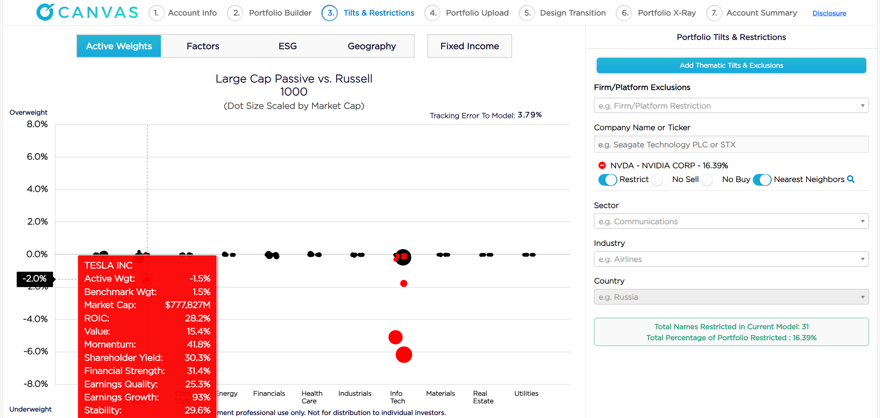


Your portfolio, your way
Limit exposure to individual stocks
Restrict nearest neighbors
Value-based screening
Remove sectors
Notes:
With direct indexing, you can tailor your portfolio to your personal needs — such as limiting exposure to certain stocks, adjusting sector exposure, or applying values‑based filters that align with what matters to you.
What you're looking at here is a screenshot from Franklin Templeton's Canvas direct indexing platform. This is an investor that holds NVIDIA and they're deciding to restrict additional exposure to NVIDIA. Why? Because they may have a concentrated position and they don't want to add to it.
In addition, what you'll see with this particular platform is we can restrict the nearest neighbor, which means it will restrict companies that participate in the same industry and/or behave like NVIDIA.
And importantly for those that are interested, there is a wide variety of values-based screening available.

Slide 16

Planning ahead for big financial events Expecting a large gain (business, real estate, liquidity event)?
Capital gain
Capital losses
Net capital gains
Tax rate
Pending sale of business
Expected capital gain: $10mm
Tax agnostic
$3,180,000
tax owed
$10mm
$0
$10mm
31.8%
With preemptive planning
$3,021,000
tax owed
$10mm
$500k
$9.5mm
31.8%
$159,000
tax savings
For illustrative purposes only. Not to be used to make investment decisions.
Notes:
If you expect a major taxable event in the future — like selling a business or property — direct indexing can help you plan ahead.
By building up tax losses over time, you may be able to reduce what you owe when the event occurs.
Here we look at a pending sale of a business where the expected gain is $10 million. At a tax rate of almost 32% they're going to owe almost $3.2 million.
If that were to occur several years out, you could preemptively invest dollars using direct indexing, and harvest and bank those losses for future use. So in this case, there were capital losses created of $500,000 in a direct indexing program, establishing $159,000 in tax savings that they could carry forward to offset future gains.

Slide 17





Important considerations
Harvesting frequency
Funding flexibility
Advisor/client experience
Pricing
Partnership
Notes:
Not all direct indexing platforms are the same. Things to keep in mind include:
Harvesting frequency: At Franklin Templeton, we offer a platform that offers daily tax loss harvesting because the market can swing back and forth in compressed periods of time and this gives you the maximum opportunity and flexibility to harvest tax losses to offset gains.
Funding flexibility: Some providers simply intake cash and stock. There are a smaller subset that will only intake mutual funds and ETFs. At Franklin Templeton, we can take all four.
Advisor/client experience: On-demand scenario modeling for your clients means that you can run a transition in minutes for your clients before the meeting and then make real-time updates when they inevitably want to see tweaks. This allows you to nimbly remodel their portfolio in a few keystrokes to continue having an intelligent conversation as opposed to emailing back and forth later. And of course, we also offer live support if you need assistance.
Pricing: Simply put, we are one of the most effective and efficiently priced in the industry.
Partnership: What type of field support, home office support, and specialist support do they have? We are incredibly excited to help you grow your practice and solve for an expanded set of client needs and we have the specialists and expertise you need to make it seamless.

Slide 18
Why we check for opportunities everyday
January–June 2025:
49% of S&P 500 stocks were down through end of May
Harvesting frequency per account:
66%—3x
45%—4x
20%—6x or more
Tax Loss Harvesting 2025 Franklin Templeton S&P 500 – Canvas Tax Managed
Jan
Feb
Mar
Apr
May
Jun
Data as of June 30, 2025, unless otherwise noted.
Past performance is no guarantee of future results. Tax loss harvesting may be influenced by factors including, but not limited to, asset allocation, method of funding, manager skill in portfolio construction and implementation, market appreciation, cash flows, and tax parameters. The Franklin Templeton S&P 500 – Canvas Tax Managed ‘composite’ includes all taxable portfolios that are fully invested in the strategy and are cash funded and managed to a 1% tracking error.
Notes:
Markets can shift quickly — and daily tax‑loss harvesting may capture more opportunities than quarterly or monthly approaches.
Let’s revisit why Franklin Templeton's platform is built on daily tax loss harvesting by taking a look at the Canvas experience in action.
Had you invested in the S&P 500 during the six-month time frame of January through June 2025, almost 50% of S&P stocks were down through the end of May.
66% of Canvas accounts had three trades in that period, 45% had four trades, and 20% had six or more.
But what's interesting is when the opportunity presented itself. January and February were a bit light, then a bit more opportunity for loss harvesting in March, and then April, May and June was when the volatility really increased.
Imagine if you were in a quarterly program where your period for lock-in occurred in March – you would have cycled in March, you would have missed April and May and you would have been back in it for June for another tax loss harvesting.
Our clients harvested more losses in April 2025 alone than in the first 10 months of 2024 – this is when daily tax harvesting capabilities goes to work for your clients.

Slide 19
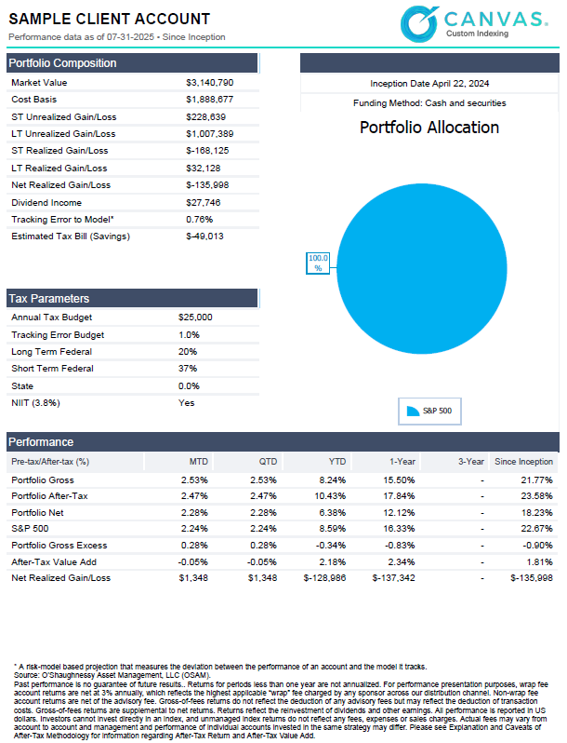
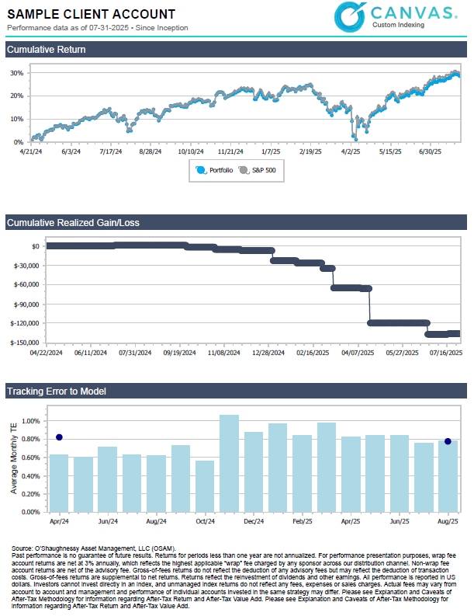
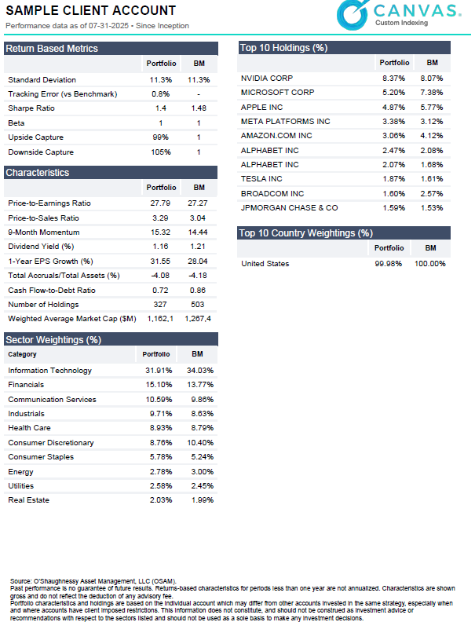
Your client report highlights
Estimated tax savings and banked losses
Holdings view
Personalization summary (your tilts, exclusions, guardrails)
Progress toward your target portfolio
Notes:
Your report shows: • Estimated tax savings • What you own • Your personalized settings (like exclusions or preferences) • Your progress toward your target portfolio

Slide 20
Ready to see your options?
Share your current investment statements with us
Tell us what matters most to you (growth, taxes, risk, values)
Receive a personalized transition plan—clear, actionable and tailored to your goals
Discover how direct indexing can help you achieve your financial goals. Let’s get started—contact us today!
Notes:
Share your current investment information, tell us what matters most to you, and we’ll create a personalized transition plan tailored to your goals.

Slide 21
Important legal, Canvas®, hypothetical and/or back-tested disclosure information (as of March 2025)
Canvas® is an interactive web-based investment tool developed by O’Shaughnessy Asset Management, L.L.C. (“OSAM”) that permits an investment professional to select a desired investment strategy for the professional’s client. At all times, the investment professional, and not OSAM, is responsible for determining the initial and ongoing suitability of any investment strategy for the investment professional’s underlying client. The professional’s client shall not rely on OSAM for any such initial or subsequent review or determination. Rather, to the contrary, at all times the professional shall remain exclusively responsible for same. See MORE ABOUT CANVAS below and Release and Hold Harmless at the end of this Important Disclosure Information.
Reliance on investment professional: OSAM has relied, and shall continue to rely, on the investment professional’s knowledge and experience to understand the inherent limitations of the performance presentation, including those pertaining to back-tested hypothetical performance. All performance presentations, including hypothetical performance, are the direct result of the investment professional’s request, independent of OSAM. Depending upon the investment professional’s direction and selection, hypothetical presentations can include both OSAM and non-OSAM Models and/or strategies. The below discussion as to the material limitations of back-tested hypotheticals apply to both OSAM and non-OSAM Models and/or strategies.
Intended recipient: Canvas content is generally intended for the delivery to an investment professional only and not to be shared with an underlying client. It is subject to the investment professional’s compliance for delivery to an individual investor, if and where applicable. No hypothetical performance-related content should be provided directly to the professional’s client without the accompanying consultation and explanation of the professional. The content is intended to assist the professional in evaluating the appropriate investment strategy for the professional’s client.
Past performance may not be indicative of future results. Therefore, it should not be assumed that future performance of any specific investment or investment strategy (including the Models), will be profitable, equal any historical index or blended index performance level(s), or prove successful. Historical index results do not reflect the deduction of transaction and custodial charges, or the deduction of an investment management fee, the incurrence of which would have the effect of decreasing indicated historical performance results. The Russell 3000 is a market capitalization-weighted index of 3000 widely held large, mid, and small cap stocks. Russell chooses the member companies for the Russell 3000 based on market size and liquidity. The MSCI All Country World Index is a market capitalization weighted index designed to provide a broad measure of equity-market performance throughout the world. The MSCI is maintained by Morgan Stanley Capital International and is comprised of stocks from 23 developed countries and 24 emerging markets. The Barclays Capital Aggregate Bond Index is a market capitalization-weighted index, meaning the securities in the index are weighted according to the market size of each bond type. Most U.S. traded investment grade bonds are represented. Municipal bonds and treasury inflation-protected securities are excluded, due to tax treatment issues. The index includes treasury securities, government agency bonds, mortgage-backed bonds, corporate bonds, and a small amount of foreign bonds traded in US. The historical performance results for the Russell 3000, MSCI and Barclays are provided exclusively for comparison purposes only, to provide general comparative information to help assist in determining whether a Model or other type strategy (relative to the reflected indices) is appropriate for his/her investment objective and risk tolerance. Please note: (1) Performance does not reflect the impact of client-incurred taxes; (2) Neither Model or the selected strategy holdings correspond directly to any such comparative index; and (3) comparative indices may be more or less volatile than the Model or selected strategy.
MORE ABOUT CANVAS®
Canvas is an interactive web-based investment tool developed by O’Shaughnessy Asset Management, L.L.C. (“OSAM”) that permits an investment professional to select a desired investment strategy (the “Strategy”) for the professional’s client. At all times, the investment professional, and not OSAM, is responsible maintaining the initial and ongoing relationship with the underlying client and rendering individualized investment advice to the client. In addition, the investment professional and not OSAM, is exclusively responsible for:
determining the initial and ongoing suitability of the Strategy for the client;
devising or determining the specific initial and ongoing desired Strategy;
monitoring performance of the Strategy; and,
modifying and/or terminating the management of the client’s account using the Strategy

Slide 22
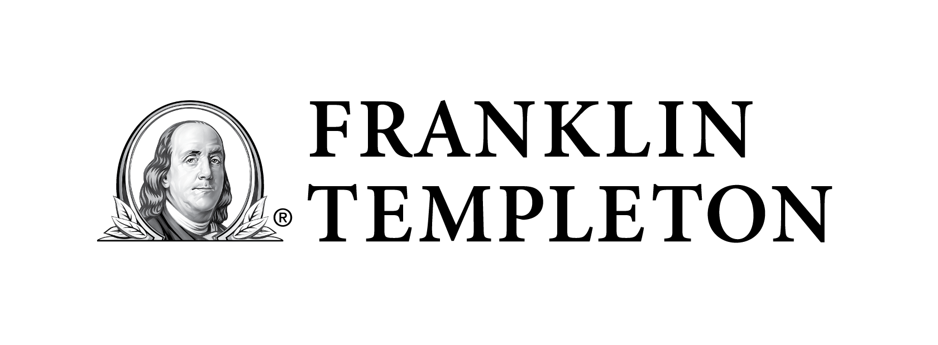
IMPORTANT INFORMATION
Investors cannot invest directly in an index, and unmanaged index returns do not reflect any fees, expenses or sales charges.
Franklin Templeton, its affiliates, and its employees are not in the business of providing tax or legal advice to taxpayers. These materials and any tax-related statements are not intended or written to be used, and cannot be used or relied upon, by any such taxpayer for the purpose of avoiding tax penalties or complying with any applicable tax laws or regulations. Tax related statements, if any, may have been written in connection with the “promotion or marketing” of the transaction(s) or matter(s) addressed by these materials, to the extent allowed by applicable law. Any such taxpayer should seek advice based on the taxpayer’s particular circumstances from an independent tax advisor.
Any information, statement or opinion set forth herein is general in nature, is not directed to or based on the financial situation or needs of any particular investor, and does not constitute, and should not be construed as, investment advice, forecast of future events, a guarantee of future results, or a recommendation with respect to any particular security or investment strategy or type of retirement account.
Investors seeking financial advice regarding the appropriateness of investing in any securities or investment strategies should consult their financial professional.
Separately Managed Accounts (SMAs) are investment services provided by O’Shaughnessy Asset Management, LLC (OSAM), a federally registered investment adviser. Client portfolios are managed based on investment instructions or advice provided by OSAM. Management is implemented by OSAM, or, in the case of certain programs, the program sponsor or its designee.
These materials are being provided for illustrative and informational purposes only. The information contained herein is obtained from multiple sources that are believed to be reliable. However, such information has not been verified, and may be different from the information included in documents and materials created by the sponsor firm in whose investment program a client participates. Some sponsor firms may require that these materials be preceded or accompanied by investment profiles or other documents or materials prepared by such sponsor firms, which will be provided upon a client’s request. For additional information, documents and/or materials, please contact Franklin Templeton.
At Franklin Templeton, everything we do has a single focus: to deliver better client outcomes. We have deep expertise across equity, fixed income, alternatives, multi-asset solutions and cash strategies. We offer an unmatched range of specialist investment managers, consisting of more than 1,600 investment professionals. Over 75 years of experience in identifying opportunities and delivering investment solutions to clients.
(800) 342-5236
franklintempleton.com
© 2026 Franklin Templeton. All rights reserved. O’Shaughnessy Asset Management, LLC is a Franklin Templeton affiliated company.
CNVS-DIP

