Slide 1






March 31, 2026
At Franklin Templeton, we believe that success requires more than just expertise—it demands
powerful partnerships. As a forward-thinking asset manager, we build dynamic relationships with
our clients, understand their goals, and navigate the complexities of the market together. Our team leverages cutting-edge strategies and deep industry insights to unlock opportunities to help grow wealth.
With Franklin Templeton by their side, investors don’t prepare for the future—they shape it.
We empower you and
your firm to solve business challenges together, backed
by our C-suite leadership
and supported by a network
of specialists covering all aspects of your business.
We offer a comprehensive range of investment capabilities across public
and private markets,
all managed by dedicated specialists.
Strategic
partners
Investment
specialists
Client
goals
We tap into the expertise
of investment professionals around the world to deliver deep insights to help
our partners anticipate opportunities and
navigate change.
Thought leaders
Innovation
drivers
Our clients have access to
a wide range of proprietary tools, cutting-edge technologies and expert teams to navigate shifting landscapes with confidence.
Extensive investment capabilities with $1.68tn in AUM¹
Equity $670bn | Fixed Income $434bn | Alternative $283bn | Multi-Asset $207bn
Emerging/Frontier Global Convertibles Sector Single Country Thematic US | Bank Loans Corporate Credit Global & E.M. Credit Currencies Government Multi-Sector Municipals Securitised Sustainable Bonds Short Duration Stable Value | Alternative Credit Private Credit Digital Assets Hedged Strategies Private Equity Real Estate Secondaries Venture Capital | Balanced Income Model Portfolios Target Date Target Risk Target Volatility
Complemented by innovations in: Sustainable and Impact Investing, ETFs, Frontier Risk Alternatives, Custom Indexing and many others.
      1.AUM is in USD as of March 31, 2026.
Not FDIC Insured | No Bank Guarantee | May Lose Value

Slide 2
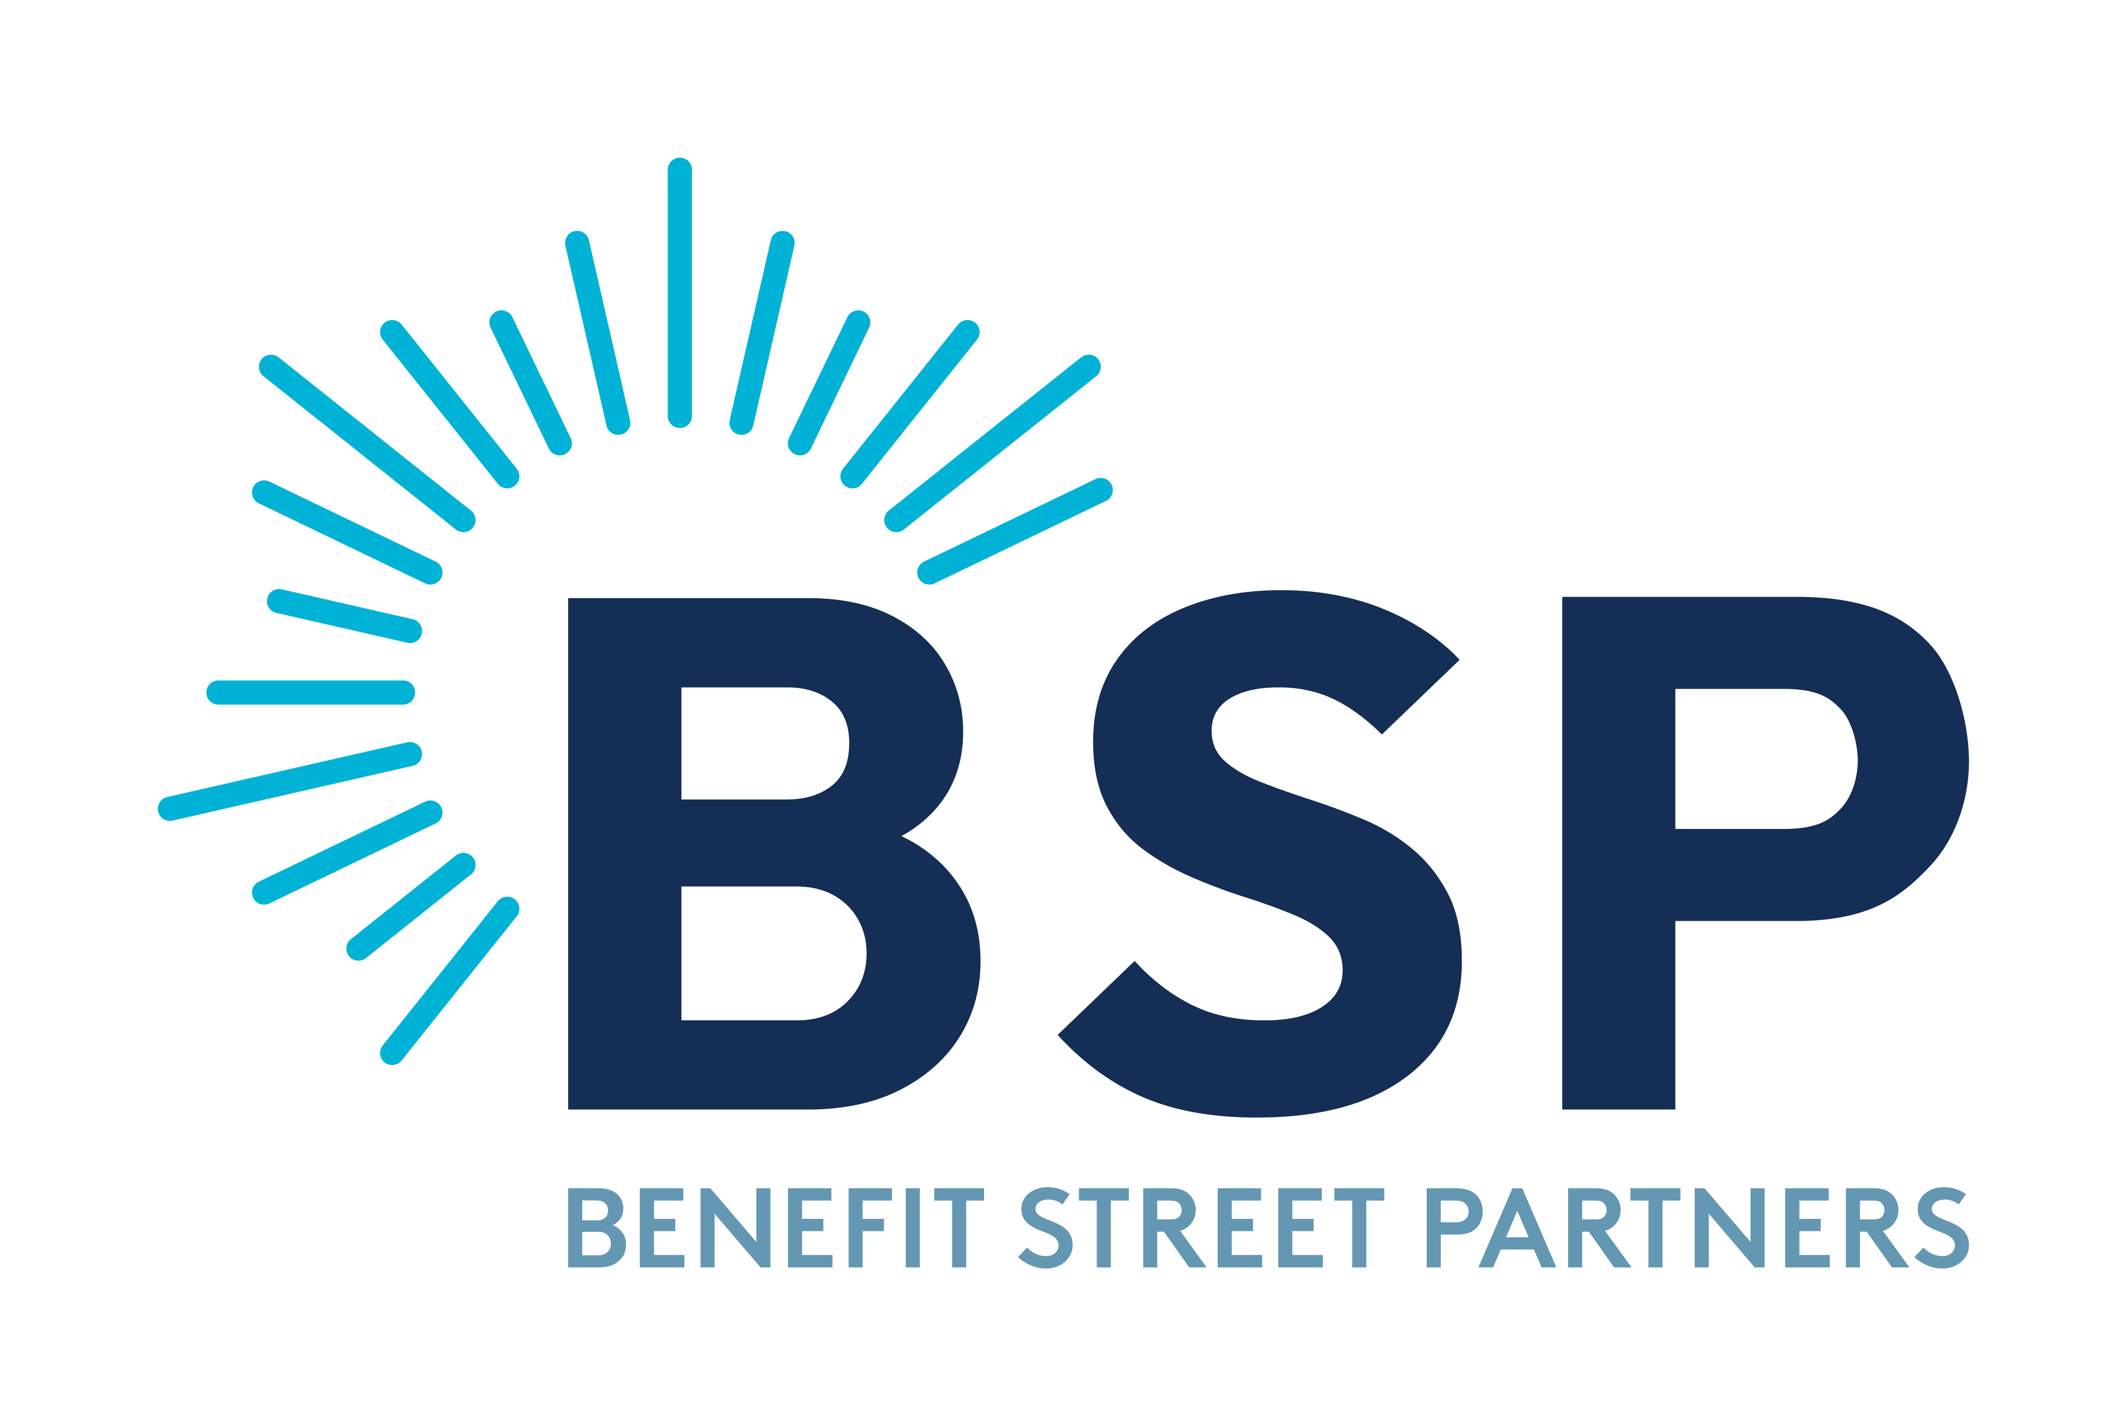

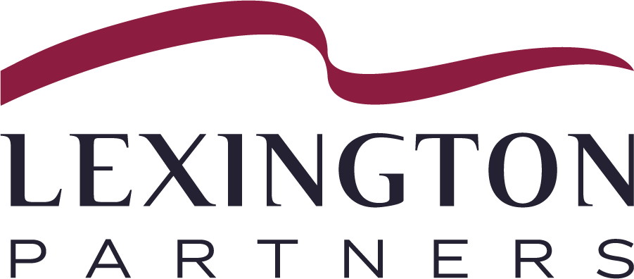

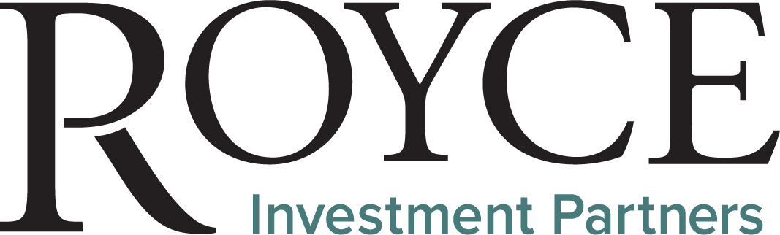


Meet the Franklin Templeton companies
We’ve broadened our capabilities through a long track record of successful, strategic acquisitions, adding multiple investment managers to our platform in the last five years alone. We preserve the investment autonomy of each investment manager and underpin each team with large-scale expertise in distribution, marketing, data science, operations, and risk management practices.
Global alternative credit specialist offering strategies spanning private and public markets.
Investing in private real estate across the risk/return spectrum.
Active equity strategies across global developed, emerging and local markets.
Offers secondary private equity and co-investments.
Equity manager pursuing stock-driven alpha across styles.
Pioneering small-cap investing
since 1972.​
Provides actively managed global fixed-income solutions.
IMPORTANT LEGAL INFORMATION
This material is intended to be of general interest only and should not be construed as individual investment advice or a recommendation or solicitation to buy, sell or hold any security or to adopt any investment strategy. It does not constitute legal or tax advice.
Issued in the U.S.: Franklin Resources, Inc. and its subsidiaries offer investment management services through multiple investment advisers registered with the SEC. Franklin Distributors, LLC and Putnam Retail Management LP, members FINRA/SIPC, are Franklin Templeton broker/dealers, which provide registered representative services. Franklin Templeton, One Franklin Parkway, San Mateo, California 94403-1906, (800) DIAL BEN/342-5236, franklintempleton.com.
ClearBridge Investments, LLC, Royce Investment Partners, Western Asset Management Company, LLC and Lexington Partners are Franklin Templeton affiliated companies.
All data as of March 31, 2026, unless otherwise noted.
FTLM-FCST
Copyright © 2026. All Rights Reserved.

