Slide 1


The home stretch
Seven things you need to do in the decade before you retire
Notes:
Have you ever been in, or watched a foot race? As the runners turn the last corner and start their final sprint, the intensity ratchets up. This part of the race is known as the home stretch. During this critical stage, the last thing a runner wants to do is stumble with the finish line in sight.
As you get to the point in your career where you can start to see the retirement finish line, you want to make sure you don’t stumble either. Today we’re going to look at seven things you need to do in the decade (or so) before you retire.
My hope is that by identifying potential hurdles as well as strategies for success, you will feel better prepared as you sprint through your home stretch towards retirement.

Slide 2
Seven things you need to do in the decade before you retire
Determine when the time is right
Take aim at your retirement target
Maximize your nest egg
Get a portfolio checkup
Create a social security strategy
Build a retirement income stream
Look beyond the money
Notes:
Here are the seven things we’ll discuss today to help you prepare:
Determine When the Time is Right
Take Aim at Your Retirement Target
Maximize Your Nest Egg
Get a Portfolio Checkup
Create a Social Security Strategy
Build a Retirement Income Stream
Look Beyond the Money
Let’s get started with number one.

Slide 3
1. Determine when the time is right
Notes:
One of the first things you’ll need to do when preparing for retirement is to determine when the time is right.
To do that, let’s look at a little bit of the history of retirement.

Slide 4
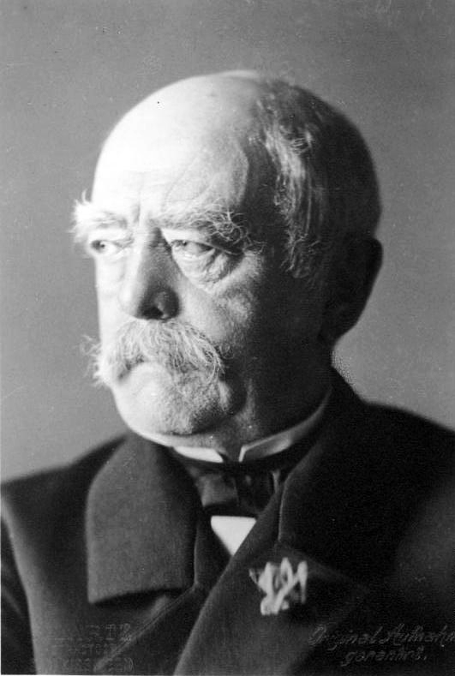
The godfather of retirement
1890
2026
AGE
90
80
70
60
50
40
30
20
10
0
LIFE EXPECTANCY
LIFE EXPECTANCY
RETIREMENT AGE
LIFE EXPECTANCY
RETIREMENT AGE
LIFE EXPECTANCY
OTTO VON BISMARCK
Sources: US Census Bureau: US Life Tables 1890,1901, 1910, and 1901-1910. Life expectancy for 1890 based on state of Massachusetts life tables. United Nations, Department of Economic and Social Affairs, Population Division. World Population Prospects: The 2024 Revision.
Notes:
Otto von Bismarck was chancellor of Germany in the late 1800s and is often credited with creating the concept of retirement. To help combat pressure from socialist opponents during a period of high unemployment, Otto implemented what was called the Old Age and Disability Insurance Law. This law provided a state pension for anyone who reached the age 70.
[CLICK] But not that many people actually took advantage of the program. Why?
[CLICK] Because at that time, the average life expectancy was only 43.5 years.
Here in the United States, Social Security was introduced in 1935 and initially defined 65 as the retirement age.
[CLICK] Today, the age of retirement has remained largely unchanged. Meanwhile, life expectancy has significantly increased – to almost 80 years for someone born in 2026. Early on, someone would’ve been lucky to reach retirement age. Today, some people will easily spend 20 years or more living in retirement.

Slide 5
At what age do you think you’ll retire?
Cost of healthcare (Medicare doesn’t start until 65)
Nest egg not big enough
Expenses higher than anticipated
62
60
58
65
60
63
60
56
57
66
60
61
62
63
64
65
67
68
69
70
64
70
Source: Employee Benefit Research Institute. 2024 Retirement Confidence Survey. January 2024.
Notes:
At what age do you think you’ll retire? This critical question is not that easy to answer. When the Employee Benefit Research Institute asked workers over 25 to estimate when they’d retire, some surprising results emerged.
[Click]
Over half of workers expect to retire at age 65 or later.
[Click]
However, the majority of retirees – 70% - report retiring earlier than age 65.
[Click]
The median age of retirement is 62. 32% report retiring before they turn 60.
Source: Employee Benefit Research Institute. 2024 Retirement Confidence Survey. January 2024.

Slide 6
Nearly half of people retire in their early 60s
Percentage of Americans retiring by age group
44%
61–65
22%
55–60
11%
8%
6%
6%
66–69
2%
%
<50
50–54
1%
70–74
75–79
>80
Source: Franklin Templeton Retirement Income Strategies and Expectations (RISE) Survey, 2022. The RISE survey was conducted online among a sample of 2,029 adults 40 years of age and older and weighted by age, gender, geographic region, race, and education. The custom-designed program assigns a weighting factor to the data based on current population statistics from the US Census Bureau and was administered February 17-28, 2022 by ENGINE INSIGHT’s Online CARAVAN®, which is not affiliated with Franklin Templeton. The percentage refers to the percent of survey respondents who retired between certain ages.
Notes:
It’s good to know that we might not retire exactly when we planned. But when do people actually retire? This chart, based on the Franklin Templeton Retirement Income Strategies and Expectations survey in 2022, shows that the largest cohort of people retire between age 61 and 65.
Ultimately, as you determine the right time to retire, it’s best to think of it as a guidepost, not an absolute. You may have to make adjustments as you’re confronted with life’s twists and turns.
Source: Franklin Templeton Retirement Income Strategies and Expectations (RISE) Survey, 2022. The RISE survey was conducted online among a sample of 2,029 adults 40 years of age and older and weighted by age, gender, geographic region, race, and education. The custom-designed program assigns a weighting factor to the data based on current population statistics from the US Census Bureau and was administered February 17-28, 2022 by ENGINE INSIGHT’s Online CARAVAN®, which is not affiliated with Franklin Templeton. The percentage refers to the percent of survey respondents who retired between certain ages.

Slide 7





Couples should plan for age differences
Women may
live 5 years
or more on
their own
83
81
25
23
65
63
8
Sources: US Census Bureau, Current Population Survey, Annual Social and Economic Supplements. Social Security Administration, 2023 OASDI Trustees Report, Period Life Expectancy
Notes:
One important factor to consider when it comes to deciding when you’ll retire is whether you need to plan as a couple. To explain, let’s look at an example.
Imagine a couple who married a few decades ago. In 1984, the average age men first got married was 25 and for women it was 23, resulting in a marriage gap between the groom and the bride of about two years. Interestingly, while the average age that men and women marry today is much older, the age gap has remained roughly the same at about two years.
[CLICK] Fast forward to the day the husband is ready to retire at age 65. If his spouse is not covered by a workplace medical plan, and is younger than 65, she won’t yet be eligible for Medicare and will need to pay out of pocket for health care insurance.
[CLICK] Move ahead in time to the point he reaches age 83, the average life expectancy for a 65-year old man in 2023. At this point, if he passes away, his spouse will be living on her own.
[CLICK] Because women tend to live longer on average and she was younger when they married, the wife is likely to spend five years or more on her own in retirement.
And these are just averages. For some the gaps will be significantly wider.
Thus, when couples are planning for retirement, life expectancy and age differences are important factors to consider.

Slide 8
Important ages for retirement
65 ±3 months²
Sign up for Medicare
50
IRA/401(k) Catch-Up Contributions Begin
55
Eligible for Early Distributions from Current Qualified Employer Plan
60
Widow(er) Social Security Eligibility
66-67
Social Security
Full Retirement Age
70
Maximum Social Security Benefits
59½
Full retirement age for qualified plans¹
62
Early Social Security Benefits Eligibility
73-75³
Required Minimum Distributions (RMDs) Begin
At this age, individuals may begin taking withdrawals from their 401(k) without penalty.
Initial Medicare enrollment eligibility is a 7-month period that includes the month you turn 65 and the 3 full months before and after.
Starting in 2023, the age to begin taking Required Minimum Distributions (RMDs) from qualified, tax-deferred retirement accounts and avoid IRS penalties increased from 72 to 73. Starting in 2033, the age to begin taking RMDs from qualified, tax-deferred retirement accounts and avoid IRS penalties will increase from 73 to 75.
Notes:
Over the coming decade you need to be prepared for many important age-related milestones.
From starting catch-up contributions at age 50, to determining why you’ll have to begin your required minimum distributions in your 70s, you have lots to do. But it is doable.
We’ll discuss some of these important milestones today. Working together with a financial professional, you can determine how to prepare as you sprint through the home stretch and into retirement.

Slide 9
2. Take aim at your retirement target
Notes:
Now that we’ve discussed the timing of retirement, let’s look at one of the biggest questions people have when deciding if they’re ready to retire—how much do I need?
To do this, we’ll look at three rules of thumb that can be used to help take aim at your retirement target.

Slide 10


Income needs are different in retirement
Costs That Go Away
Costs That May Go Up
Costs That May Go Down
70%–90%
pre-retirement income
Rule of thumb #1
Save enough to generate 70–90% of your pre-retirement income.
Social Security payroll taxes
Mortgage
Healthcare
Retirement contributions
Transportation
Travel
Utilities
Clothing
Home maintenance
Food
Notes:
The first rule of thumb is that you’ll need to save enough to generate 70-90% of your pre-retirement income. Why might you need less in retirement?
[CLICK] Certain costs are likely to go down once you retire. Perhaps you’ll finish paying off your mortgage, or you’ll spend less commuting or dry-cleaning work clothes. Many people spend less on food because they finally have time to prepare meals.
[CLICK] But, these reductions can be countered by other costs that go up in retirement. Many retirees are no longer covered by a workplace medical plan. And even with Medicare, premiums and copays could rise as you age and need more health care. Hopefully you’ll spend more on travel. Or, if you spend more time at home, your utility usage will probably increase. Not to mention an aging home requires more maintenance.
[CLICK] These costs that go up or down may offset each other. But two big things that likely reduce your paycheck while working, go away when you retire. First, you won’t need to pay Social Security/Medicare payroll taxes anymore, and second, you’ll no longer be taking money out of your paycheck to contribute to your retirement.
[CLICK] These are why many people require less income in retirement.

Slide 11
How much you should have saved at various ages
Multiples of your current salary to save by age
Rule of thumb #2
Save a multiple of your salary based on your age.
SALARY
$100,000
SAVINGS
$600,000– $800,000
10–12X
8–10X
6–8X
5–6X
4–5X
3–4X
2–3X
1X
30
35
40
45
50
55
60
65 Years
AGE
Notes:
The second rule of thumb is that you should save multiples of your salary by age. Let me show you what I mean.
[CLICK] As you get older, you should have a higher multiple of your salary saved for retirement. For example, if you are making $100,000 at age 55, you should have retirement savings 6-8 times that, or $600,000-$800,000.
See where you fall on this chart and think about how much you currently earn and have saved for retirement. Are you on track?

Slide 12
What you need in order to withdraw 4% over 20 years
RETIREMENT SAVINGS REQUIRED
DESIRED ANNUAL INCOME
with a 1.5% return
with a 5% return
Rule of thumb #3
Save enough to generate a 4% withdrawal rate.
$25,000
$545,000
$391,000
$50,000
$1,091,000
$782,000
$100,000
$2,181,000
$1,564,000
    This is for illustrative purposes only and does not reflect the performance of any Franklin Templeton fund.
Desired annual income is increased by 2.5% each year to account for inflation and is distributed in monthly installments. Assumes constant rates of return and depletion of savings by the end of the 20th year. Actual amounts and time in retirement may differ from the example shown here.
Notes:
The third rule of thumb is that you need enough retirement savings to generate a desired income using a four percent withdrawal rate. Let’s look at what that means.
[CLICK] Here are several different desired annual income amounts that you, once retired, might want to generate.
[CLICK] Assume while you are retired, you have your savings invested in something conservative that returns 1.5% a year. To provide the desired annual income amounts for 20 years, including yearly increases for inflation, you’d need to have a minimum of this much saved at the time you retire.
[CLICK] Instead of a 1.5% return, what if you were able invest your savings and get a 5% return? Notice that the minimum amount you’d need to have saved when you start retirement is lower. In this example the higher return means that the total savings you need at retirement can be lower.
However, it’s important to understand investment returns are not guaranteed and you generally need to take on more risk to get a higher return. You can work with a financial professional to develop a retirement savings and investment plan appropriate for your individual circumstances.
These rules of thumb are meant to give you a general idea of how much you may need to have saved for retirement. While these numbers may seem large, they don’t have to be out of reach. Let’s look at some ideas to increase your retirement savings.

Slide 13
3. Maximize your nest egg
Notes:
As you enter the home stretch before retirement, you have the ability to save more than ever before. The US government offers multiple, tax-advantaged options for you to increase your retirement savings. Let’s look at some of them now.

Slide 14


Take advantage of work-sponsored plans
AGE
50
Historical Society Volunteer
AGE
50
INCOME
$150,000
Maximum annual contribution (2025)
Plan Type | Maximum annual contribution
401(k) 403(b) 457 | $19,000
SIMPLE 401(k) SIMPLE IRA | $13,000
SEP IRA | $56,000
Plan type
401(k)
403(b)
457
$24,500
SIMPLE 401(k)
SIMPLE IRA
$17,000
SEP IRA
$72,000
Maximum contribution $6,000
Catch-up contribution $1,000 for age 50+
Employer match
$4,500
Employer plan
$24,500
EMPLOYER PLAN
Source: US Internal Revenue Service. Must have earned income at least equal to the contribution amount. 401(k)/403(b) and SEP IRA matching contributions are allowable on employee compensation up to a maximum of $345,000 in 2024.
Notes:
Let’s follow a hypothetical couple as we look at maximizing your nest egg. Imagine a couple who are both 50 years old. He’s an engineer and she’s a retired teacher who does volunteer work. Together they have an annual income $150,000.
[CLICK] When it comes to saving for retirement, one of the most common ways to do so is through a workplace plan such as a 401(k). Here are the 2025 maximum annual contribution limits for various plan types.
Assuming the working spouse participates in a 401(k) plan, a contribution of up to $24,500 can be made each year.
[CLICK] In addition, many employers offer matching contributions. For example, a possible company match is $0.50 for every dollar up to 6% of your total salary. That would mean up to $4,500 of additional contributions every year.

Slide 15
Participate in catch-up contributions at age 50
AGE
50
Historical Society Volunteer
AGE
50
INCOME
$150,000
Maximum annual contribution (2025)
Plan Type | Maximum annual contribution
401(k) 403(b) 457 | $19,000
SIMPLE 401(k) SIMPLE IRA | $13,000
SEP IRA | $56,000
Plan type
401(k)
403(b)
457
$8,000
SIMPLE 401(k)
SIMPLE IRA
$4,000
SEP IRA
—
Catch-up (50+)
$8,000
Maximum contribution $6,000
Catch-up contribution $1,000 for age 50+
Employer match
$4,500
Employer plan
$24,500
Source: US Internal Revenue Service. An individual must be 50 by the end of the calendar year to be eligible for the age 50 and over catch-up provision.
Notes:
Here’s where getting older can actually help. If you participate in a workplace plan and are 50 or older, you can do what’s called a catch-up contribution.
[CLICK] In the example, this means saving an additional $8,000 in 2025 in the 401(k) plan.

Slide 16
You may be eligible to add personal retirement savings
AGE
50
Historical Society Volunteer
AGE
50
INCOME
$150,000
Single income
limit (2025)
Married income limit (2025)
Plan Type | Maximum annual contribution
401(k) 403(b) 457 | $19,000
SIMPLE 401(k) SIMPLE IRA | $13,000
SEP IRA | $56,000
Plan type
Traditional IRA¹
$89,000
$149,000
Roth IRA
$168,000
$252,000
Maximum contribution $7,500
Catch-up contribution $1,100 for age 50+
Catch-up (50+)
$1,100
Roth IRA
$7,500
Catch-up (50+)
$8,000
Maximum contribution $6,000
Catch-up contribution $1,000 for age 50+
Employer match
$4,500
Employer plan
$24,500
1. Anyone, regardless of income, can contribute to a Traditional IRA. However, they lose the tax deduction if their income exceeds the Traditional IRA limits in the table.
Source: US Internal Revenue Service. Must have earned income at least equal to the contribution amount. If you are married and only your spouse is covered by a retirement plan at work, then the Traditional IRA income limit increases to $240,000. If neither you nor your spouse is covered by a retirement plan at work, then there is no Traditional IRA income limit. An individual must be 50 by the end of the calendar year to be eligible for the age 50 and over catch-up provision.
Notes:
Many people assume that if you participate in a workplace retirement plan, you’re not eligible to save using a tax-advantaged Individual Retirement Account (IRA). This isn’t always the case.
If your income is under the limits listed here, you can also participate in a traditional or Roth IRA, even if you’ve already maximized your 401(k) contributions.
For example, since our couple is married and has income less than $240,000, the working spouse can contribute $7,500 to a Roth IRA.
[CLICK] And just like the 401(k), those 50 and older are eligible to make a catchup contribution of $1,100 to their IRA.
(Note for presenter: Anyone, regardless of income, can contribute to a Traditional IRA. However, they lose the tax deduction if their income exceeds the Traditional IRA limits in the table).

Slide 17
Add a spousal IRA for a spouse without income
AGE
50
Historical Society Volunteer
AGE
50
INCOME
$150,000
Married income limit (2025)
Plan type
Traditional Spousal IRA
$149,000
Roth Spousal IRA
$252,000
Catch-up (50+)
$1,100
Spousal IRA
$7,500
Maximum contribution $7,500
Catch-up contribution $1,100 for age 50+
Catch-up (50+)
$1,100
Roth IRA
$7,500
Catch-up (50+)
$8,000
Employer match
$4,500
Employer Plan
$24,500
Source: US Internal Revenue Service. Must have earned income at least equal to the contribution amount. If you are covered by a retirement plan at work but your spouse isn’t, then the Traditional Spousal IRA income limit increases to $240,000. If neither you nor your spouse is covered by a retirement plan at work, then there is no Traditional Spousal IRA income limit. Your spouse must be 50 by the end of the calendar year to be eligible for the age 50 and over catch-up provision.
Notes:
Another way to save is through a spousal IRA. Even if one spouse doesn’t have earned income, the working spouse can contribute to an IRA on their behalf.
A spousal IRA also has income limits, but as you can see, because our couple’s combined income is less than $240,000 they can add $7,500 to a Roth spousal IRA for her.
[CLICK] And, because both spouses are 50, a $1,100 catch-up contribution can also be made.

Slide 18
How tax-advantaged retirement savings can add up
Hypothetical growth of retirement savings with a 6% return
AGE
50
Stay-at-
home Mom
AGE
50
INCOME
$150,000
$1,219,376
Catch-up (50+)
$1,000
$51,000
@
Spousal IRA
$7,000
Catch-up (50+)
15
YEARS
6%
RETURN
$1,000
Roth IRA
$7,000
Catch-up (50+)
$7,500
Employer match
$4,500
Employer Plan
$23,000
YEARS
    Shows a compounded annual hypothetical 6% growth over 15 years, without taxes, on an investment of $51,000 made in 12 equal end-of-month installments. This is a hypothetical example only and does not represent any specific investment product. Actual investments may include fees, charges and other expenses that would affect an investment’s return. It assumes no distributions are made during these periods. However, lower maximum tax rates on capital gains and dividends would make the investment return for the taxable investment more favorable. Actual returns will vary, perhaps significantly from the return shown here.
Notes:
If our couple was able to take advantage of every opportunity we’ve covered, they could save $51,000 a year in tax-advantaged retirement accounts.
Saving that much for 15 years, and earning a 6% return over that period…
[CLICK] would add well over $1 million to their retirement nest egg.
Now this only represents what may be saved in tax-advantaged retirement accounts. You can save in regular accounts as well.
Every individual or couple has unique circumstances and may not be able to use all the savings opportunities mentioned. Working with a financial professional, you can identify the best strategies to help you maximize your retirement savings.

Slide 19
Get a portfolio checkup
Notes:
As you get closer to retirement, it’s a good time to take your portfolio in for a checkup.

Slide 20
How today’s jobs complicate retirement planning
Average worker switches jobs 12 times
63% of American workers have access to defined contribution retirement plans
69% of plans have automatic enrollment
Sources: U.S. Bureau of Labor Statistics, 2023: Number of Jobs, Labor Market Experience, Marital Status and Health for those Born 1957-1964. Congressional Research Service, 2024: Contributions to Defined Contribution Retirement Plans. DCIIA Retirement Research Center, 2020: Plan Sponsor Survey; Implementation of Auto Features Continues to Rise as Plans Recognize Benefits.
Notes:
Today’s workforce is more mobile than ever. In a 2023 report, the Bureau of Labor Statistics found that workers born between 1957 and 1964 switched jobs an average of 12 times by age 50.
Today, the most common way people save for retirement is through a workplace plan like a 401(k). In fact, another recent report showed that 63% of American workers have access to some type of defined contribution plan though their employer.
And many of these retirement plans are structured with automatic enrollment as a way to increase retirement savings. It’s estimated that 69% of plans automatically enroll participants.
The convergence of these three factors means there are a lot of retirement accounts that get created then forgotten, abandoned, or at the very least, left behind at previous employers.

Slide 21
Perception vs. reality of your asset allocation
Bonds
40%
Stocks
60%
Bonds
10%
Stocks
90%
Current retirement plan allocation
Overall retirement plan allocation
Previous
job 1
Previous
job 2
Notes:
It may be a good idea to consolidate your old retirement accounts.
Why? The challenge with multiple retirement accounts is that it’s difficult to get a clear picture of your overall asset allocation. For example, if your retirement account at your current employer looked like this, you might think you’ve got a good mix of stocks and bonds in your portfolio.
[CLICK] But what about the accounts left behind at prior jobs? If they were opened when you were younger, they may be more heavily weighted towards stocks, as that may have been an appropriate investment when retirement was a distant thought.
[CLICK] If you were to combine all your accounts, your total asset allocation may be very different than you originally thought.
Being too heavily invested in stocks may put you at risk if you are nearing retirement. Let’s look at an example to explain.

Slide 22
What if you have too much invested in stocks?
Hypothetical example
$1,167,595
$1,167,595
3 Years
10 Months
Your goal
3 Years
10 Months
Your assumption 8% return
12 Months
Your assumption 8% return
12 Months
$871,103
$871,103
You are here
50/50 stocks
and bonds
50/50 stocks and bonds
$584,342
$584,342
100% stocks
100% stocks
12/99
12/00
12/01
12/02
Retirement
3
2
1
Retirement
Years to Retirement
    This is a hypothetical example only and does not represent any specific investment product. Actual investments may include fees, charges and other expenses that would affect an investment’s return. It assumes no distributions are made during these periods. Actual returns will vary. Investment return and principal value will fluctuate, and when redeemed, securities may be worth more or less than the original cost.
Source: © 2023 Morningstar, Inc. Assumes $900,000 investment on 12/31/99 and monthly contributions of $833. 100% stocks portfolio represented by the S&P 500 Index. Blended 50/50 stocks and bonds portfolio represented by equal allocations to the S&P 500 Index and the Bloomberg US Aggregate Bond Index, rebalanced annually. Indexes are unmanaged and one cannot invest directly in an index. They do not reflect any fees, expenses or sales charges.
Notes:
Let’s assume it’s 1999, and you’re three years from your retirement target date. You have $900,000 saved with a goal to reach $1,000,000. You’ve done well with your stock portfolio and decide to continue contributing at your past rate of $10,000 per year (about $830 per month) for your last three years of work.
[CLICK] If you assume you’ll earn an 8% average annual return for stocks, it appears you’ll meet, and exceed, your goal within a year. You might even start to think you’ll get to retire early.
[CLICK] But your assumption meets a harsh reality in the early 2000s. As you can see, the tech bubble burst and the stock market plummeted. So, instead of growing, your retirement portfolio tumbles, leaving you more than $400,000 short of your retirement goal.
In other words, you stumbled just before the finish line. When you are younger, volatility matters less because you and your portfolio have time to recover. However, when you’re only a few years from retirement, a sharp drop in your portfolio can have a severe impact on your retirement plan.
But what if you’d invested half your portfolio in bonds?
[CLICK] While your account still dropped some, you may have ended the three-year period in a more manageable place.
[CLICK] In fact, if you kept working, it would’ve taken you only 12 additional months to reach your original retirement goal. Meanwhile, the stock portfolio would’ve taken nearly four additional years to hit your retirement goal.
Note: actual returns will vary.

Slide 23
The problem with jumping out of the market
Hypothetical example
Your goal
50/50 stocks and bonds
50/50 stocks and bonds
You are here
$713,368
100% T-Bills
100% T-Bills
3
2
1
Retirement
Years to Retirement
    This is a hypothetical example only and does not represent any specific investment product. Actual investments may include fees, charges and other expenses that would affect an investment’s return. It assumes no distributions are made during these periods. Actual returns will vary. Investment return and principal value will fluctuate, and when redeemed, securities may be worth more or less than the original cost.
    Treasuries if held to maturity, offer a fixed rate of return and fixed principal value; their interest payments and principal are guaranteed.
Source: © 2023 Morningstar, Inc. Assumes $900,000 investment on 12/31/07 and monthly contributions of $833. Blended 50/50 stocks and bonds portfolio represented by equal allocations to the S&P 500 Index and the Bloomberg US Aggregate Bond Index, rebalanced annually. Treasury Bills represented by the FTSE 3M Treasury Bill Index. Indexes are unmanaged and one cannot invest directly in an index. They do not reflect any fees, expenses or sales charges.
Notes:
At the other end of the spectrum are investors who jump out of the market due to volatility. Let’s take the same blended portfolio of stocks and bonds from the last slide and imagine a similar scenario—you’re three years from retirement and $100,000 away from your goal.
[CLICK] This time, however, it’s the end of 2007 and the Global Financial Crisis is about to erupt. By February 2009, as your portfolio drops, you may be tempted to say “this market volatility is too much.”
You convert your portfolio into a conservative investment like Treasury Bills, which offer a fixed rate of return and guaranteed interest payments and principal value at maturity.
While conservative investments are generally less risky than other asset classes, they also typically generate lower returns over time.
[CLICK] In fact, if you stayed invested in Treasury Bills until your retirement target date, you would’ve been well short of your $1 million goal.
[CLICK] On the other hand, by staying invested in the blended portfolio you would’ve hit your retirement goal right on time.
[CLICK] One of the challenges of jumping out of the market is that you also have to get back in. Otherwise, you might never reach your goal.
So the moral of the story is that as you approach retirement, you don’t want to be too aggressive or too conservative. You can work with a financial professional to consolidate your retirement accounts and determine an appropriate allocation for your portfolio.

Slide 24
Update your beneficiaries
LIVING TRUST
New spouse
Young children
Trust
Notes:
One last tip while you’re doing a portfolio checkup. It’s a good time to confirm the beneficiary information on all your retirement accounts. If the accounts were established long ago, they may need to be updated with a new spouse, younger children or step-children.
If you’ve set up a living trust, you may want to add the trust as a beneficiary in your retirement accounts.
Here’s something else you might not be aware of. In most cases, the beneficiaries listed on your retirement accounts override the beneficiaries listed in your will or trust, even if the will or trust is newer.

Slide 25
Create a social security strategy
Notes:
Social Security may be a primary income source for retirees. That’s why having a strategy for dealing with this important retirement program is essential.

Slide 26
The outlook for social security
Benefits promised exceeded revenues
Benefits promised
2021
Surplus
runs out
Potential Solution
Payroll tax increase
2035
Surplus
3.67%
79%
of benefits
Revenues
1980
1990
2000
2010
2020
2030
2040
2050
2060
    This chart is a conceptual illustration of Social Security revenues, benefits promised and surplus.
Source: Social Security Administration, 2024, The 2024 Annual Report of the Board of Trustees of the Federal Old-Age and Survivors Insurance and Federal Disability Insurance Trust Funds. The figures shown are for the combined Old-Age and Survivors Insurance and Federal Disability Insurance trust funds. There is no assurance any estimate, forecast or projection will be realized.
Notes:
One myth that seems to be persistent is that Social Security will not be there when you retire. Let’s look at why that’s not very likely.
From the early 1980’s through the early 2020’s, total Social Security revenues exceeded the benefits paid out.
[CLICK] A massive surplus, often referred to as the Social Security Trust Fund, was built up over the years and totaled about $2.9 trillion at the end of 2021.
However, Social Security began running a deficit in 2021 and had to use about $57 billion from the trust to help make all its benefit payments.
Social Security has run a deficit ever since and this trend is expected accelerate into the future as more and more Baby Boomers retire.
[CLICK] To make up for future deficits, Social Security will continue to draw from the trust to pay the full benefits it has promised. Current estimates predict the surplus will only last until 2035. Sensationalist headlines often mischaracterize this as the “end of Social Security.”
But this doesn’t mean Social Security is bankrupt. Even with the surplus depleted, Social Security will still collect payroll taxes from workers and employers. The latest estimates show these tax collections will allow Social Security to continue paying about 79% of promised benefits. Of course, a 20% cut in benefits might be hard to swallow, it doesn’t mean Social Security will completely go away.
[CLICK] Fortunately, there are many possible solutions to fix Social Security. One option to make up the gap is to increase payroll taxes by an estimated 3.67% (split between employees and employers).
So, while it continues to be a hot topic, and we may not see action from the government until it becomes a crisis, there are options that can keep Social Security funded well into the future.

Slide 27
What’s your full retirement age (FRA)?
YEAR OF BIRTH
FULL RETIREMENT AGE
<1956 | Completed
1957 | 66 and 6 months
1958 | 66 and 8 months
1959 | 66 and 10 months
1960> | 67
Source: Social Security Administration, Full Retirement and Age 62 Benefit by Year of Birth chart. 2024.
Notes:
It’s important to understand some of the basics of how Social Security works so you can maximize this program for your personal situation.
One of the first things you need to know is your full retirement age, or FRA, as defined by the Social Security Administration. It is determined by the year you were born.
In this table, you can see that anyone born in 1956 or earlier has already reached FRA. Congratulations! Those with birth years after 1956 reach FRA on a sliding scale until 1960. Anyone who was born in 1960 or after has an FRA of age 67.
Your FRA is important because it is the age in which you are eligible to receive your full Social Security retirement benefits.
So does that mean you have to wait until your FRA to claim your Social Security retirement benefits?
The answer is no. You can claim your Social Security early, but doing so comes with a penalty… your benefits are reduced the earlier you claim Social Security.
Does anyone know what’s normally the earliest age you can start collecting Social Security retirement benefits?
The youngest age you can normally receive Social Security is age 62. You can file for benefits any time between age 62 and 70. And the way that Social Security works, the longer you wait, the more you’ll get.
Let’s look at an example.

Slide 28
Getting paid to wait with social security
Social security retirement benefit amounts by age
Average monthly benefit
Maximum monthly benefit
AGE
Source: Social Security Administration. Estimated Social Security benefits at different ages for claims filed in 2025. Maximum monthly benefit assumes 35 years of income exceeding the Social Security payroll tax cap, which in 2025 is $176,100. Average monthly benefit assumes 35 years of income matching the national average wage index series, which in 2023, the most recent year available, was $66,621.80.
Notes:
In 2024, these are the maximum amounts a person could receive in Social Security retirement benefits from age 62 to 70. To qualify you would’ve needed a very high income for a very long time (hitting the Social Security payroll tax cap for 35 years).
You can see that delaying the start of Social Security benefits would increase the amount of monthly income you generate.
While it would be nice if we all qualified for maximum Social Security benefits, the reality is that very few people do.
[CLICK] For someone with a history making an average income in the US, these are the monthly Social Security benefits one could expect in 2024. Again, notice that the older you are when you start taking Social Security, the higher the benefit amount.
Delaying is one way to increase your retirement income, but you might also be thinking it could be tough to live on just Social Security.

Slide 29
Income replaced by social security
Pre-retirement income replaced by social security
$10,000
$50,000
$100,000
$150,000
$200,000
Source: Social Security Administration. Benefits calculated for different income levels using the Social Security Administration’s Primary Insurance Amount formula for an individual retiring at age 62 in 2024 and waiting until FRA to claim benefits.
Notes:
And the more you earn at work, the less Social Security will replace. As you can see, if you make $50,000 per year, Social Security is designed to replace about 48% of your pre-retirement income.
If you move further out to $150,000 in income per year, Social Security will only replace about 30% of your pre-retirement income.
While Social Security isn’t likely to disappear, you might want to work with a financial professional to estimate how much income it will generate and develop a strategy for when to start receiving your benefits.

Slide 30
Building a retirement income stream
Notes:
To pay for living expenses in retirement, you’ll likely need a combination of income from Social Security and other income sources. Since there’s no such thing as a retirement paycheck, let’s look at how you can convert your retirement savings into income.

Slide 31
Living off income-generating investments
Hypothetical example
  10-Year Average Monthly Income From a $500,000 Investment
  For the 10-year period ended June 30, 2024
$2,739
$1,641
$1,474
$1,162
$93
$214
    Past performance does not guarantee future results. This is a hypothetical example only and does not represent any specific investment product. Actual investments may include fees, charges and other expenses that would affect an investment’s return. Actual returns will vary, perhaps significantly from the values shown here. Depending upon the investment, returns and principal can fluctuate, and when redeemed, securities may be worth more or less than the original cost.
    Money market savings accounts and CDs are insured by the Federal Deposit Insurance Corporation for up to the current maximum limit of $250,000.
    CDs offer a fixed rate of return.
Sources: FDIC for Money Market Savings Accounts and One-Year CDs, Bloomberg. Calculated based on a hypothetical $500,000 investment and the average 10-year yields based on month-end yield-to-worst values of the Bloomberg US Aggregate Bond , Municipal Bond, US Corporate, and the US Corporate High Yield indexes. Municipal Bonds income is based on the tax-equivalent yield, adjusted for the maximum 40.8% top marginal rate for net investment income (includes 3.8% Net Investment Income surtax from the Affordable Care Act). Indexes are unmanaged and one cannot invest directly in an index. They do not reflect any fees, expenses or sales charges.
Notes:
One basic strategy is to take your retirement savings and invest it into something that generates interest payments
An example could be to invest in money market savings accounts or CDs. Recently, these have been paying much higher income than they were just a couple years ago. However, while they may appear attractive now, it’s important to remember that retirement is likely to last many years.
Looking at the last 10 years, a $500,000 investment into a money market savings account would have only generated about $93 a month on average… probably not even enough to purchase a bag of groceries anymore.
One-Year CDs did slightly better generating $214 per month on average over the last decade. Maybe enough to pay a utility bill.
Neither of these investments has historically generated enough for most people to live on.
[CLICK] However, there are other income-generating investments that have offered higher yields and provided better income over the past 10 years. These investments come with additional risks, but also have historically provided significantly more income to investors.

Slide 32
What are systematic withdrawals?
 | Month | Withdrawal | Share price | Shares sold | Share balance
 |  |  | $5 |  | 100,000
 | January | $1,500
 | February | $1,500
 | March | $1,500
 | April | $1,500
 | May | $1,500
 | June | $1,500
$6 | -250 | 99,750
$4 | -375 | 99,375
$5 | -300 | 99,075
$5 | -300 | 98,775
$4 | -375 | 98,400
$6 | -250 | 98,150
Retirement
savings
$500,000
    This table is for illustrative purposes only and does not reflect the performance of any Franklin Templeton fund.
    An investor participating in a systematic withdrawal plan should review, every year, the results being obtained and the value of remaining shares. Based on this annual review, the individual can increase or decrease the amount of the monthly withdrawals if that seems appropriate. The results of such a program vary substantially depending on the investment performance during the period the program is in effect. The rate or amount chosen for withdrawal determines the value remaining at the end of the period. In a period of declining market values, continued withdrawals could eventually exhaust the principal.
Notes:
Another strategy for creating a stream of retirement income is to take out systematic withdrawals. A systematic withdrawal sells a small portion of your overall retirement portfolio at regular intervals to generate income.
Imagine you had $500,000 in your retirement account and purchased 100,000 shares of an investment at $5 per share.
[CLICK] Now let’s look at what might happen if you planned to take a $1,500 per month systematic withdrawal.
[CLICK] In good months, when your retirement portfolio goes up in value, you’ll sell fewer shares to generate your monthly income.
[CLICK] However, in months when your retirement portfolio goes down in value you’ll need to sell more shares.

Slide 33
Turning retirement savings into retirement income
Income-
Producing Products
No distribution of original savings
Income may fluctuate
Systematic Withdrawal Plan
May distribute original savings
Consistent income
Notes:
Each of the investment strategies we discussed for producing income in retirement has its pros and cons.
Using a portfolio of income-producing investments may help keep your nest egg intact by only distributing income, rather than your original retirement savings.
[CLICK] However, many income-producing investments vary in the amount they produce on a monthly basis.
[CLICK] Creating a systematic withdrawal plan can help ensure you’ll get consistent income each month.
[CLICK] But, this type of plan also runs the risk of eating into your original investment, especially when markets drop.
All investments involve risks, including the possible loss of principal. By working with a financial professional, you can explore these strategies, and others, that may help you generate the retirement income you need from your investment portfolio.

Slide 34
Look beyond the money
Notes:
The last thing you need to do before you retire is look beyond the money. Let me explain what this means.

Slide 35
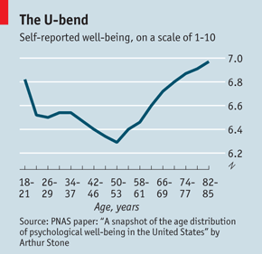


The human happiness curve
Level of Happiness
Self-reported well-being, on a scale of 1-10
“
15
25
35
45
55
65
75
85
95
18-21
26-29
34-37
42-46
50-53
58-61
66-69
74-77
82-85
Age
Sources: The Economist, 2010: The U-Bend of Life: Why, Beyond Middle Age, People Get Happier as They Get Older. Proceedings of the National Academy of Sciences (PNAS), 2010: A Snapshot of the Age Distribution of Psychological Well-Being in the United States. Journal of Consumer Research, 2014: Happiness from Ordinary and Extraordinary Experiences.
Notes:
When it comes to retiring, money is important. It provides opportunity. But it isn’t everything. If you’re 45 to 55 years old and feeling a bit down, you’re not alone. This is when people report feeling the most unhappy in life. The stresses of work, kids, aging parents, health and many other factors tend to weigh most heavily on this age group. It’s probably not a coincidence that the term “mid-life crisis” is also associated with this age range.
The good news is that for many, it’s going to get better. Study after study has shown that, on average, as people get older, they become happier. This trend has been observed across gender, income level, education, culture and geography.
This U-curve of human happiness has been attributed to lower stress levels, less regret, less concern for status, and having lots of experience regulating your emotions.
A study from the Journal of Consumer Research concluded, “As people age, they tend to savor the familiar, peaceful, ordinary events that comprise their daily lives and reflect who they are in the present.”

Slide 36



Happiness factors in retirement
HEALTH
FRIENDSHIPS
FAMILY
Sources: 2018 Academic Research Colloquium for Financial Planning and Related Disciplines: Spending, Relationship Quality, and Life Satisfaction in Retirement. Psychology Today, 2017: To Age Well You Need Friends. University of California, San Francisco, 2012: Loneliness Linked to Serious Health Problems and Death Among Elderly. Cigna, 2018: US Loneliness Index Report, 2018: Most Americans are Considered Lonely.
Notes:
Having money may make retirement easier, but as the saying goes, it doesn’t buy happiness.
Several studies have shown that the most important factors that determine happiness in retirement are health, friendships and family.
It’s important to take steps now to ensure that you remain healthy. Maybe that means joining a gym, taking more walks or doing yoga. It’s been said that all the money in the world doesn’t matter if you’re not healthy enough to enjoy it.
Having strong friendships and good relationships with family has been shown to boost both mental and physical health. One study showed that socially isolated individuals face health risks comparable to those of smokers.

Slide 37

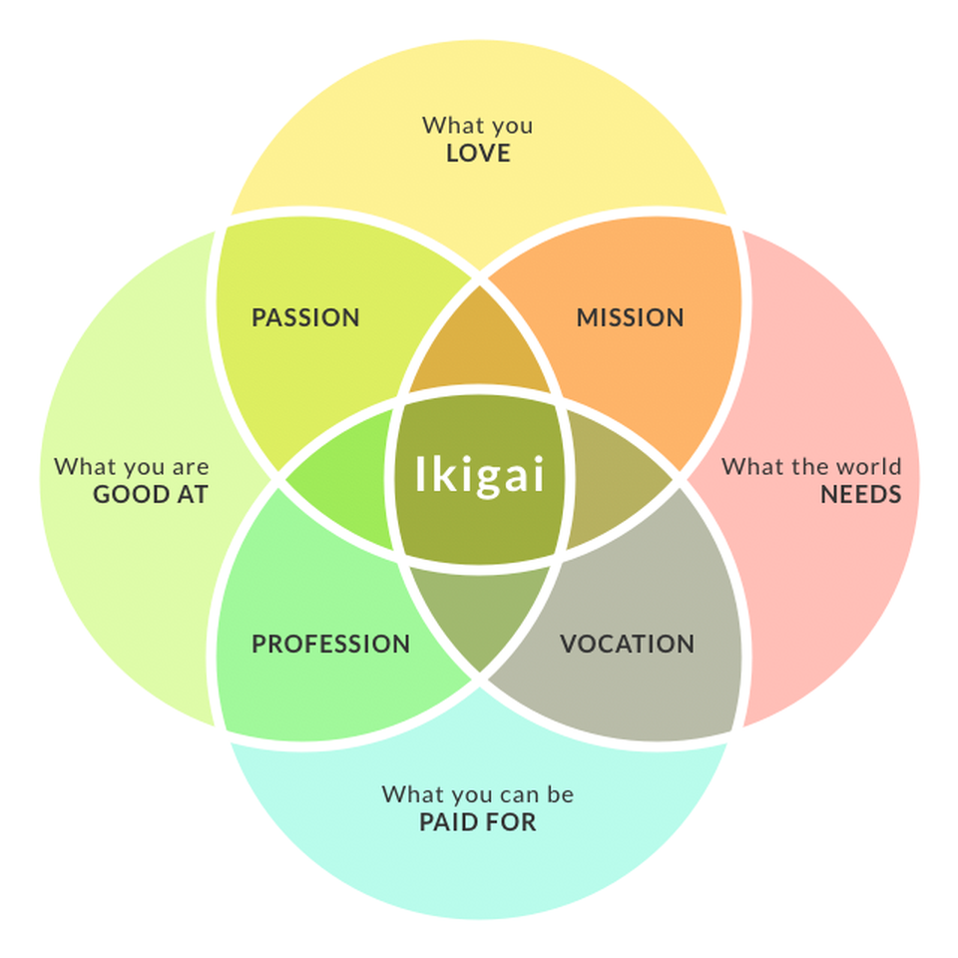

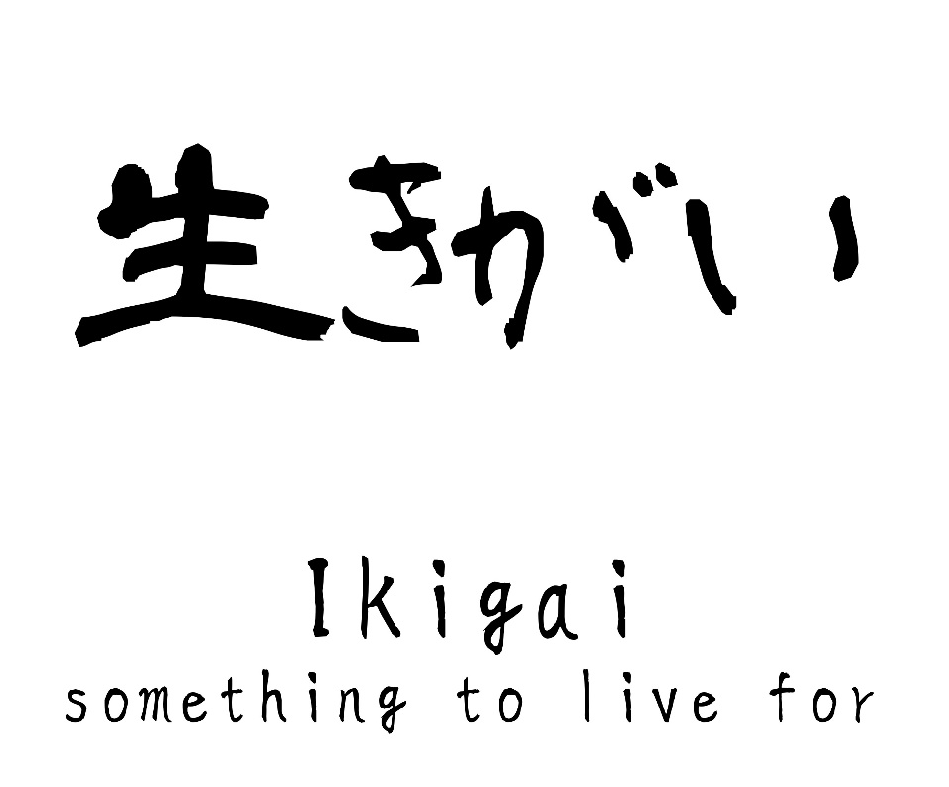
What is your Ikigai?
What you
LOVE
What you
are
GOOD AT
PASSION
MISSION
What the world
NEEDS
Ikigai
PROFESSION
VOCATION
What you can be
PAID FOR
Notes:
Beyond health and relationships, it’s important to have a sense of purpose. The island of Okinawa in Japan is known for having one of the longest life expectancy rates in the world. While there are likely many factors that contribute to this, one of the reasons may be the concept of ikigai (pronounced ick-ee-guy).
Ikigai is a word that roughly translates into your reason for being, or the reason you get out of bed each morning.

Slide 38
What is your Ikigai?
What you
LOVE
What you
LOVE
What
you are
GOOD
AT
What
the world
NEEDS
What you
are
GOOD AT
What you
are
GOOD AT
What the world
NEEDS
What the world
NEEDS
ikigai
What you can be
PAID FOR
What you can be
PAID FOR
Notes:
It has also been described as the place where the answer to four important questions overlap:
What do you love?
What does the world need?
What can you get paid for?
What are you good at?
People in Okinawa might think the concept of retirement doesn’t make sense. You don’t wake up one day and stop doing everything, you just change what you are doing.
For people who plan properly for retirement, that may mean being able to focus less on getting paid for things and more on things you are good at, that you love and what the world needs.

Slide 39






Create your retirement living plan
Contributing to a cause
Visiting family and friends
Pursuing hobbies
Traveling
Starting a business
Going to school
Notes:
You don’t just need a retirement plan, you need a retirement living plan. With longer life expectancy and better health during those later years, people can do a lot during retirement.
New retirees often go through a phase of increased travel and leisure activities, giving themselves a reward for all their hard work. They also may spend more time on their favorite hobbies or do the things that they have always wanted to do but didn't have the time.
Some re-channel their talents and energies into starting a business, pursuing a secondary education, or devoting significant hours volunteering for philanthropic purposes.
However you spend your time, it’s important that you do something that you find meaningful.

Slide 40





Things accomplished by people age 65+
73
65
82
76
80
Peter Roget
Invented the thesaurus
Colonel Sanders Started KFC
Madonna Buder
Triathlete
Grandma Moses
Started painting
Yuichiro Miura
Climbed Mount Everest
Notes:
Here are some impressive accomplishments of people who focused on having a retirement living plan:
Peter Roget invented the thesaurus at age 73.
Colonel Harlan Sanders started Kentucky Fried Chicken at age 65.
Madonna Buder (also known as the Iron Nun) began training for triathlons in her late 40s, and completed an Ironman triathlon at age 82.
Grandma Moses began painting at 76.
Yuichiro Miura became the oldest person to reach the summit of Mount Everest at age 70, and then reset the record when he summited again at age 80.

Slide 41
Retirement is wonderful if you have two essentials – much to live on and much to live for.”
- Unknown
Notes:
In short, “Retirement is wonderful if you have two essentials—much to live on and much to live for.”
That’s why it’s important that you are here today. You’ve shown that you want to take the steps to be prepared.

Slide 42
Seven things you need to do in the decade before you retire
Determine when the time is right
Take aim at your retirement target
Maximize your nest egg
Get a portfolio checkup
Create a social security strategy
Build a retirement income stream
Look beyond the money
Notes:
So today we talked about how to be prepared for the home stretch. Specifically, we looked at seven things you need to do in the decade before you retire:
Determine When the Time is Right. We talked about the challenges of setting a rigid age for when you retire and discussed why you need to plan for a surviving spouse.
Take Aim at Your Retirement Target. We looked at rules of thumb you can use to determine how much you’ll need to retire.
Maximize Your Nest Egg. We saw how you can use catch-up provisions and tax-advantaged retirement savings accounts to maximize your nest egg.
Get a Portfolio Checkup. We talked about why it may be important to consolidate your retirement accounts and make sure they’re allocated correctly. We also talked about the importance of updating beneficiaries and trust documents.
Create a Social Security Strategy. We discussed how your age and income affect the benefits you will receive from Social Security.
Build A Retirement Income Stream. We built an income stream using income-generating investments and a systematic withdrawal plan, and discussed the pros and cons.
Look Beyond the Money. We highlighted why you need to create a retirement living plan that focuses on health, relationships and having a sense of purpose.

Slide 43

Work with a financial professional
Notes:
There is a lot you may want to do, and probably should do, as you sprint through the home stretch before retirement. That’s why working with a financial professional may be one of the best investments you can make.
They can help you address the specific questions and needs you have for each of the seven things we discussed, and more.

Slide 44
Important Legal Information
All investments involve risks, including possible loss of principal.
This material is intended to be of general interest only and should not be construed as individual investment advice or a recommendation or solicitation to buy, sell or hold any security or to adopt any investment strategy. It does not constitute legal or tax advice. This material may not be reproduced, distributed or published without prior written permission from Franklin Templeton.
The views expressed are those of the investment manager and the comments, opinions and analyses are rendered as at publication date and may change without notice. The underlying assumptions and these views are subject to change based on market and other conditions and may differ from other portfolio managers or of the firm as a whole. The information provided in this material is not intended as a complete analysis of every material fact regarding any country, region or market. There is no assurance that any prediction, projection or forecast on the economy, stock market, bond market or the economic trends of the markets will be realized.
The value of investments and the income from them can go down as well as up and you may not get back the full amount that you invested. Past performance is not necessarily indicative nor a guarantee of future performance.
Any research and analysis contained in this material has been procured by Franklin Templeton for its own purposes and may be acted upon in that connection and, as such, is provided to you incidentally. Data from third party sources may have been used in the preparation of this material and Franklin Templeton ("FT") has not independently verified, validated or audited such data. Although information has been obtained from sources that Franklin Templeton believes to be reliable, no guarantee can be given as to its accuracy and such information may be incomplete or condensed and may be subject to change at any time without notice. The mention of any individual securities should neither constitute nor be construed as a recommendation to purchase, hold or sell any securities, and the information provided regarding such individual securities (if any) is not a sufficient basis upon which to make an investment decision. FT accepts no liability whatsoever for any loss arising from use of this information and reliance upon the comments, opinions and analyses in the material is at the sole discretion of the user.
Products, services and information may not be available in all jurisdictions and are offered outside the U.S. by other FT affiliates and/or their distributors as local laws and regulation permits. Please consult your own financial professional or Franklin Templeton institutional contact for further information on availability of products and services in your jurisdiction.
U.S. by Franklin Templeton, One Franklin Parkway, San Mateo, California 94403-1906, (800) DIAL BEN/342-5236, franklintempleton.com. Investments are not FDIC insured; may lose value; and are not bank guaranteed.
HS-PPT 10/25

