Slide 1

Notes:
Presentation description: Many risks that people face during their working years, like inflation and market volatility, become magnified in retirement. Aligning retirement assets with appropriate time horizons may help retirees as they convert their lifetime savings into retirement income. This presentation examines different approaches to building a sustainable retirement income strategy.
Making It Last – Building Retirement Income strategies
8/7/2025

Slide 2

Making it last
Advanced retirement income strategies for everyday investors
Notes:
Hello, I’m _____________ and I’d like to welcome you to Making It Last, Franklin Templeton’s presentation series offering key insights for developing and preserving a comprehensive retirement income strategy.
Making It Last – Building Retirement Income strategies
8/7/2025

Slide 3
Making it last – Retirement Income Modules
Retirement income challenges
Social Security choices
Building retirement income strategies
Tax-smart withdrawals
Installing guardrails for volatile markets
Notes:
Making It Last is a series of presentation modules. Today, I will be focusing on our Building Retirement Income Strategies module.
Creating a strategy to convert lifetime savings into retirement income can be challenging. It may seem simple on the surface, but becomes much more complicated once things like market risk, taxes, inflation, and longevity are factored in.
In this presentation, I will discuss a couple of approaches to build a retirement income strategy and how they might work in different market environments.
Making It Last – Building Retirement Income strategies
8/7/2025

Slide 4

Building retirement income strategies
A retirement income reality check
Multi-asset plus reserve strategy
Time-based bucket strategy
Notes:
Here’s our agenda today:
First, I’ll begin with a quick retirement income reality check. I’ll discuss some outdated ideas and why they may not be the best options today.
Next, I’ll introduce a multi-asset plus reserve strategy to generate retirement income.
Last, we’ll look at how a time-based bucket strategy works.
Let’s get started.
Making It Last – Building Retirement Income strategies
8/7/2025

Slide 5
Living off the interest
Annual income from a $500,000 money market fund investment over the last 30 years
2024
This chart is for illustrative purposes only and does not reflect the performance of any Franklin Templeton fund.
Past performance does not guarantee future results.
Source: Source: Lipper for Investment Management. Annual income is based on an average of month end Lipper Money Market Fund yields each calendar year. Indexes are unmanaged and one cannot invest directly in an index. Index returns do not reflect any fees, expenses or sales charges.
Notes:
Probably the most basic retirement income strategy is to invest your savings into something conservative that generates income, and then live off whatever interest payments you receive.
This chart shows the average annual income you could have earned with a $500,000 investment in money market mutual funds over the last 30-years.
Because interest rates are always changing, you can see that there were some periods where annual income was much higher, mostly in the mid- to late 1990s, and other periods where income was much lower, mostly in the 2010’s.
[CLICK] If looking at a $10,000 annual income threshold, which is less than $1,000 a month, we can see that this strategy fell short more than half the time.
Many retirees may not be able to stomach the year-to-year volatility of a strategy like this. In some years enough income was generated to buy a new car, in other years the income was so small it might not have been enough to even cover a weekly grocery bill.
Making It Last – Building Retirement Income strategies

Slide 6
Stocks have delivered strong historical returns but the ride is often bumpy
S&P 500 index average annual total returns over the last 30 years
The average annual total return of the S&P 500 Index over the last 30 years was:
10.88%
2023
This chart is for illustrative purposes only and does not reflect the performance of any Franklin Templeton fund.
Past performance does not guarantee future results.
Source: © 2024 Morningstar, Inc. Indexes are unmanaged and one cannot invest directly in an index. Index returns do not reflect any fees, expenses or sales charges.
Notes:
If living off interest payments is not a viable strategy, you might think about investing in the stock market. After all, stocks have had strong historical returns.
[CLICK] In fact, over the last 30 years stocks have delivered an average annual return of nearly 11%.
Why not invest in stocks, earn that 11% and take out the gains each year while keeping the original investment untouched?
[CLICK] Unfortunately, that historical return is an average, and not guaranteed each year. This chart shows that in the last 30 years, stocks failed to hit the average return 11 times.
More critical are the years in which stocks had negative returns. The combination of withdrawals and declining markets can be very damaging to retirement savings.
Building an effective retirement income strategy that can both generate the required income needed and withstand market ups and downs may require a more diversified, strategic approach.
Let’s walk through a couple of examples.
Making It Last – Building Retirement Income strategies

Slide 7
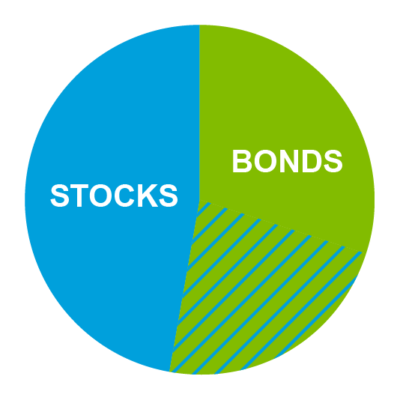




Multi-asset plus reserve strategy
Multi-asset
growth and income investments
Reserve
2-3 years of cash/fixed income investments
Retirement Assets
Notes:
The first strategy I’d like to share is called a multi-asset plus reserve strategy.
[CLICK] In this approach, retirement assets are split into two portfolios.
One is a multi-asset portfolio, which simply means it is set up to invest in a mix of stocks and bonds.
It will hold the majority of the retirement savings and the allocation to stocks and bonds can vary depending on a person’s situation and risk tolerance.
The second is a reserve portfolio that is designed to hold enough to cover retirement income needs for two to three years. It will be invested very conservatively.
Let’s see how this strategy works in different hypothetical markets, starting with an up market.
Making It Last – Building Retirement Income strategies

Slide 8
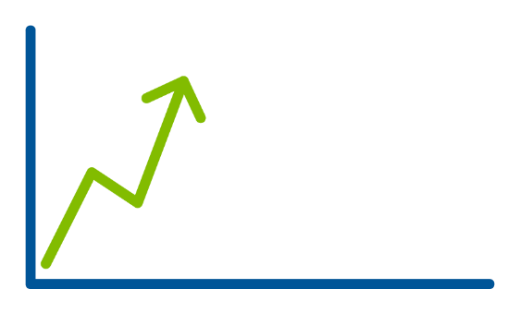

Multi-asset plus reserve strategy
Multi-asset
growth and income investments
Reserve
2-3 years of cash/fixed income investments
UP Market
Notes:
In a rising market the multi-asset portfolio may grow, depending on the underlying investments and the mix of stocks and bonds.
[CLICK] When this occurs, money will be withdrawn from this portfolio to support annual retirement expenses.
Of course, markets don’t always go up, sometimes they go down.
Making It Last – Building Retirement Income strategies

Slide 9
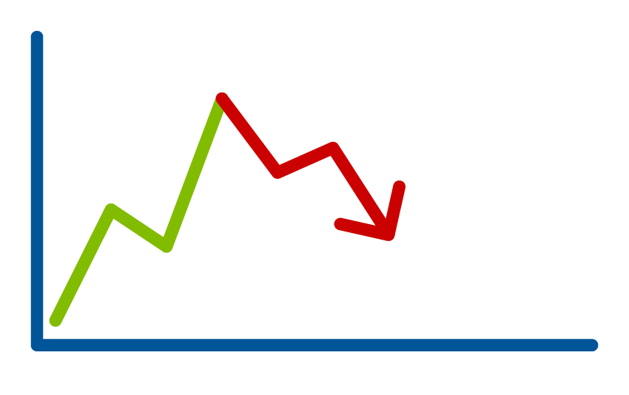


Multi-asset plus reserve strategy
Multi-asset
growth and income investments
Reserve
2-3 years of cash/fixed income investments
DON’T USE
DOWN Market
Notes:
When the market contracts, it’s expected the multi-asset portfolio will lose some value as well, depending on the underlying investments and the mix of stocks and bonds.
[CLICK] When the value of the multi-asset portfolio has dropped, you don’t want to further deplete it by taking withdrawals to support retirement expenses.
Doing so would be the equivalent of selling low.
[CLICK] Instead, the reserve portfolio is used to support retirement expenses during a down year.
With its cash and conservative investments, it functions like an emergency fund.
The hope is that using the reserve portfolio will buy some time and allow a market recovery to take hold.
Making It Last – Building Retirement Income strategies

Slide 10
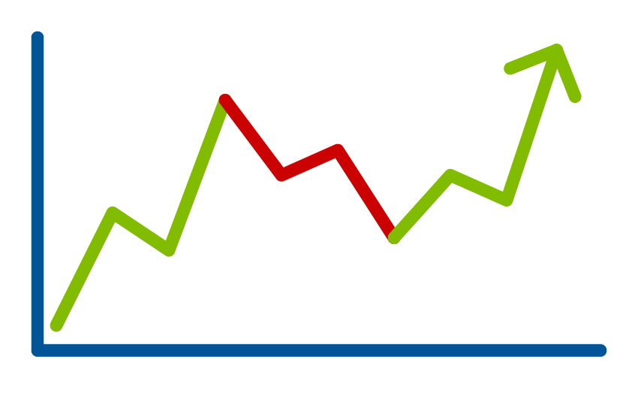
Multi-asset plus reserve strategy
Multi-asset
growth and income investments
Reserve
2-3 years of cash/fixed income investments
Market RECOVERY
Notes:
In a market recovery, it’s expected the multi-asset portfolio will also recover.
[CLICK] When this happens, we’ll switch back and use the multi-asset portfolio to fund retirement expenses.
[CLICK] And, if the recovery is strong enough, money may also be shifted to replenish the reserve portfolio.
Now let’s look at another strategy that is sometimes referred to as the bucket strategy.
Making It Last – Building Retirement Income strategies

Slide 11










Time-based bucket strategy
Retirement Assets
Now (1 Year)
cash investments
Soon (2-10 Years)
income investments
Later (10+ Years)
growth investments
Notes:
There are many variations of the bucket strategy, but the most common consists of three buckets which we’ll call Now, Soon, and Later.
[CLICK] Retirement assets are split into these three buckets.
The Now Bucket is the smallest and holds the money needed in the short-term, usually within the next year. It will consist of cash and very safe investments.
The Soon Bucket holds the money needed in the intermediate-term, generally over the next 2-10 years. It should be several times the size of the Now Bucket. The savings will be invested to generate income, usually in bonds, other fixed income investments, or dividend paying stocks.
The Later Bucket is generally the largest bucket and holds the money needed in the long-term, usually 10 or more years. It is invested for growth and typically holds stocks.
Segmenting retirement savings like this helps align investment allocations and risks with an appropriate time horizon.
Let’s look at some different hypothetical markets and how this strategy works, starting again with an up market.
Making It Last – Building Retirement Income strategies

Slide 12










Time-based bucket strategy
UP Market
Now (1 Year)
cash investments
Soon (2-10 Years)
income investments
Later (10+ Years)
growth investments
Notes:
When the market rises, it’s expected the Soon and Later Buckets will both rise as well. The Now Bucket remains unchanged because it’s mostly cash.
[CLICK] Over the course of the year, funds are withdrawn from the Now Bucket, depleting it by the end of the year.
[CLICK] To fund the next year’s spending, the Now Bucket will be refilled from the Soon Bucket.
[CLICK] Then, the Later Bucket replenishes the Soon Bucket, bringing all three back into balance.
Now let’s look at what happens when there’s a down market.
Making It Last – Building Retirement Income strategies

Slide 13


Time-based bucket strategy
DOWN Market
DON’T USE
Now (1 Year)
cash investments
Soon (2-10 Years)
income investments
Later (10+ Years)
growth investments
Notes:
When the market declines, it’s expected the Soon and Later Buckets, based on their investments, may also see a decline. The Now Bucket, with its cash and very safe investments, doesn’t change.
[CLICK] During the year, money is still withdrawn from the Now Bucket, emptying it by year end.
[CLICK] The Soon Bucket will again be used to replenish the Now Bucket and provide next year’s spending.
[CLICK] However, this time the Later Bucket isn’t used to replenish the Soon Bucket. It will remain untouched.
In this scenario, the Soon Bucket acts as a cushion, buying time for the Later Bucket to recover. Even after a decline, the Soon Bucket should have enough to fund retirement spending for several years, if needed.
The hope is that the market, along with the buckets, will eventually recover.
Making It Last – Building Retirement Income strategies

Slide 14



Time-based bucket strategy
Market RECOVERY
Now (1 Year)
cash investments
Soon (2-10 Years)
income investments
Later (10+ Years)
growth investments
Notes:
In a market recovery, it’s expected the Soon and Later Buckets will rise.
[CLICK] Once again, money is taken from the Now Bucket for the current year’s spending needs.
[CLICK] Like before, it is replenished using the Soon Bucket.
[CLICK] And once it has recovered, the Later Bucket can be used to replenish the Soon Bucket.
These are just a couple of approaches you can use to build a retirement income strategy.
Making It Last – Building Retirement Income strategies

Slide 15
Benefits of a diverse retirement income strategy
Doesn’t rely solely on income yields or stock appreciation to generate retirement income
Establishes an approach to help manage market volatility
Aligns investment allocations and risks with an appropriate time horizon
Diversification and asset allocation strategies do not ensure a profit or protect against a loss.
Notes:
Let’s recap the benefits of building a diverse retirement income strategy.
One, it doesn’t rely solely on income yields or stock appreciation to generate retirement income.
Income-oriented investments don’t always generate enough income to live on, and on their own, stocks may introduce an unacceptable level of risk to a retirement income strategy.
[CLICK] Two, a diverse strategy establishes an approach to help manage market volatility.
Markets can be unpredictable, and it helps to have a plan when they don’t behave as expected.
[CLICK] And three, building a diverse retirement income strategy helps align investment allocations and risks with an appropriate time horizon.
A financial professional can help assess your individual situation and design a customized strategy to meet your unique retirement income goals and risk tolerance.
Making It Last – Building Retirement Income strategies
8/7/2025

Slide 16
Retirement is wonderful if you have two essentials – much to live on and
much to live for.”
– Unknown
Notes:
At Franklin Templeton we like to say, “Retirement is wonderful if you have two essentials—much to live on and much to live for.”
That’s why it’s important that you are here today. You’ve shown that you want to take the steps to be prepared.
Thank you for your time today.
Making It Last – Building Retirement Income strategies
8/7/2025

Slide 17
All investments involve risks, including possible loss of principal. There are no assurances that desired outcomes from ideas outlined in this document will be attained.
Franklin Templeton, its affiliates and its employees are not in the business of providing tax or legal advice to taxpayers. These materials and any tax-related statements are not intended or written to be used, and cannot be used or relied upon by any such taxpayer for the purpose of avoiding tax penalties or complying with any applicable tax laws or regulations. Tax-related statements, if any, may have been written in connection with the “promotion or marketing” of the transaction(s) or matter(s) addressed by these materials to the extent allowed by applicable law. Any such taxpayer should seek advice based on the taxpayer’s particular circumstances from an independent tax professional.
The content in this presentation is general in nature and intended for educational purposes only is not directed to or based on the financial situation or needs of any particular investor, and does not constitute, and should not be construed as, investment advice, a forecast of future events, a guarantee of future results, or it should not be considered tax, legal or investment advice or an investment recommendation. Consult your financial professional for personalized advice that is tailored to your specific goals, individual situation, and risk tolerance.
U.S. by Franklin Templeton, One Franklin Parkway, San Mateo, California 94403-1906, (800) DIAL BEN/342-5236, franklintempleton.com. Investments are not FDIC insured; may lose value; and are not bank guaranteed.
MIL3 PPT 8/25

