Slide 1

Notes:
Presentation description: In retirement, it’s often assumed that income taxes will decline. While this may be true for some, it isn’t always the case. If they aren’t managed properly, taxes can have a significant impact on retirement income. This presentation identifies the taxes retirees are likely to face and how they might benefit from applying a tax-smart withdrawal strategy.
Making It Last – Tax-Smart Withdrawals
8/8/2025

Slide 2

Making it last
Advanced retirement income strategies for everyday investors
Notes:
Hello, I’m _____________ and I’d like to welcome you to Making It Last, Franklin Templeton’s presentation series offering key insights for developing and preserving a comprehensive retirement income strategy.
Making It Last – Tax-Smart Withdrawals
8/8/2025

Slide 3
Making it last – Retirement Income Modules
    Retirement income challenges
    Social Security choices
    Building retirement income strategies
    Tax-smart withdrawals
    Installing guardrails for volatile markets
Notes:
Making It Last is a series of presentation modules. Today, I will be focusing on our Tax-Smart Withdrawals module.
Taxes are something very few people like to think about. But, if not managed properly, they can take a big bite out of your retirement.
In this presentation, I will discuss how making tax-smart withdrawals may help reduce your tax burden and extend your retirement income strategy.
Making It Last – Tax-Smart Withdrawals
8/8/2025

Slide 4

Tax-smart withdrawals
Where you live can make
a big difference
The evolution of retirement assets
Implementing withdrawal
strategies
Notes:
Here’s our agenda:
First, I’d like to talk about where you choose to live in retirement, and how that can make a big difference in the taxes you might pay.
Next, we’ll look at how saving for retirement has changed over the years.
Last, I’ll introduce a couple of withdrawal strategies that may help reduce the tax bite on your retirement income.
Let’s begin.
Making It Last – Tax-Smart Withdrawals
8/8/2025

Slide 5
The art is not in making money,
but in keeping it.”
5
Notes:
Taxes can be one of the biggest expenses you’ll face in retirement, and they can significantly eat away at your retirement income strategy.
Fortunately, being aware of what taxes you’ll face and developing smart withdrawal strategies may help you keep more of what you’ve saved.
Making It Last – Tax-Smart Withdrawals
8/8/2025

Slide 6
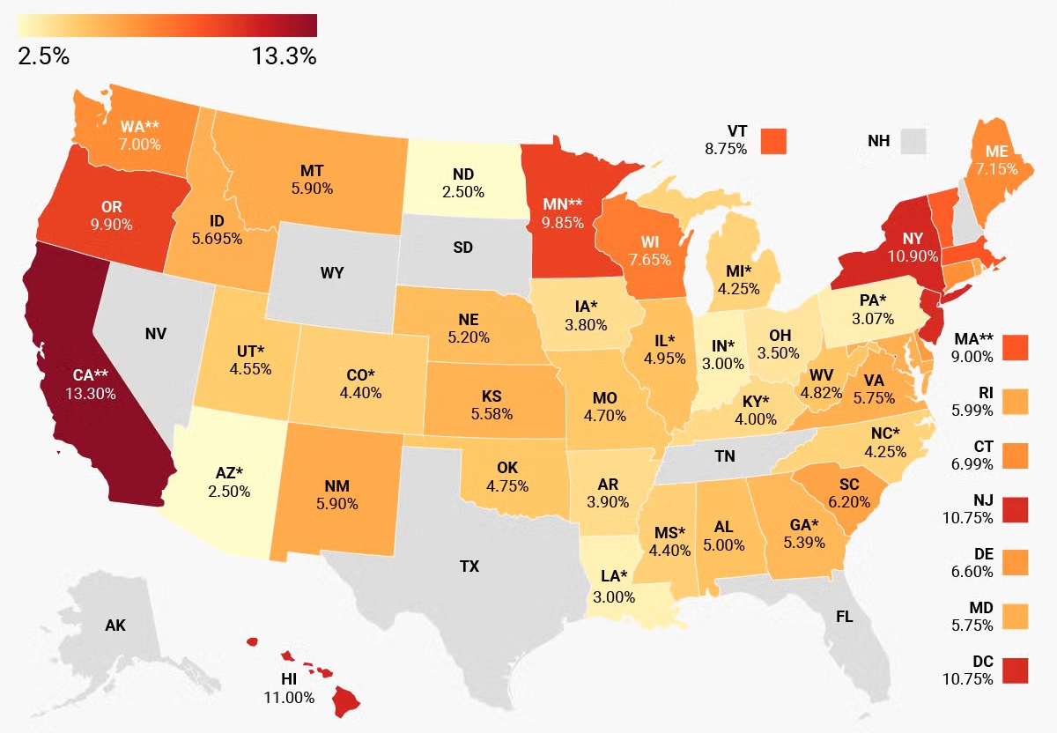
Top marginal state individual income tax rates
As of January 1, 2025
Source: Tax Foundation, 2025; state tax statutes, forms, and instructions; Bloomberg Tax.
Note: Map shows top marginal rates: the maximum statutory rate in each state. This map does not show effective tax rates, which would include the effects of various tax preferences. Local income taxes are not included.(*) State has a flat income tax.( ** ) Washington's 7% rate only applies to high earners' capital gains income. Top rates exclude non-UI payroll taxes in CA (1.1%), MA (0.46%), and WA (0.58%), and a 1% high earners' capital gains surtax in MN.
6
Notes:
Where one lives in retirement can have a big impact on how much tax one pays on their retirement income.
Income taxes are a major source of revenue for many states and even some local cities and counties.
Most states have some form of income tax that may be assessed on your retirement income, and the rates can vary widely.
Understanding and estimating how much state income tax you might have to pay should be an important part of your retirement income strategy.
Making It Last – Tax-Smart Withdrawals

Slide 7
States that tax some portion of Social Security
No State Tax on Social Security
State May Tax Social Security
Recently Eliminated State Tax on Social Security
Sources: AARP, 2024.
7
Notes:
In addition, your Social Security benefits may be considered taxable income, depending on where you live.
Currently, 10 states have some form of taxation on Social Security. Missouri and Nebraska recently passed legislation that eliminated their taxes on Social Security beginning this year. And, West Virginia has proposed legislation that would end its Social Security tax by 2026.
In addition, some states, such as Colorado and Vermont, have recently reduced their taxes on Social Security benefits.
If you reside in one of these 10 states, you should understand how the Social Security taxes are applied and factor it into your retirement income strategy.
Moving may help reduce state taxes, but for many retirees it may not be a realistic option. Other important factors, such as the cost of living, proximity to friends and family, and other taxes, such as sales and property taxes, should also be considered before relocating.
However, something that impacts all of us, no matter where we live, are federal income taxes.* Let’s talk about some potential strategies that may help reduce federal taxes on retirement income.
To begin, let’s review how the retirement landscape has evolved over the last 40+ years.
*Note to Presenter: US federal income taxes are assessed based on citizenship not location. So even moving to another country does not relieve a US citizen of their federal income tax obligations.
Making It Last – Tax-Smart Withdrawals

Slide 8
The evolution of retirement savings accounts
Tax Exempt
(Roth)
Tax Exempt (Roth)
Tax Deferred (401K, IRA)
Tax Deferred (401k, IRA)
Pension
Health Savings Account (HSA)
Taxable
Taxable
Taxable
Pension
Social Security
Pension
Social Security
Social Security
1980s
2000s
2020s
8
Notes:
Back in the early 1980s, people generally funded their retirement from just three potential sources, Social Security, a company pension, and any personal bank or brokerage savings they may have accumulated, usually in some sort of taxable investment account.
This is what was commonly referred to as “the three-legged stool of retirement.”
[CLICK] By the early 2000s, we started to see some significant changes in the types of accounts available to retirement savers.
While worker pensions were on the decline, new retirement savings options gained in popularity.
Tax-deferred retirement accounts like 401(k)s and IRAs were created by legislation in the mid-1970s and really grew in popularity through the 80s and 90s.
In 1997, tax-exempt Roth savings accounts were introduced, offering a different way to save for retirement—pay your federal income taxes on your contributions up front and never have to pay them again.
[CLICK] Today, tax-deferred 401(k)s and IRAs have mostly displaced pensions as the predominant retirement savings vehicles available to workers.
Tax-exempt (Roth) accounts continue to grow in popularity and in 2003 health savings accounts (HSAs) were introduced as a tax-advantaged way to save for health expenses.
Each account type comes with different tax implications. While today’s retirement account options are more complex, they may also provide greater flexibility to manage when, and potentially how much, taxes are owed.
Making It Last – Tax-Smart Withdrawals

Slide 9
The conventional withdrawal order
1st
Taxable
(Brokerage/Bank Accounts)
2nd
Tax deferred
(401k, IRAs)
3rd
Tax exempt
(Roth, HSAs)
  The Good: Optimizes for compounding potential of tax-advantaged accounts and it is easy to execute.
  The Bad: Doesn’t fully consider the long-term impact of taxes.
9
9
Notes:
As these new savings options grew in popularity, a conventional withdrawal order was developed to help retirees with multiple accounts stage the sequence of their withdrawals. It says that:
First, money should be taken from any taxable personal accounts such as a brokerage account.
Second, tax-deferred accounts like traditional IRAs or 401(k)s, should be accessed.
And third, tax-exempt accounts, like Roth IRAs or Health Savings Accounts, should be used.
[CLICK] The benefit of the conventional withdrawal order is it keeps money in tax-advantaged accounts for as long as possible, allowing those funds to potentially benefit from tax-deferred growth. And this strategy is easy to learn and execute.
[CLICK] However, one problem with the conventional withdrawal order is that it doesn’t fully assess the long-term impact of taxes on retirement income, which can be significant.
This is partly because taxes are levied annually, so most of us look at how much tax is owed on a year-to-year basis. Instead, it may be beneficial to make withdrawal decisions with the goal of minimizing total lifetime taxes.
Using a tax-informed withdrawal order may help further reduce your tax bill and stretch a retirement income strategy.
To explain, let’s look at an example.
Making It Last – Tax-Smart Withdrawals

Slide 10

A real world look at the conventional strategy
  Age at Retirement: 65
  Desired Retirement Income: $70,000
  Age When Social Security Starts: 67
  Social Security Benefit: $25,000/year
  Retirement Assets: $1,000,000
This example is intended only to illustrate the federal income tax effects of retirement account withdrawals. It does not take into account state or municipal taxes. All values used in the example are hypothetical and will differ for every individual.
10
10
10
Notes:
Here we have a married couple who are both 65 and ready to retire.
To live comfortably in retirement, they feel they’ll need $70,000 per year in total income.
They plan to begin receiving Social Security benefits in a couple years, at age 67, which will contribute $25,000 per year to their retirement income.
Last, to fund their retirement, this couple has saved $1,000,000 in several accounts:
$150,000 in a taxable brokerage account
$550,000 in a tax-deferred 401(k) account
And $300,000 in a tax-exempt Roth account
First, let’s see how using the conventional withdrawal order would work for this hypothetical couple.
Making It Last – Tax-Smart Withdrawals

Slide 11
The conventional withdrawal strategy
Tax Deferred
Tax exempt
Taxable
Social security
$56,548
Taxes Paid
Age
    For illustrative purposes only.
Source: Franklin Templeton with data obtained from the Internal Revenue Service. Assumes 2024 tax rates and standard deduction amounts for a married couple filing jointly and age 65 and older. Long-term capital gains taxes are applied to 20% of taxable withdrawals. All figures are net of inflation and no cost-of-living adjustments are made to Social Security benefits. Retirement savings are assumed to grow at a 3% real rate of return. There is no assurance that any estimate, forecast or projection will be realized.
11
11
11
Notes:
Here we have a chart we’ll use to represent our couple’s projected retirement. Along the bottom, their ages are shown from 65 up to 95. Each year we have to come up with $70,000 from a combination of Social Security and their taxable, tax-deferred and tax-exempt savings accounts.
Let’s see how this would work using the conventional retirement withdrawal strategy.
[CLICK] First, our couple will use funds from their taxable brokerage account. They had $150,000 in this account, so it’s enough to cover ages 65 and 66, but runs out when they are 67.
[CLICK] Remember that at age 67, our couple will begin receiving Social Security of $25,000 per year.
[CLICK] Next, they will supplement their Social Security benefits by continuing to draw money from their tax-deferred 401(k) account until those assets deplete when they are 81.
[CLICK] Last, they will use their tax-exempt Roth account until it is exhausted. This gets our couple almost through age 94. Not bad, that’s 29 years of retirement income.
[CLICK] However, under this strategy our couple would have to withdraw extra money each year between the ages of 67 and 81 to cover income taxes totaling more than $56,000.
What if there’s a smarter way?
Making It Last – Tax-Smart Withdrawals

Slide 12
The benefits of a tax-informed withdrawal strategy
  Step 1: Fill up 0% tax bracket
  Step 2: Avoid Social Security Taxes
  Step 3: Use taxable or tax-exempt (Roth) assets to fill income gaps
Tax exempt
$0 Federal Income Taxes Owed
Taxable
$107,353
More Income
2 Years
7 Months Extra
Social security
Tax Deferred
Age
    For illustrative purposes only.
Source: Franklin Templeton with data obtained from the Internal Revenue Service. Assumes 2024 tax rates and standard deduction amounts for a married couple filing jointly and age 65 and older. Long-term capital gains taxes are applied to 20% of taxable withdrawals. All figures are net of inflation and no COLA adjustments are made to Social Security benefits. Retirement savings are assumed to grow at a 3% real rate of return. There is no assurance that any estimate, forecast or projection will be realized.
Notes:
Instead of following the conventional withdrawal order, our couple may benefit from using a tax-informed withdrawal strategy. This time we’ll look to stage the withdrawals to minimize taxes over the life of their retirement.
[CLICK] First, they should always utilize their 0% federal income tax bracket by withdrawing from tax-deferred assets. The opportunity to take untaxed income should never be wasted.
Each year we are all eligible to have some income that is not taxed. It typically comes in the form of the IRS standard deduction. Currently, the standard deduction for a married couple over 65 is $32,300.
[CLICK] Next, they want to try and avoid taxes on their Social Security benefits. The Social Security tax threshold is very low and can easily be crossed if you’re not careful.
[CLICK] Our couple will still utilize their 0% tax bracket but will have to reduce their tax-deferred withdrawals a little each year they receive Social Security to avoid triggering taxes on their benefits.
[CLICK] Last, they fill any income gaps with taxable (brokerage) or tax-exempt (Roth) assets. Long-term capital gains have a much higher tax threshold while tax-exempt (Roth) assets are not federally taxable at all, providing great flexibility for our couple.
The result?
[CLICK] $0 of federal income taxes paid. Nothing. This translates into…
[CLICK] Over $107,000 of additional income. That’s the federal income tax savings over $56,000, plus about $50,000 in potential growth those savings could generate. What does this buy?
[CLICK] An extra 2 years and 7 months of retirement income. More than two extra years and all our couple did was change how they withdrew their retirement savings.
Everyone’s situation is unique, and those with higher income requirements or more assets may not be able to completely avoid federal income taxes. However, there are some general guidelines you can follow to avoid paying more in taxes than necessary.
Making It Last – Tax-Smart Withdrawals
8/8/2025

Slide 13
Tax-informed withdrawal guidelines
Step 1: Fill up lower tax brackets with tax-deferred income each year
Step 2: Be aware of taxes on Social Security benefits
Step 3: Strategically utilize taxable and tax-exempt (Roth) assets to supplement income needs
Notes:
Step 1, always try to fill up lower tax brackets using tax-deferred income every year.
Filling up the 0% tax bracket as we did in our example is a must. But for those with more savings or higher income needs, it may make sense to fill up the 10% or 12% tax brackets. Later in retirement, required minimum distributions may force withdrawals into a higher tax rate, so taking some of that money and paying 10% income tax today might be better than a much higher tax rate in the future.
Even if the money isn’t needed, it may make sense to take it anyway, pay the lower tax rate, and convert the proceeds into a Roth account. This is a popular strategy that can potentially add flexibility later in retirement.
[CLICK] Step 2, be aware of taxes on Social Security benefits. The federal tax threshold on Social Security is only $32,000 for married couples and $25,000 for singles.
In fact, when Congress and the Reagan administration passed Social Security reforms in 1983, these tax thresholds were not indexed. They’re the same today as they were more than 40 years ago. In 1984 less than 10% of beneficiaries paid Social Security taxes. Today, more than half do.
[CLICK] Step 3, strategically utilize any taxable personal savings or tax-exempt (Roth) accounts you have. These offer significant tax flexibility and may help provide income without triggering taxes.
These guidelines are broadly applicable, but everyone’s tax situation is unique. Tax laws can change, and you should carefully review and discuss your options with a qualified tax professional.
Fortunately, intelligently staging your withdrawals across different account types may significantly benefit your retirement income strategy.
Source: Social Security Administration, https://www.ssa.gov/history/taxationofbenefits.html, https://www.ssa.gov/policy/docs/issuepapers/ip2015-02.html
Making It Last – Tax-Smart Withdrawals
8/8/2025

Slide 14
Retirement is wonderful if you have
two essentials – much to live on and
much to live for.”
– Unknown
Notes:
At Franklin Templeton we like to say, “Retirement is wonderful if you have two essentials—much to live on and much to live for.”
That’s why it’s important that you are here today. You’ve shown that you want to take the steps to be prepared.
Thank you for your time today.
Making It Last – Tax-Smart Withdrawals
8/8/2025

Slide 15
  All investments involve risks, including possible loss of principal. There are no assurances that desired outcomes from ideas outlined in this document will be attained.
  Franklin Templeton, its affiliates and its employees are not in the business of providing tax or legal advice to taxpayers. These materials and any tax-related statements are not intended or written to be used, and cannot be used or relied upon by any such taxpayer for the purpose of avoiding tax penalties or complying with any applicable tax laws or regulations. Tax-related statements, if any, may have been written in connection with the “promotion or marketing” of the transaction(s) or matter(s) addressed by these materials to the extent allowed by applicable law. Any such taxpayer should seek advice based on the taxpayer’s particular circumstances from an independent tax professional.
  The content in this presentation is general in nature and intended for educational purposes only is not directed to or based on the financial situation or needs of any particular investor, and does not constitute, and should not be construed as, investment advice, a forecast of future events, a guarantee of future results, or it should not be considered tax, legal or investment advice or an investment recommendation. Consult your financial professional for personalized advice that is tailored to your specific goals, individual situation, and risk tolerance.
  U.S. by Franklin Templeton, One Franklin Parkway, San Mateo, California 94403-1906, (800) DIAL BEN/342-5236, franklintempleton.com. Investments are not FDIC insured; may lose value; and are not bank guaranteed.
MIL4-PPT-08/25

