Slide 1
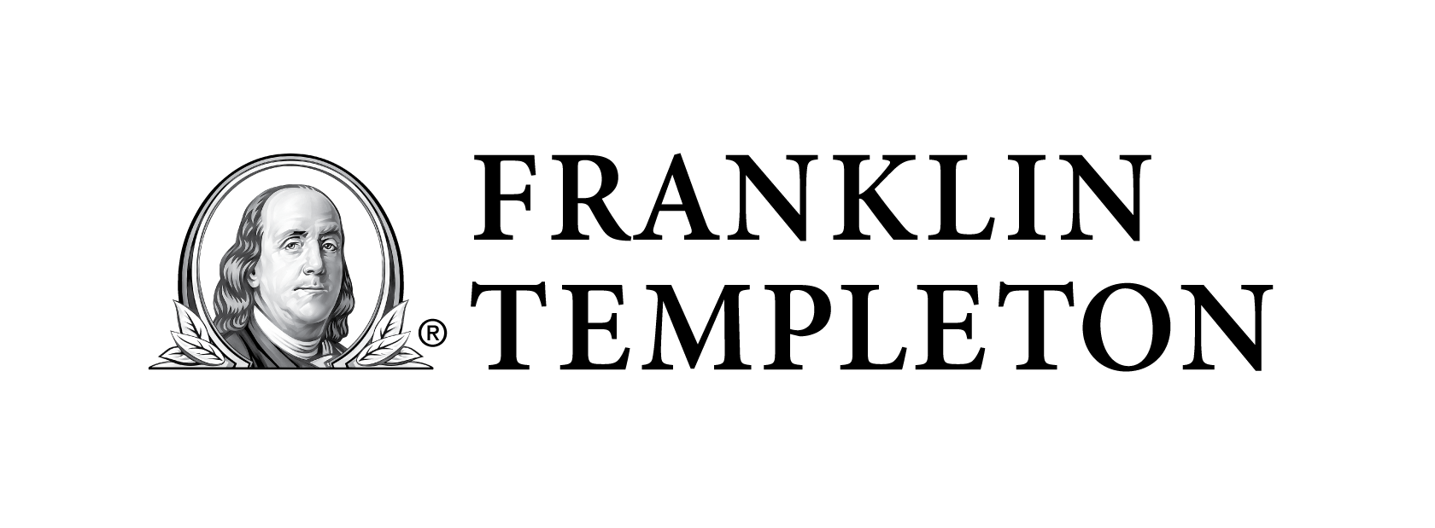
Notes:
Presentation description: One of the biggest risks to a retirement income strategy is early negative returns that, when paired with normal withdrawals, can significantly harm a retirement portfolio’s longevity. This presentation reveals how adding distribution guardrails may help offset market volatility early in retirement and help keep a retirement income strategy on track.
Making It Last – INSTALLING GUARDRAILS FOR VOLATILE MARKETS
8/12/2025

Slide 2

Making it last
Advanced retirement income strategies for everyday investors
Notes:
Hello, I’m _____________ and I’d like to welcome you to Making It Last, Franklin Templeton’s presentation series offering key insights for developing and preserving a comprehensive retirement income strategy.
Making It Last – INSTALLING GUARDRAILS FOR VOLATILE MARKETS
8/12/2025

Slide 3
Making it last – Retirement Income Modules
Retirement income challenges
Social Security choices
Building retirement income strategies
Tax-smart withdrawals
Installing guardrails for volatile markets
Notes:
Making It Last is a series of presentation modules. Today, I will be focusing on the Installing Guardrails for Volatile Markets module.
Bear markets occur about once every two and a half years* and retiring at the start of one can have a significant negative impact on a retirement income strategy. Adding guardrails may help offset a poor market environment and keep your retirement on track.
In this module, I will share what guardrails are and how installing them can help support a retirement income strategy, especially during volatile markets.
* Source: © 2024 Ned Davis Research, Inc., Dow Jones & Company, Inc. Ned Davis Research defines a bear market as a 30% drop in the Dow Jones Industrial Average after 50 calendar days or a 13% decline after 145 calendar days. A bull market requires a 30% rise in the Dow Jones Industrial Average after 50 calendar days or a 13% rise after 155 calendar days. Average frequency, duration and market decline/increase does not reflect the current bear/bull market. Indexes are unmanaged and one cannot invest directly in an index. Index returns do not reflect any fees, expenses or sales charges.
Making It Last – INSTALLING GUARDRAILS FOR VOLATILE MARKETS
8/12/2025

Slide 4

Installing guardrails for volatile markets
The #1 concern about retirement
What was Memorable about 1966
Small adjustments make a big difference
Notes:
Here’s our agenda today.
First, I’ll discuss the #1 concern many people have about retirement.
Next, we’ll look at what was memorable about 1966, and why it is especially memorable for retirees.
Last, I’ll show how small adjustments make a big difference when it comes to retirement income.
Let’s begin.
Making It Last – INSTALLING GUARDRAILS FOR VOLATILE MARKETS
8/12/2025

Slide 5
Pre-retirees #1 concern about retirement is…
RUNNING OUT OF MONEY.
– Franklin Templeton RISE Survey
Source: Franklin Templeton Retirement Income Strategies and Expectations (RISE) Survey. The RISE survey was conducted online among a sample of 2,029 adults 40 years of age and older and weighted by age, gender, geographic region, race, and education. The custom-designed program assigns a weighting factor to the data based on current population statistics from the US Census Bureau and was administered February 17-28, 2022 by ENGINE INSIGHT’s Online CARAVAN®, which is not affiliated with Franklin Templeton.
5
Notes:
Every few years, Franklin Templeton conducts a survey about retirement income strategies and expectations, or the Franklin Templeton RISE survey. When they are asked, what do you think pre-retirees said their top concern about retirement is?
[CLICK] Running out of money.
Pre-retirees fear running out of money more than health problems or aging. Some even fear it more than death.
Unstable markets add to this fear, particularly during times of high volatility.
So how can we quell some of this anxiety? To explain, let’s take a trip back in time.
Making It Last – INSTALLING GUARDRAILS FOR VOLATILE MARKETS
8/12/2025

Slide 6

From rocket science to retirement income
Notes:
Many of you have probably heard of the “4% rule” which says that when you begin retirement you should withdraw 4% of you total savings the first year and then increase that amount for inflation each year going forward. Pretty simple.
While it may not seem like rocket science, it turns out it took a rocket scientist to come up with the 4% rule.
William Bengen, who graduated from MIT with a degree in aeronautics and astronautics, became a financial advisor later in life.
In the early 1990s he began researching how much money someone could safely withdrawal from their retirement savings without running out of money.
As he was pouring over historical market data, one year was key in his development of the 4% rule—1966.
What do you remember about 1966?
Making It Last – INSTALLING GUARDRAILS FOR VOLATILE MARKETS

Slide 7
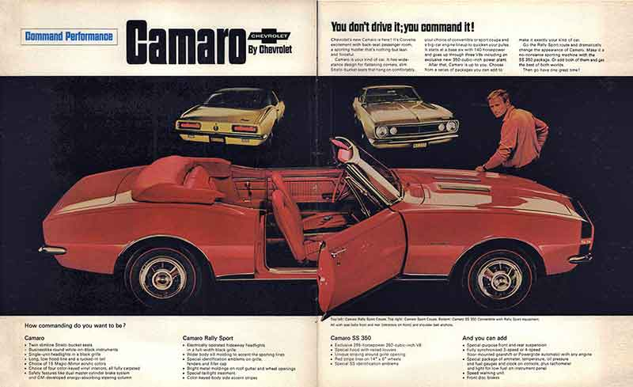

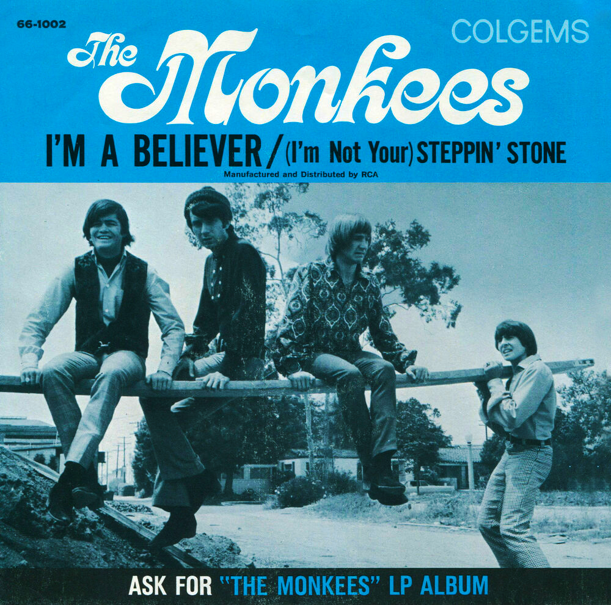
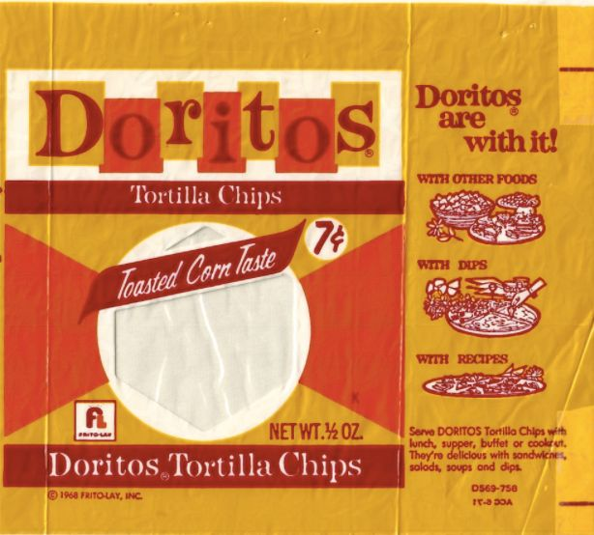


What was memorable about 1966
Doritos were sold for the first time.
Chevy introduced the Camaro.
Star Trek debuted on CBS.
The year’s #1 hit song was “I’m a Believer,” by the Monkees.
Notes:
1966 saw the introduction of one of America’s favorite snacks, Doritos tortilla chips.
[CLICK] It was also the year Chevrolet released the first Camaro.
[CLICK] Captain James T. Kirk and the crew of the starship Enterprise made their debut in the original Star Trek television series.
[CLICK] And, the top song of 1966 was “I’m a Believer” by The Monkees.
What you might not know, and what William Bengen discovered in his research, was that 1966 was the worst year for someone to retire.
Making It Last – INSTALLING GUARDRAILS FOR VOLATILE MARKETS

Slide 8
What we can learn from 1966
Annual Account Balance $1 Million Savings, 60/40 Stock/Bond Allocation, $50K Initial Withdrawal, 3% Annual Increase
$2,053,123
$2,000,000
$1,500,000
1967
$1,000,000
$500,000
1966
1966: -4.58%
$0
$0
1966
1970
1975
1980
1985
1990
1995
This chart is for illustrative purposes only and does not reflect the performance of any Franklin Templeton fund.
Past performance does not guarantee future results.
Source: © 2024 Morningstar, Inc. Assumes an initial $1 million investment into a 60% stock/40% bond portfolio on 12/31/1965 and 12/31/1966, rebalanced annually. Withdrawals start at $50,000, are increased 3% annually and are taken at the beginning of each year. Stocks and bonds are represented by the Ibbotson S&P 500 Index and the Ibbotson US Long-Term Government Index, respectively. Indexes are unmanaged and one cannot invest directly in an index. They do not reflect any fees, expenses or sales charges.
Notes:
The success of a retirement income strategy can be significantly impacted by when it starts. To illustrate, let’s look at a common investment strategy.
Assume a retiree has $1 million invested in a 60%/40%, stock/bond portfolio. Annual withdrawals start at $50,000 and increase 3% each year for inflation. Here’s what happened to someone retiring in 1966.
[CLICK] The line represents the account balance left at the end of each year. As you can see, after 29 years the strategy depleted to $0.
[CLICK] Using the exact same strategy but starting just 12 months later at the beginning of 1967, had a very different outcome. While 1966 ran out of money, 1967 funded retirement and doubled the initial retirement account balance.
So, what happened? 1966 isn’t associated with financial calamities such as the Great Depression, Dot-Com Bust, or Global Financial Crisis.
[CLICK] While the return of -4.58% wasn’t good, it would’ve hardly seemed catastrophic at the time.
However, an early negative return compounds into all future years of retirement. Combined with increasing withdrawals and a volatile market in the 1970’s, the strategy never recovered. This is an example of sequence of returns risk.
A poor sequence of returns can set a retirement income strategy down a path from which it might not recover. And it’s hard to detect early in retirement whether it was bad enough to tip the scales into an unrecoverable downtrend. You can see the account balances closely mirror each other for about 15 years before deviating.
Making It Last – INSTALLING GUARDRAILS FOR VOLATILE MARKETS

Slide 9
What we can learn from 1966
Annual Account Balance $1 Million Savings, 60/40 Stock/Bond Allocation, $50K Initial Withdrawal, 3% Annual Increase
$2,000,000
Guardrail Approach
No increase after negative years
$1,606,858
$1,500,000
$1,000,000
$500,000
$0
$0 3% annual increase
1966
1970
1975
1980
1985
1990
1995
This chart is for illustrative purposes only and does not reflect the performance of any Franklin Templeton fund.
Past performance does not guarantee future results.
Source: © 2024 Morningstar, Inc. Assumes an initial $1 million investment into a 60% stock/40% bond portfolio on 12/31/1965 and 12/31/1966, rebalanced annually. Withdrawals start at $50,000, are increased 3% annually and are taken at the beginning of each year. Stocks and bonds are represented by the Ibbotson S&P 500 Index and the Ibbotson US Long-Term Government Index, respectively. Indexes are unmanaged and one cannot invest directly in an index. They do not reflect any fees, expenses or sales charges.
9
Notes:
Fortunately, making small, early adjustments to a retirement income strategy can make a big difference. Using guardrails may help with this.
[CLICK] Guardrails are rules or triggers that guide a retirement income strategy and help it stay on track. A protective, or downside guardrail aims to keep a retirement portfolio balance from dropping too low to support future withdrawals.
A common protective guardrail says that in years when the retirement portfolio experiences a negative return, no increase in the annual withdrawal amount is applied the following year.
For most people this makes sense. If you have a bad year, you don’t go and increase how much you spend, you hold steady or even tighten your belt a little.
[CLICK] Applying this guardrail approach in 1966 completely changed the trajectory of the retirement income strategy.
Instead of running out of money, the guardrail approach funded retirement withdrawals for 30 years and still had a remaining balance of more than $1.6 million at the end.
Making It Last – INSTALLING GUARDRAILS FOR VOLATILE MARKETS

Slide 10
Withdrawals still increased significantly over time
Annual Withdrawals With a Guardrail
$1 Million Savings, 60/40 Stock/Bond Allocation, $50K Initial Withdrawal
Annual withdrawals are flat after poor years, but no cuts.
1995
This chart is for illustrative purposes only and does not reflect the performance of any Franklin Templeton fund.
Past performance does not guarantee future results.
Source: © 2024 Morningstar, Inc. Assumes an initial $1 million investment into a 60% stock/40% bond portfolio on 12/31/1965, rebalanced annually. Withdrawals start at $50,000, are increased 3% if the portfolio grew the prior year and are taken at the beginning of each year. Stocks and bonds are represented by the Ibbotson S&P 500 Index and the Ibbotson US Long-Term Government Index, respectively. Indexes are unmanaged and one cannot invest directly in an index. They do not reflect any fees, expenses or sales charges.
10
Notes:
Perhaps more importantly, using guardrails didn’t require any dramatic reductions that may have otherwise been necessary.
In fact, while annual withdrawals were flat after poor years, there were no cuts and the income generated still almost doubled over time.
But 1966 was a long time ago. Let’s look at how this protective guardrail would have worked more recently.
Most of us know or recall that 2000 was the year of the dot-com peak, just before it’s infamous collapse and the recession that followed. Someone retiring at the beginning of 2000 was certainly exposed to a poor sequence of returns to begin their retirement.
Making It Last – INSTALLING GUARDRAILS FOR VOLATILE MARKETS

Slide 11
Implementing a guardrail approach in 2000
Annual Account Balances
$1 Million Savings, $50K Initial Withdrawal, 60/40 Stock/Bond Allocation
$ 1,041,963 3% decrease after negative years
$ 743,294 No increase after negative years
$ 426,955 3% annual increase
This chart is for illustrative purposes only and does not reflect the performance of any Franklin Templeton fund.
Past performance does not guarantee future results.
Source: © 2024 Morningstar, Inc. Assumes an initial $1 million investment into a 60% stock/40% bond portfolio on 12/31/1999, rebalanced annually. Withdrawals start at $50,000 and are taken at the beginning of each year. Stocks and bonds are represented by the Ibbotson S&P 500 Index and the Ibbotson US Long-Term Government Index, respectively. Indexes are unmanaged and one cannot invest directly in an index. They do not reflect any fees, expenses or sales charges.
11
Notes:
Using the same strategy as before, you can see that the annual retirement account balance has declined over the years, similar to what happened in 1966.
Looking ahead, this strategy may struggle to support the annual income withdrawals and difficult adjustments may be required.
[CLICK] However, as you can see, adding a protective guardrail would have significantly improved the account balance.
There are many different criteria that can be used to construct guardrails. For example, someone who retired at the start of 2000 and watched as their retirement assets immediately began to drop, might have decided to reduce their spending.
[CLICK] Someone using a more conservative guardrail, one that cut the annual withdrawal rate by 3% in years when their retirement portfolio declined, funded their retirement and still had more savings than they started with by the end of 2023.
Let’s review the benefits of guardrails.
Making It Last – INSTALLING GUARDRAILS FOR VOLATILE MARKETS

Slide 12
Three protective guardrail benefits
May help offset poor returns early in retirement
Emphasizes small, incremental changes over | | | large, disruptive changes
Can be implemented or modified at any time
Notes:
One, guardrails can be built into your retirement income strategy and may help offset poor returns that occur early in retirement.
[CLICK] Two, they emphasize small, incremental changes to a retirement income strategy, which may be easier to tolerate than larger, more disruptive changes.
[CLICK] And three, guardrails can be changed or adjusted to fit your specific circumstances, even if you are already retired. The earlier guardrails are put in place, the more impact they can have.
If you are interested in adding guardrails to your retirement income strategy, work with your trusted financial professional who can help determine what might be appropriate for you.
Making It Last – INSTALLING GUARDRAILS FOR VOLATILE MARKETS
8/12/2025

Slide 13
Retirement is wonderful if you have two essentials – much to live on and
much to live for.”
– Unknown
Notes:
At Franklin Templeton we like to say, “Retirement is wonderful if you have two essentials—much to live on and much to live for.”
That’s why it’s important that you are here today. You’ve shown that you want to take the steps to be prepared.
Thank you for your time today.
Making It Last – INSTALLING GUARDRAILS FOR VOLATILE MARKETS
8/12/2025

Slide 14
All investments involve risks, including possible loss of principal. There are no assurances that desired outcomes from ideas outlined in this document will be attained.
Franklin Templeton, its affiliates and its employees are not in the business of providing tax or legal advice to taxpayers. These materials and any tax-related statements are not intended or written to be used, and cannot be used or relied upon by any such taxpayer for the purpose of avoiding tax penalties or complying with any applicable tax laws or regulations. Tax-related statements, if any, may have been written in connection with the “promotion or marketing” of the transaction(s) or matter(s) addressed by these materials to the extent allowed by applicable law. Any such taxpayer should seek advice based on the taxpayer’s particular circumstances from an independent tax professional.
The content in this presentation is general in nature and intended for educational purposes only is not directed to or based on the financial situation or needs of any particular investor, and does not constitute, and should not be construed as, investment advice, a forecast of future events, a guarantee of future results, or it should not be considered tax, legal or investment advice or an investment recommendation. Consult your financial professional for personalized advice that is tailored to your specific goals, individual situation, and risk tolerance.
U.S. by Franklin Templeton, One Franklin Parkway, San Mateo, California 94403-1906, (800) DIAL BEN/342-5236, franklintempleton.com. Investments are not FDIC insured; may lose value; and are not bank guaranteed.
MIL5-PPT-08/25

