Slide 1




Expanded Uses – It’s Not Just for College Anymore
529 plans: the basics
Not FDIC Insured • No Bank Guarantee • May Lose Value
Notes:
Main Point: Here’s what we’ll discuss today.
Let’s begin.
First, we’ll talk about the basics of 529 plans and benefits for NJ families.
Second, I’ll review the myths and facts about 529 plans.
Fourth, I’ll review the NJBEST plan, along with reviewing some next steps
Please feel free to ask questions at any point. I want our time together to be as helpful to you as possible.

Slide 2
Important Disclosure
The Plan and its associated persons make no representations regarding the suitability of the Plan’s investment portfolios for any particular investor. This material is intended to be of general interest only and should not be construed as individual investment advice or a recommendation by Franklin Distributors, LLC. Other types of investments and other types of education savings vehicles may be more appropriate depending on your personal circumstances.

Slide 3

Presented by

Slide 4
Paying for College

Slide 5
Sources of college funding¹
Families reported spending an average of $28,026 on college in academic year 2022–23, an 11% increase from academic year 2021–22.
Friend & Family
29%
Parent: 40%
2%
Parent: 8%
Student: 10%
Student: 11%
Loans & Borrowing
Grants & Scholarships
48%
of funding is from Parents
Income & Savings
1. The sum may not be equal to 100% due rounding. Sallie Mae and Ipsos. How America Pays for College 2023.
Notes:
Main Idea: How to pay for college.
So what about financial aid to pay for college? Over the last 15 years there’s been a shift in available aid in the form of grants, loans, work study and now, tax credits.
According to a 2023 survey conducted by Sallie Mae and Ipsos¹ of 986 parents with a child from 18- to 24-year-old enrolled as undergraduate students and 1,213 undergraduate students aged 18–24, Parents are the primary source of college funding, representing 48% of college funding.
While saving for the entire cost of education may be daunting, every dollar saved is one more dollar that someone would not need to borrow and that is a win.
1. Source: Sallie Mae and Ipsos. How America Pays for College 2023

Slide 6

Current College Planning Trends
Student debt has exploded
Federal financial aid has decreased and is predominantly loans
$1.7T
Of total federal financial aid, loans comprise 69%
$833B
Growth in student debt
Federal financial aid (total) has decreased by 25% over last 10 years
Cost of college can exceed $60k annually
College education pays off for most
$60,420
Average private 4-year college = $60,420,
public in state = $28,840
College grads earn more — on average $29k more per year than high school graduates
$28,840
Sources: finaid.org; College board, Trends in student aid 2023; College Board, Trends in College Pricing 2023, includes tuition, room & board, and fees; (College Board, Education Pays, 2023).
Notes:
Let’s look at the major trends within the higher education world. While the challenges are clear, college costs rising faster than overall inflation, student loan debt reaching critical levels, the reality is that college education still provides real, long-term value.
529 FAID 07/18

Slide 7

A Vehicle to Help You Save
529 College
Savings Plans
Notes:
Main Point: As we reviewed, there are four sources of funding that parents and students use to pay for “’Cost of Attendance” for postsecondary education
Grants and Scholarships
Loans and Borrowing
Income and Savings
Friends and Family
Today we will be discussing 529 plans, a vehicle to help you with the “savings” piece of the puzzle.

Slide 8

What Is a 529 Savings Plan?
A 529 plan is a tax-advantaged investment plan that allows almost any adult—a parent, guardian, grandparent, aunt or uncle, even a friend—to help pay for someone’s education, regardless of income level. You can even open a 529 plan for yourself.
Earnings grow federal income tax-free​¹
Qualified education expenses are wide-ranging​
529 Plans are not just for traditional 4-year colleges​
The money is always owned and controlled by the person who sets up the account, not the beneficiary.
Some states offer additional benefits for residents who invest in their state plan, such as state tax deductions or matching programs.
Federal income tax, a 10% federal tax penalty, and state income tax and penalties may apply to nonqualified withdrawals of earnings.
1. Tax benefits are conditioned on meeting certain requirements. Please see Program Description for more complete information.
Notes:
Main Point: Define 529 plans for the audience.
Here’s a bit of history on 529 plans. In 1997, Congress passed legislation that created qualified state tuition programs under Section 529 of the Internal Revenue Code. The intention was to provide tax incentives to families trying to meet the high cost of a college education.
Provide overview on slide

Slide 9
How 529 Plans CAN Be used

Slide 10
Qualified education expenses
Federal Tax-free withdrawals for qualified education expenses.
Higher education expenses (includes four-year universities, community colleges, graduate schools and vocational/trade schools) | Other education expenses
Tuition and fees Room and board Books and supplies Computers and related equipment | Apprenticeship programs K-12 tuition¹ Education loan payments²
Tax benefits are conditioned on meeting certain requirements. Federal income tax, a 10% federal tax penalty, and state income tax and penalties may apply to nonqualified withdrawals of earnings. Generation-skipping tax may apply to substantial transfers to a beneficiary at least two generations below the contributor.
The Federal Tax Cuts and Jobs Act (TCJA), which was signed into law in December 2017 and became effective January 1, 2018, expanded the definition of a qualified higher education expense to include up to $10,000 (federal tax-free withdrawals) per year in tuition expenses at private, public and religious elementary and secondary schools (K-12). The state tax consequences of using 529 plans for elementary or secondary education tuition expenses will vary depending on state law and may include recapture of tax deductions received from the original state and may also include taxes and penalties. Some states do not offer state tax deductions or tax credits for K-12 tuition, and other restrictions may apply.
Repayment of qualified student loans, subject to a maximum lifetime limit of $10,000. State income tax treatment varies by state.
Notes:
There have been several changes to the legislation expanding the use of 529s and what is considered a qualified withdrawal.
The 2017 Tax Cuts and Job Act
529 Plans allowed to be used for K-12 tuition - $10,000/year per beneficiary¹
Allowed transfer of 529 plan funds to ABLE 529 accounts
The 2019 Secure Act
529 plans can be used for certified apprenticeships
529 funds can be used to pay off principal or interest of certain existing loans of the beneficiary or their sibling, subject to various limits including annual limits
The Secure 2.0 Act of 2022
529 plans were given an additional tax benefit, which will allow qualified savers to transfer unused 529 funds into a beneficiary’s Roth IRA (maximum $35,000 lifetime).¹ This will allow account owners to avoid penalties on the unused portions of their savings that are not used for qualified educational expenses.
1. The Federal Tax Cuts and Jobs Act (TCJA), which was signed into law in December 2017 and became effective January 1, 2018, expanded the definition of a qualified higher education expense to include up to $10,000 (federal tax-free withdrawals) per year in tuition expenses at private, public and religious elementary and secondary schools (K-12). The state tax consequences of using 529 plans for elementary or secondary education tuition expenses will vary depending on state law and may include recapture of tax deductions received from the original state and may also include taxes and penalties. Some states do not offer state tax deductions or tax credits for K-12 tuition, and other restrictions may apply. 2. SECURE Act 2.0. Transfers are subject to Roth IRA contribution limits, and the account must have been open for more than 15 years. This provision is effective for distributions after December 31, 2023. Other conditions apply. For more information please visit: www.finance.senate.gov.

Slide 11
Control and flexibility
The Owner Controls 529 Plan Assets
The account owner—not the beneficiary—maintains control of the assets, including how and when they will be used.
Flexible Contribution Amounts
529 plans typically offer low initial contribution amounts.
Anyone can contribute
Parents, grandparents, aunts, uncles, and friends can all contribute to the account.
Options if your child decides not to attend college
Leave the assets in the plan for later use
Change the beneficiary to another family member¹
Unused 529 funds can be transferred into a beneficiary's Roth Individual Retirement Account.²
Please refer to the Program Description for full definition of family member.
SECURE Act 2.0. Transfers are subject to Roth IRA contribution limits, and the account must have been open for more than 15 years. This provision is effective for distributions after December 31, 2023. Other conditions apply. For more information please visit: www.finance.senate.gov.

Slide 12

Other Education Savings Vehicles
 | 529 PLAN | CUSTODIAL ACCOUNT (UGMA/UTMA) | COVERDELL | ROTH IRA
No Income Limitations
Beneficiary Changes allowed
Account Owner maintains control
Can be used for any eligible education institution
No Annual Contribution Limits

Slide 13
529 Education Savings Myths and Facts

Slide 14



Common 529 Education Savings Myths
MYTH
Only parents can be an account owner for 529 plans.
FACT
Parents, grandparents, aunts, uncles, friends…almost anyone can be an account owner with a valid U.S. Tax ID and a permanent address. You can even open a 529 plan for yourself!

Slide 15

Common 529 Education Savings Myths
MYTH
529 savings can only be used in the plan’s state.
FACT
You can use 529s for eligible educational institutions in the United States, no matter which state your 529 savings plan is based. You can even use it for some international programs.

Slide 16
Common 529 Education Savings Myths
MYTH
Only account owners can contribute to their 529 plan.
FACT
Parents, grandparents, aunts, uncles, and friends can all contribute to the account.

Slide 17

Common 529 Education Savings Myths
MYTH
My child can take their money from their account when they turn 18.
FACT
You have control! The account owner controls the 529 plan’s assets and how they will be used. Unlike an UGMA/UTMA¹, the beneficiary has no legal rights to the plan’s assets, even when they turn 18.
1. UTMA stands for Uniform Transfers to Minors Act, and UGMA stands for Uniform Gifts to Minors Act. UTMA and UGMA accounts are types of custodial accounts that allow you to save and transfer financial assets to a minor child without establishing a trust.

Slide 18

Common 529 Education Savings Myths
MYTH
529 plans can only be used for tuition
FACT
Qualified expenses may include:
For accredited higher education schools (e.g. college or vocational schools), savings can also be used for mandatory fees, supplies, books, and room and board, if the beneficiary is enrolled at least half-time.
Tuition of $10,000 per year for K-12
Amounts paid as principal or interest on certain existing loans of the beneficiary or their sibling¹
Qualified investors can transfer unused 529 funds to a beneficiary's Roth Individual Retirement Account.²
Repayment of qualified student loans, subject to a maximum lifetime limit of $10,000. State income tax treatment varies by state.
SECURE Act 2.0. Rollovers are subject to Roth IRA contribution limits, and the account must have been open for more than 15 years. This provision is effective for distributions after December 31, 2023. Other conditions apply. For more information please visit: www.finance.senate.gov

Slide 19
NJBEST New Jersey’s 529 college savings plan
Notes:
We talked about the basics of 529 plans in general, and reviewed other options to save for education expenses. If you still have questions on what is the best option for you, we suggest speaking to a Financial Professional for assistance. Now we’ll spend some time discussing the specifics of the NJBEST 529 College Savings Plan, available for New Jersey residents who would like to invest directly (without the help of a Financial Professional).

Slide 20

About NJBEST
NJBEST New Jersey's 529 College Savings Plan is offered and administered by the New Jersey Higher Education Student Assistance Authority (HESAA).
HESAA, the Higher Education Student Assistance Authority, is the only New Jersey state agency with the sole mission of providing students and families with financial and informational resources for students to pursue their education beyond high school.
NJBEST is managed and distributed by Franklin Distributors, LLC, an affiliate of Franklin Resources, Inc., which operates as Franklin Templeton.
Notes:
HESAA’s site provides a wide variety of resources to help students plan for college, apply for state aid and state sponsored grants and scholarships.

Slide 21

What Makes NJBEST Special for New Jersey Families
State Tax Deduction¹
New Jersey taxpayers, with gross income of $200,000 or less, may qualify for a state income tax deduction for contributions into an NJBEST plan of up to $10,000 per year. The maximum deduction is $10,000.
Matching Grant Program²
One-time grant of up to $750 matched dollar-for-dollar of the initial deposit into a new NJBEST account for a new beneficiary.
Scholarship Opportunity³
Students at New Jersey colleges or universities can receive a tax-free college scholarship worth up to $6,000, depending on how long the plan has been open.
Won’t interfere with New Jersey Financial Aid⁴
Plan assets of up to $25,000 won’t be included in determining a beneficiary’s eligibility to receive financial aid awarded by the state of New Jersey.
The New Jersey College Affordability Act allows for a state tax deduction for contributions into an NJBEST 529 College Savings Plan of up to $10,000 per year, for those with gross income of $200,000 or less. The maximum deduction is $10,000. Because each investor’s circumstances are different, please consult your tax professional for more information about considerations that may be relevant to your particular situation.
The New Jersey College Affordability Act allows taxpayers with gross income of $75,000 or less to be eligible for a one-time grant of up to $750 matched dollar-for-dollar of the initial deposit into an NJBEST 529 College Savings Plan account. Visit hesaa.org for terms and conditions and how to apply. This program is subject to available funding.
Investing in an NJBEST 529 College Savings Plan does not guarantee admission to any particular elementary or secondary school or to college, or sufficient funds for elementary or secondary school or for college. The scholarship is only available for college and is awarded any fall or spring semester of college. The NJBEST Scholarship is provided by the New Jersey Higher Education Student Assistance Authority.
Please refer to the Program Description for more information.
Notes:
Why NJBEST? As a New Jersey resident, you may be eligible for the following benefits when investing in an NJBEST 529 College Savings Plan.
(Review NJ Benefits on slide)

Slide 22
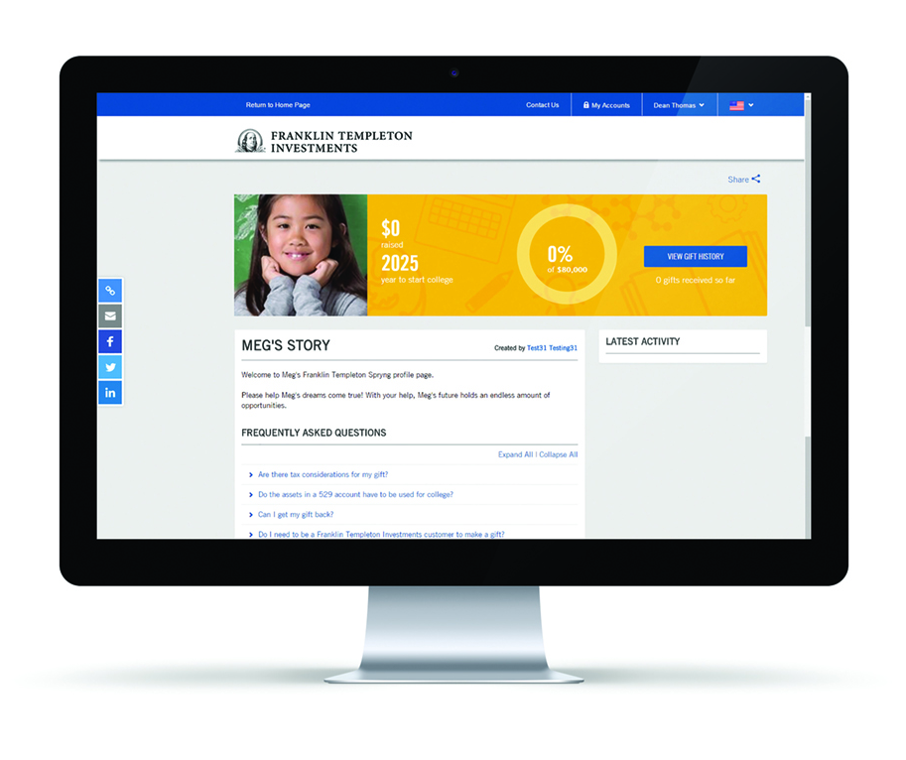
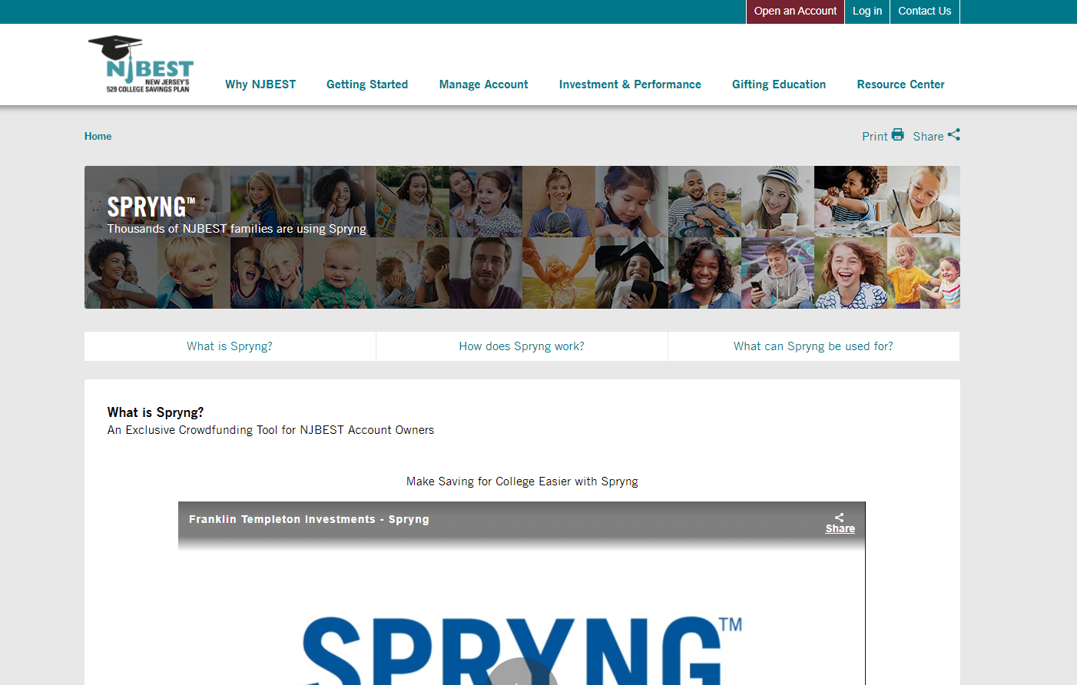
Make Saving for College Easier with SpryngTM
Designed exclusively for NJBEST account owners
Spryng is a personal crowdfunding tool that allows account owners to easily create an online profile for their child, share the profile with friends and family, and encourage contributions directly into the child’s 529 account.
Saving with Spryng – Easy as 1, 2, 3
Create a personal story about the 529 beneficiary.
Publish once your
profile is complete!
Share via email or social media with friends and family!
Investors should read the Program Description carefully before investing and consider whether their, or their beneficiary’s, home state offers any state tax or other state benefits such as financial aid, scholarship funds, and protection from creditors that are only available for investments in its qualified tuition program.

Slide 23
Investment Strategies¹
NJBEST offers the following investment strategies to help meet your savings needs.
Portfolios that automatically adjust
Designed for college savings, age-based asset allocations move into more conservative portfolios as college nears
You can choose from three age-based portfolio options – conservative, moderate or growth – depending on what track best addresses your individual situation
Nearly 2/3 of current NJBEST investors chose the age-based portfolios²
Build Your Own Portfolio
Choose one or more Objective-Based or Individual Portfolios that best meet your savings needs
Determine how much you want to invest in each option
You can mix and match all of the Investment options. You can also change your investment options up to two times per year
An investment in NJBEST 529 College Savings Plan is an investment in a municipal security that may invest in one or more underlying funds. It is not an investment in shares of the underlying fund(s), which could include Brandywine Global Investment Management, LLC, ClearBridge Investments, LLC, Martin Currie Inc., and Western Asset Management Company, LLC, subsidiaries of Franklin Templeton, Inc and unaffiliated investment companies. Asset allocation, diversification and rebalancing do not guarantee a profit or protect against loss. The Age-Based Asset Allocations have been designed for savings intended for qualified higher education (i.e. college) expenses, not for elementary or secondary education tuition expenses.
As of 12/31/2023
Notes:
Main Point: Introduce investment options at a high level
An investment in NJBEST 529 College Savings Plan is an investment in a municipal security that may invest in one or more underlying funds. It is not an investment in shares of the underlying fund(s). Asset allocation, diversification and rebalancing do not guarantee a profit or protect against loss. The Age-Based Asset Allocations have been designed for savings intended for qualified higher education (i.e. college) expenses, not for elementary or secondary education tuition expenses.

Slide 24
Calculators and Tools
Available under the Resource Center on NJBEST.com
Comprehensive College Planning Tool
Our College Planning Calculator helps you compare different approaches by taking into consideration scholarships, grants, loans and your personal savings.
Use the calculator to compare various approaches that may reduce student loan payments in the future.
Contribution Calculator
See how monthly contributions make a difference. It is important to save on a regular basis. Use this calculator to learn how making contributions every month has the potential to grow into significant savings over time.
Financial Aid Calculator
Help estimate your child’s Student Aid Index (SAI) before completing the FAFSA.
College Search Tool
Search by net price, selectivity, setting, graduation rate and more.
Scholarship Search Tool
Use the scholarship search tool to help uncover potential additional sources of college funding.

Slide 25
Let’s Review
Higher Education Leads to Opportunities
Investing in an education is an expense that is worth it, given lifelong income advantages.
529 Plans Provide a Wide Range of Benefits
The tax treatment and expanded flexibility of 529 plans provide many reasons to consider this method of saving for higher education.
Put Time on Your Side
Start small if you have to but start now.
Notes:
Main Point: Summarize seminar.
We’ve covered a lot of information today. I think it would be helpful to do a quick recap of the topics we’ve discussed.
You’re here today for information about how to finance an education. I hope what I’ve provided helps you believe that you can afford to finance a higher education that will empower a loved one.
Although other investment vehicles are available, 529 plans may be the most advantageous way available today to pursue your education savings objectives.
Remember: Start small if you have to, but start now.

Slide 26

All investments involve risk including possible loss of principal. Diversification does not guarantee a profit or protect against a loss.
Investors should carefully consider plan investment goals, risks, charges and expenses before investing. To obtain the Program Description, which contains this and other information, call Franklin Distributors, LLC, the manager and underwriter for the plan, at (877) 4NJ-BEST. You should read the Program Description carefully before investing and consider whether your or the beneficiary's home state offers any state tax or other state benefits such as financial aid, scholarship funds, and protection from creditors that are only available for investments in its qualified tuition program.
The Plan and its associated persons make no representations regarding the suitability of the Plan’s investment portfolios for any particular investor. This material is intended to be of general interest only and should not be construed as individual investment advice or a recommendation by Franklin Distributors, LLC. Other types of investments and other types of education savings vehicles may be more appropriate depending on your personal circumstances.
NJBEST New Jersey's 529 College Savings Plan is offered and administered by the New Jersey Higher Education Student Assistance Authority (HESAA); managed and distributed by Franklin Distributors, LLC, an affiliate of Franklin Resources, Inc., which operates as Franklin Templeton. Franklin Resources / Franklin Distributors, LLC and HESAA are separate organizations.
Investments in NJBEST are not insured by the FDIC or any other government agency and are not deposits or other obligations of any depository institution. Investments are not guaranteed by the State of New Jersey, Franklin Distributors, LLC, Franklin Templeton, or its affiliates and are subject to risks, including loss of principal amount invested. Investing in the plan does not guarantee admission to any particular primary, secondary school or college, or sufficient funds for primary, secondary school or college.
Franklin Templeton, its affiliates, and its employees are not in the business of providing tax or legal advice to taxpayers. These materials and any tax-related statements are not intended or written to be used, and cannot be used or relied upon, by any such taxpayer for the purpose of avoiding tax penalties or complying with any applicable tax laws or regulations. Tax-related statements, if any, may have been written in connection with the “promotion or marketing” of the transaction(s) or matter(s) addressed by these materials, to the extent allowed by applicable law. Any such taxpayer should seek advice based on the taxpayer's particular circumstances from an independent tax professional.
© 2024. Franklin Distributors, LLC. Member FINRA/SIPC.
(877) 4NJ-BEST
NJBEST.com
© 2024 Franklin Distributors, LLC. Member FINRA/SIPC. All rights reserved.

Slide 27
Appendix/
Additional Resources

Slide 28

NJBEST.com – How to Open an Account Online

Slide 29
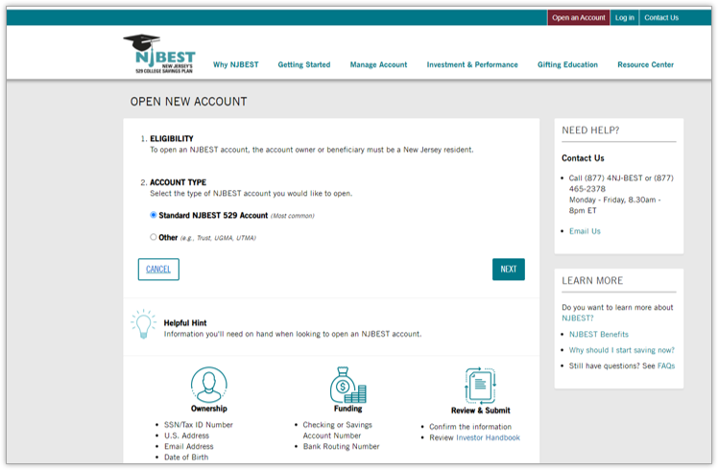
NJBEST.com – How to Open an Account Online​

Slide 30
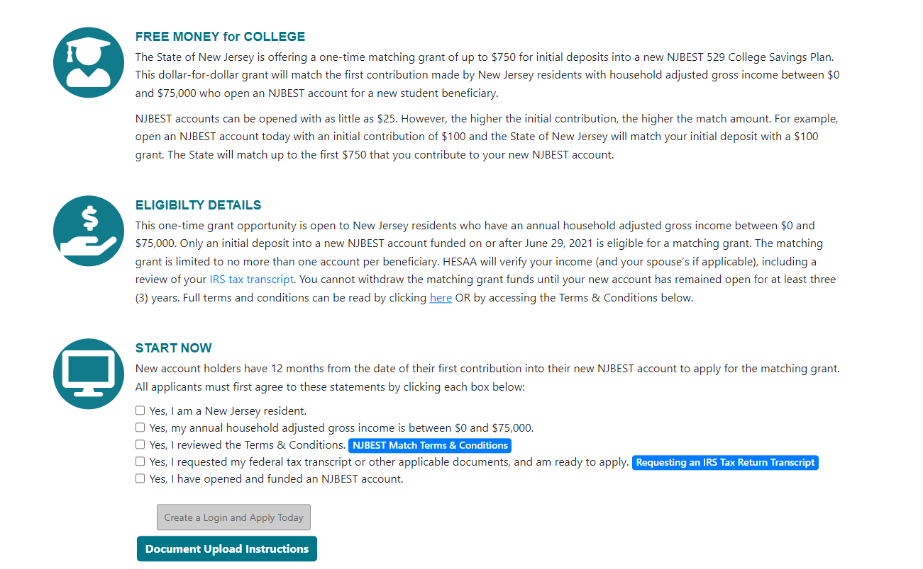
How to Apply for State Matching Grant after you open NJBEST account
Visit HESAA's site for terms and conditions and how to apply. This program is subject to available funding.
https://www.hesaa.org/Pages/NJBESTMatchingProgram.aspx

